Slide 1
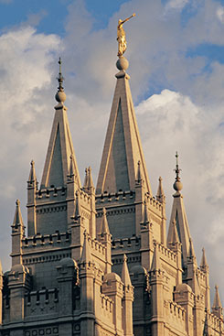
Chapter 40: Temple Work and Family History

Slide 2
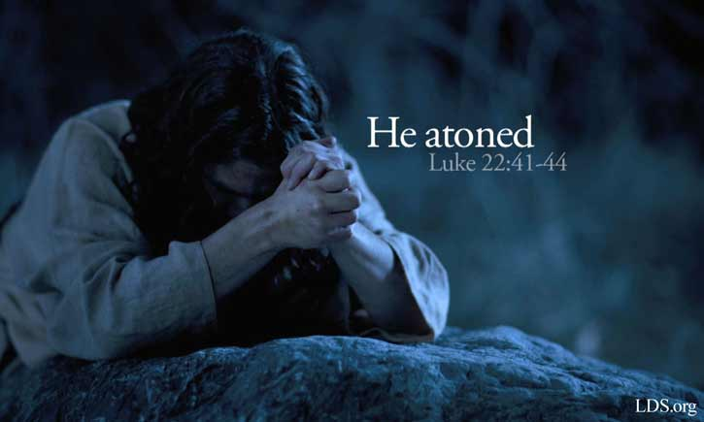
Heavenly Father Wants His Children to Return to Him
The Atonement of Jesus Christ assures each of us that we will be resurrected and live forever. But if we are to live forever with our families in Heavenly Father’s presence, we must do all that the Savior commands us to do. This includes being baptized and confirmed and receiving the ordinances of the temple.

Slide 3
Heavenly Father wants all of His children to return and live with Him. For those who died without baptism or the temple ordinances, He has provided a way for this to happen. He has asked us to perform ordinances for our ancestors in the temples.

Slide 4
Temples of the Lord
Temples of The Church of Jesus Christ of Latter-day Saints are special buildings dedicated to the Lord. Worthy Church members may go there to receive sacred ordinances and make covenants with God. Like baptism, these ordinances and covenants are necessary for our salvation. They must be performed in the temples of the Lord.

Slide 5
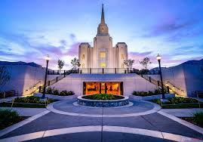

Slide 6
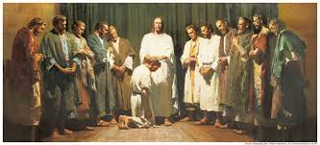
Temple Ordinances Seal Families Together Forever
All temple ordinances are performed by the power of the priesthood. Through this power, ordinances performed on earth are sealed, or bound, in heaven. The Savior taught His Apostles, “Whatsoever thou shalt bind on earth shall be bound in heaven” (Matthew 16:19; see also D&C 132:7).

Slide 7
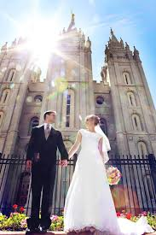
When a man and woman are married in the temple, their children who are born thereafter also become part of their eternal family. Couples who have been married civilly can receive these blessings by preparing themselves and their children to go to the temple and be sealed to each other. Parents who adopt children legally may have those children sealed to them.

Slide 8
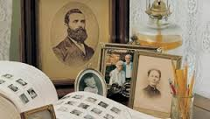
Our Ancestors Need Our Help
How does the doctrine of salvation for the dead show God’s justice, compassion, and mercy?
What experiences have you had doing temple work for your ancestors?

Slide 9
Family History—How We Begin Helping Our Ancestors
1. Identify our ancestors.
2. Find out which ancestors need temple ordinances performed.
3. Make certain that the ordinances are performed for them.

Slide 10
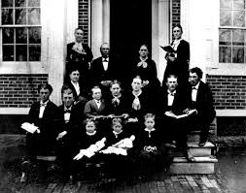
Identify Our Ancestors
A good way to begin gathering information about our ancestors is to see what we have in our own homes. We may have birth, marriage, or death certificates. We may also find family Bibles, obituaries, family histories, or diaries and journals. In addition, we can ask relatives for information they have.

Slide 11
Find out which ancestors need temple ordinances performed.

Slide 12
Our own family records might have information about what has been done. If not, the Church has a record of all ordinances that have been performed in the temple. Your ward or branch family history consultant can help you in this effort.

Slide 13
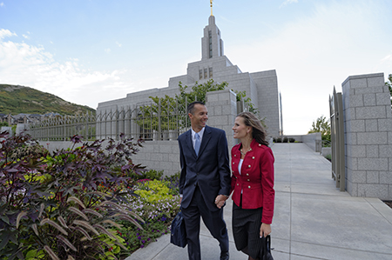
Make Certain the Ordinances Are Performed

Slide 14
One of the blessings of family history work comes from going to the temple and performing ordinances in behalf of our ancestors. We should prepare ourselves to receive a temple recommend so that, when possible, we can do this work. If our children are 12 years old or older, they can share in these blessings by being baptized and confirmed for their ancestors.
If it is not possible for us to go to the temple to participate in the ordinances, the temple will arrange to have the ordinances performed by other Church members.

Slide 15
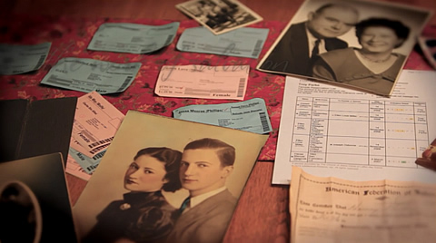
Additional Family History Opportunities

Slide 16
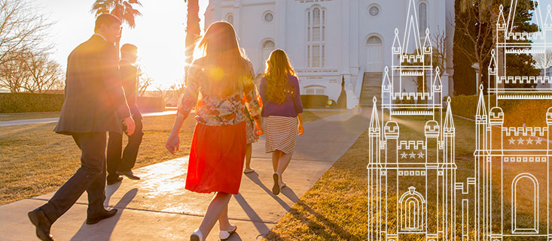
1. Attend the temple as often as possible.
2. Do research to identify ancestors who are more difficult to find.
3. Help with the Church’s indexing program.
4. Contribute family history information to the Church’s current computer programs for family history.
5. Participate in family organizations.

