Slide 1
Chapter 39: The Law of Chastity

Slide 2
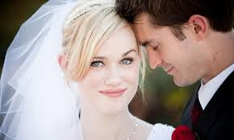
The Power of Procreation
God wanted His spirit children to be born into families so they could be properly cared for and taught. We, like Adam and Eve, are to provide physical bodies for these spirit children. The First Presidency and Quorum of the Twelve Apostles have stated, “We declare the means by which mortal life is created to be divinely appointed” (“The Family: A Proclamation to the World,” Ensign, Nov. 1995, 102). God has commanded us that only in marriage between a man and a woman are we to have sexual relations. This commandment is called the law of chastity.

Slide 3
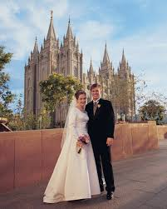
The Law of Chastity
We are to have sexual relations only with our spouse to whom we are legally married. No one, male or female, is to have sexual relations before marriage. After marriage, sexual relations are permitted only with our spouse.

Slide 5
“Before marriage, do not do anything to arouse the powerful emotions that must be expressed only in marriage. Do not participate in passionate kissing, lie on top of another person, or touch the private, sacred parts of another person’s body, with or without clothing. Do not allow anyone to do that with you. Do not arouse those emotions in your own body” (For the Strength of Youth [pamphlet, 2001], 27).

Slide 7
“People inquire about our position on those who consider themselves so-called gays and lesbians. My response is that we love them as sons and daughters of God. They may have certain inclinations which are powerful and which may be difficult to control. Most people have inclinations of one kind or another at various times. If they do not act upon these inclinations, then they can go forward as do all other members of the Church. If they violate the law of chastity and the moral standards of the Church, then they are subject to the discipline of the Church, just as others are.
“We want to help these people, to strengthen them, to assist them with their problems and to help them with their difficulties. But we cannot stand idle if they indulge in immoral activity, if they try to uphold and defend and live in a so-called same-sex marriage situation. To permit such would be to make light of the very serious and sacred foundation of God-sanctioned marriage and its very purpose, the rearing of families” (in Conference Report, Oct. 1998, 91; or Ensign, Nov. 1998, 71).

Slide 8
Satan Wants Us to Break the Law of Chastity

Slide 9
Jesus taught, “Ye have heard that it was said by them of old time, Thou shalt not commit adultery:
“But I say unto you, That whosoever looketh on a woman to lust after her hath committed adultery with her already in his heart” (Matthew 5:27–28).

Slide 10
President Gordon B. Hinckley warned: “You live in a world of terrible temptations. Pornography, with its sleazy filth, sweeps over the earth like a horrible, engulfing tide. It is poison. Do not watch it or read it. It will destroy you if you do. It will take from you your self-respect. It will rob you of a sense of the beauties of life. It will tear you down and pull you into a slough of evil thoughts and possibly of evil actions. Stay away from it. Shun it as you would a foul disease, for it is just as deadly.”

Slide 12
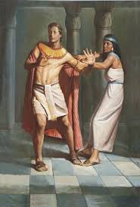
The scriptures tell about a righteous young man named Joseph who was greatly trusted by his master, Potiphar. Potiphar had given Joseph command over everything he had. Potiphar’s wife lusted after Joseph and tempted him to commit adultery with her. But Joseph resisted her and fled from her. (See Genesis 39:1–18.)

Slide 13
How are modesty and chastity related? How can parents teach their children to be modest in dress, language, and behavior?
How can we fight the spread and influence of pornography?
What promises has the Lord given us to help us overcome Satan’s temptations?

Slide 14
Breaking the Law of Chastity Is Extremely Serious
The prophet Alma grieved because one of his sons had broken the law of chastity. Alma said to his son Corianton, “Know ye not, my son, that these things are an abomination in the sight of the Lord; yea, most abominable above all sins save it be the shedding of innocent blood or denying the Holy Ghost?” (Alma 39:5). Unchastity is next to murder in seriousness.

Slide 15
If a man and a woman break the law of chastity and conceive a child, they may be tempted to commit another abominable sin: abortion. There is seldom any justifiable reason for abortion.

Slide 17
It is extremely important to our Heavenly Father that His children obey the law of chastity. Members of the Church who break this law or influence others to do so are subject to Church discipline.

Slide 18
Those Who Break the Law of Chastity Can Be Forgiven
President Kimball said: “To every forgiveness there is a condition. … The fasting, the prayers, the humility must be equal to or greater than the sin. There must be a broken heart and a contrite spirit. … There must be tears and genuine change of heart. There must be conviction of the sin, abandonment of the evil, confession of the error to properly constituted authorities of the Lord” (The Miracle of Forgiveness[1969], 353).

Slide 20
Those Who Keep the Law of Chastity Are Greatly Blessed

