Slide 1
Chapter 38: Eternal Marriage

Slide 2
Marriage Is Ordained of God
Marriage between a man and a woman is a vital part of God’s plan. The Lord has said, “Whoso forbiddeth to marry is not ordained of God, for marriage is ordained of God unto man” (D&C 49:15). Since the beginning, marriage has been a law of the gospel. Marriages are intended to last forever, not just for our mortal lives.

Slide 3
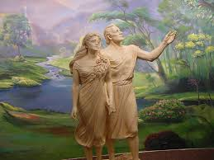
Adam and Eve were married by God before there was any death in the world. They had an eternal marriage. They taught the law of eternal marriage to their children and their children’s children. As the years passed, wickedness entered the hearts of the people and the authority to perform this sacred ordinance was taken from the earth. Through the Restoration of the gospel, eternal marriage has been restored to earth.
Why is it important to know that marriage between a man and a woman is ordained of God?

Slide 4
Eternal Marriage Is Essential for Exaltation
What is the Lord’s doctrine of marriage, and how does it differ from the views of the world?
Our exaltation depends on marriage, along with other principles and ordinances, such as faith, repentance, baptism, and receiving the gift of the Holy Ghost. We believe that marriage is the most sacred relationship that can exist between a man and a woman. This sacred relationship affects our happiness now and in the eternities.

Slide 5
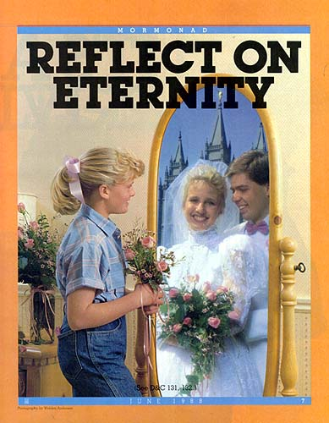
Heavenly Father has given us the law of eternal marriage so we can become like Him. The Lord has said:
“In the celestial glory there are three heavens or degrees;
“And in order to obtain the highest, a man must enter into this order of the priesthood [meaning the new and everlasting covenant of marriage];
“And if he does not, he cannot obtain it” (D&C 131:1–3).

Slide 6
Eternal Marriage Must Be Performed by Proper Authority in the Temple
An eternal marriage must be performed by one who holds the sealing power. The Lord promised, “If a man marry a wife by … the new and everlasting covenant … by him who is anointed, … and if [they] abide in [the Lord’s] covenant, … it … shall be of full force when they are out of the world” (D&C 132:19).

Slide 7
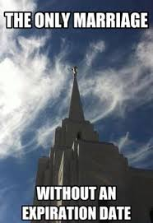
Not only must an eternal marriage be performed by the proper priesthood authority, but it must also be done in one of the holy temples of our Lord. The temple is the only place this holy ordinance can be performed.
In the temple, Latter-day Saint couples kneel at one of the sacred altars in the presence of their family and friends who have received the temple endowment.
They make their marriage covenants before God.

Slide 8
If we are married by any authority other than by the priesthood in a temple, the marriage is for this life only. After death, the marriage partners have no claim on each other or on their children. An eternal marriage gives us the opportunity to continue as families after this life.

Slide 9
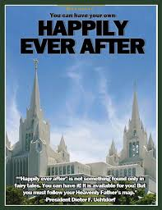
Benefits of an Eternal Marriage
What are the blessings of an eternal marriage in this life and in eternity?

Slide 10
1. We know that our marriage can last forever.

Slide 11
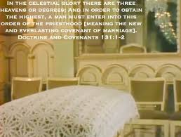
2. We know that our family relationships can continue throughout eternity.

Slide 12
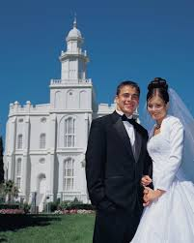
3. Because we have been married in God’s ordained way, we are entitled to an outpouring of the Spirit on our marriage as we remain worthy.

Slide 13
We Must Prepare for an Eternal Marriage
President Spencer W. Kimball taught: “Marriage is perhaps the most vital of all the decisions and has the most far-reaching effects, for it has to do not only with immediate happiness, but also with eternal joys. It affects not only the two people involved, but also their families and particularly their children and their children’s children down through the many generations. In selecting a companion for life and for eternity, certainly the most careful planning and thinking and praying and fasting should be done to be sure that of all the decisions, this one must not be wrong”

