Slide 1
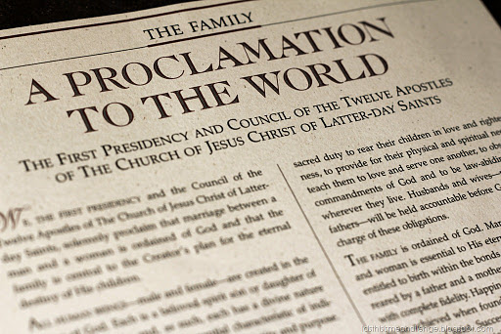
Chapter 36: The Family Can Be Eternal

Slide 2
The Importance of Families
Why did our Heavenly Father send us to earth as members of families?
“Marriage between a man and a woman is ordained of God. … The family is central to the Creator’s plan for the eternal destiny of His children” (“The Family: A Proclamation to the World,” Ensign, Nov. 1995, 102).

Slide 4
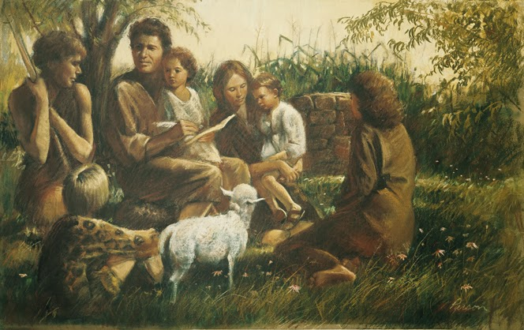
After Heavenly Father brought Adam and Eve together in marriage, He commanded them to have children (see Genesis 1:28). He has revealed that one of the purposes of marriage is to provide mortal bodies for His spirit children. Parents are partners with our Heavenly Father. He wants each of His spirit children to receive a physical body and to experience earth life. When a man and a woman bring children into this world, they help our Heavenly Father carry out His plan.

Slide 5
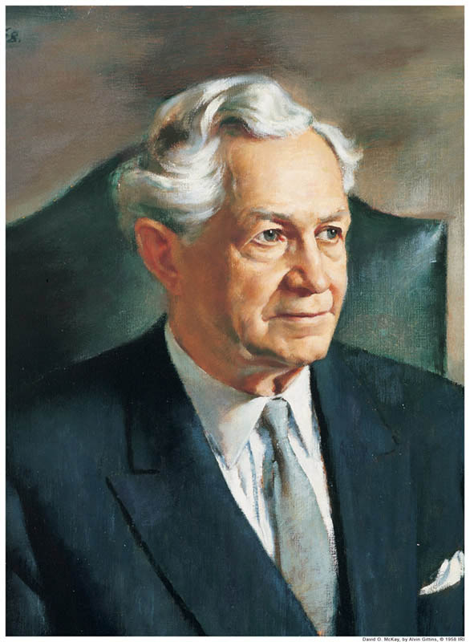
“With all my heart I believe that the best place to prepare for … eternal life is in the home”
David O. McKay

Slide 6
Fathers and mothers are responsible to teach their children about Heavenly Father. They should show by example that they love Him because they keep His commandments. Parents should also teach their children to pray and to obey the commandments (see Proverbs 22:6).

Slide 7
The Eternal Family
Families can be together forever. To enjoy this blessing we must be married in the temple. When people are married outside the temple, the marriage ends when one of the partners dies. When we are married in the temple by the authority of the Melchizedek Priesthood, we are married for time and eternity.

Slide 8
Loving Family Relationships
As parents come to know God and strive to be like Him, they will teach children to love one another. In the Book of Mormon, King Benjamin explained:
“Ye will not suffer your children … [to] fight and quarrel one with another. …
“But ye will teach them to walk in the ways of truth and soberness; ye will teach them to love one another, and to serve one another” (Mosiah 4:14–15).

Slide 9
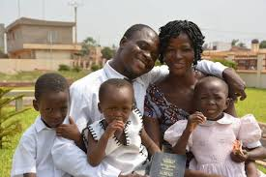

Slide 10
How to Have a Successful Family
1. Have family prayer every night and morning .Pray together as husband and wife.
2. Teach children the gospel every week in family home evening.
3. Study the scriptures regularly as a family.
4. Do things together as a family, such as work projects, outings, and decision making.
5. Learn to be kind, patient, long-suffering, and charitable.
6. Attend Church meetings regular.
7. Follow the counsel of the Lord in D&C 88:119: “Organize yourselves; prepare every needful thing; and establish a house, even a house of prayer, a house of fasting, a house of faith, a house of learning, a house of glory, a house of order, a house of God.”
8. Keep a family history, perform temple work together, and receive the sealing ordinances of the temple.

