Slide 1
Chapter 35: Obedience

Slide 2
When Jesus was on the earth, a lawyer asked Him a question:
“Master, which is the great commandment in the law?
“Jesus said unto him, Thou shalt love the Lord thy God with all thy heart, and with all thy soul, and with all thy mind.
“This is the first and great commandment.
“And the second is like unto it, Thou shalt love thy neighbour as thyself.
“On these two commandments hang all the law and the prophets” (Matthew 22:36–40).

Slide 3
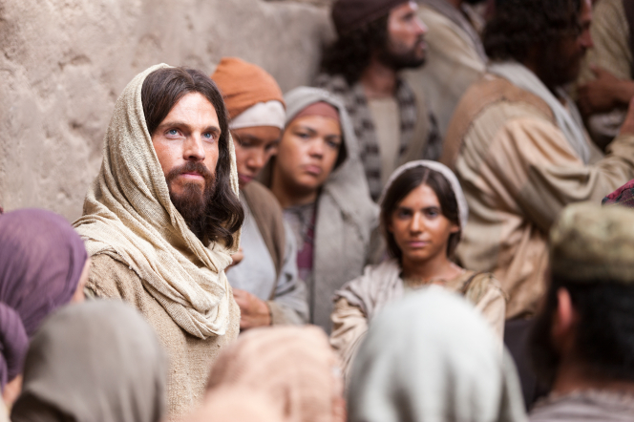

Slide 4
Each of us should ask ourselves why we obey God’s commandments. Is it because we fear punishment? Is it because we desire the rewards for living a good life? Is it because we love God and Jesus Christ and want to serve Them?
It is better to obey the commandments because we fear punishment than not to obey them at all. But we will be much happier if we obey God because we love Him and want to obey Him. When we obey Him freely, He can bless us freely.

Slide 5
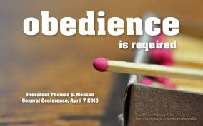
We Can Obey without Understanding Why
By keeping God’s commandments, we prepare for eternal life and exaltation. Sometimes we do not know the reason for a particular commandment. However, we show our faith and trust in God when we obey Him without knowing why.

Slide 6
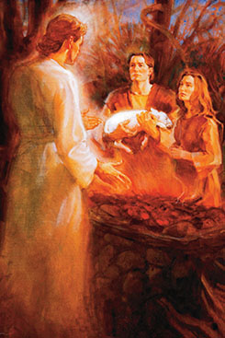
Adam and Eve were commanded to offer sacrifices to God. One day an angel appeared to Adam and asked why he offered sacrifices. Adam replied that he did not know the reason. He did it because the Lord commanded him.
The angel then taught Adam the gospel and told him of the Savior who was to come. The Holy Ghost fell upon Adam, and Adam prophesied concerning the inhabitants of the earth down to the last generation.

Slide 7
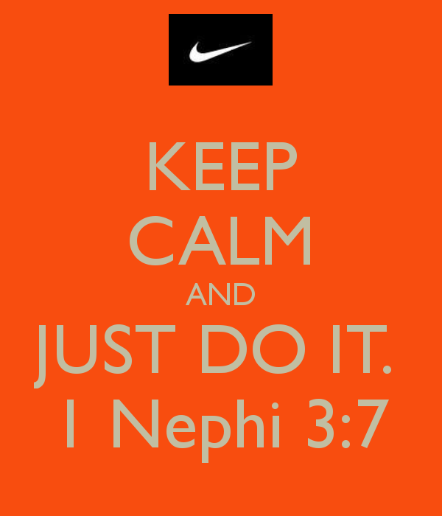
God Will Prepare a Way
When has the Lord prepared a way for you to obey Him?

Slide 8
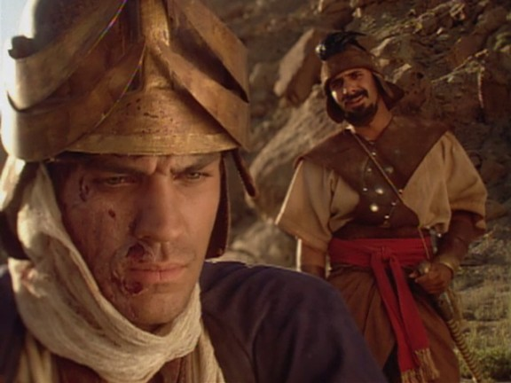
No Commandment Is Too Small or Too Great to Obey
Sometimes we may think a commandment is not very important.
2 Kings 5:1-14 Naaman is healed by following the prophets counsel.

Slide 9
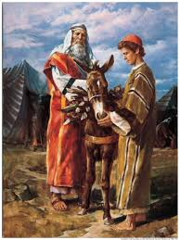
It was a “hard thing” when the Lord commanded Abraham to offer his beloved son Isaac as a sacrifice (see Genesis 22:1–13; see also chapter 26 in this book). Abraham had waited many years for the birth of Isaac, the son God had promised him. How could he lose his son in such a way? This commandment must have been exceedingly difficult for Abraham. Yet he chose to obey God.

Slide 10
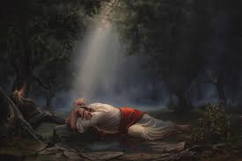
Jesus Christ Obeyed His Father
What examples come to mind when you think of Jesus Christ obeying His Father?

Slide 11
Results of Obedience and Disobedience
The kingdom of heaven is governed by law, and when we receive any blessing, it is by obedience to the law upon which that blessing is based (see D&C 130:20–21;132:5).
The Lord has told us that through our obedience and diligence we may gain knowledge and intelligence (see D&C 130:18–19).
We may also grow spiritually (see Jeremiah 7:23–24). On the other hand, disobedience brings disappointment and results in a loss of blessings.
“Who am I, saith the Lord, that have promised and have not fulfilled? I command and men obey not; I revoke and they receive not the blessing.

Slide 12
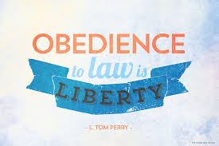

Slide 13
The Obedient Gain Eternal Life
D & C 75:5-10.
What does the phrase “endure to the end” mean to you?
What can we do to stay true to gospel principles even when it is unpopular to do so? How can we help children and youth stay true to gospel principles?

Slide 14
