Slide 1
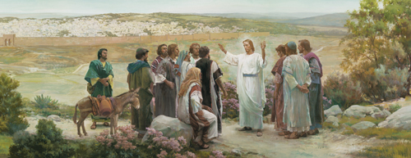
Chapter 33: Missionary Work

Slide 2
The Lord’s Church Is a Missionary Church
The Lord revealed the gospel plan to Adam: “And thus the Gospel began to be preached, from the beginning” (Moses 5:58). Later, Adam’s righteous descendants were sent to preach the gospel: “They … called upon all men, everywhere, to repent; and faith was taught unto the children of men” (Moses 6:23).

Slide 3
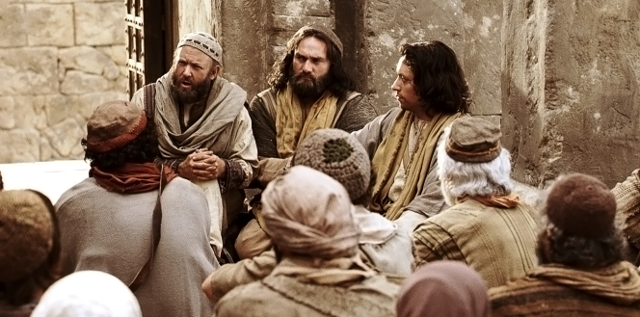
The Lord’s Church has always been a missionary church. When the Savior lived on the earth, He ordained Apostles and Seventies and gave them the authority and responsibility to preach the gospel. Most of their preaching was to their own people, the Jews (see Matthew 10:5–6). After Jesus was resurrected, He sent Apostles to preach the gospel to the Gentiles. He commanded the Apostles, “Go ye into all the world, and preach the gospel to every creature” (Mark 16:15).

Slide 4
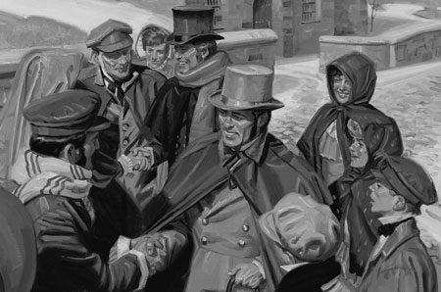
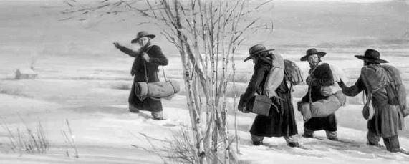
Missionary work began again when the Lord’s Church was restored through the Prophet Joseph Smith. Today the Apostles and Seventies have been given the chief responsibility for preaching the gospel and seeing that it is preached in all the world. The Lord told Joseph Smith: “Proclaim my gospel from land to land, and from city to city. … Bear testimony in every place, unto every people” (D&C 66:5, 7). In June 1830, Samuel Harrison Smith, the Prophet’s brother, began the first missionary journey for the Church.

Slide 5
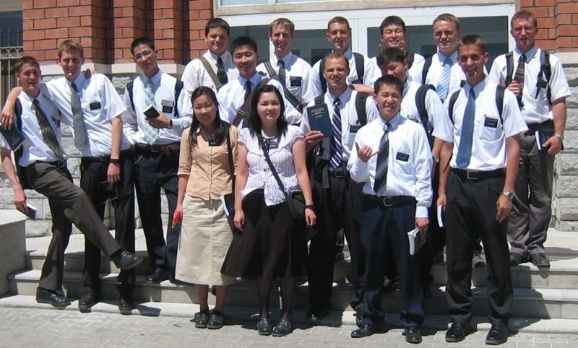
Since that time, over one million missionaries have been called and sent forth to preach the gospel. The message they take to the world is that Jesus Christ is the Son of God and our Savior. They testify that the gospel has been restored to the earth through a prophet of God. The missionaries are given the responsibility to preach the gospel to all people, to baptize them, and to teach them to do all things that the Lord has commanded (see Matthew 28:19–20).

Slide 6
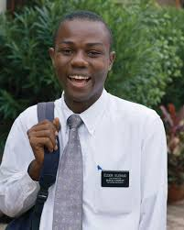
The Gospel Will Be Preached to All the World
We have been told in latter-day revelation that we must take the restored gospel to every nation and people (see D&C 133:37). The Lord never gives us a commandment without preparing a way for us to accomplish it (see 1 Nephi 3:7). The Lord has prepared ways for us to teach the gospel in nations that were once closed to us. As we continue to pray and exercise faith, the Lord will open other nations to missionary work.

Slide 7
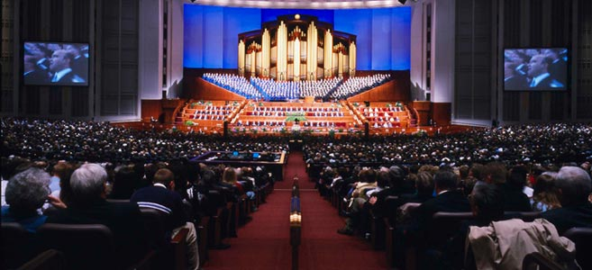
The Lord is also “inspiring the minds of great people to create inventions that further the work of the Lord in ways this world has never known” (Russell M. Nelson, in “Computerized Scriptures Now Available,” Ensign, Apr. 1988, 73). Newspapers, magazines, television, radio, satellites, computers, the Internet, and related technology help give the gospel message to millions of people. We who have the fulness of the gospel need to use these inventions to fulfill the Lord’s commandment

Slide 8
Missionary Work Is Important
“This is our first interest as a Church—to save and exalt the souls of the children of men” (Ezra Taft Benson, in Conference Report, Apr. 1974, 151; or Ensign, May 1974, 104). Missionary work is necessary in order to give the people of the world an opportunity to hear and accept the gospel. They need to learn the truth, turn to God, and receive forgiveness from their sins.

Slide 9
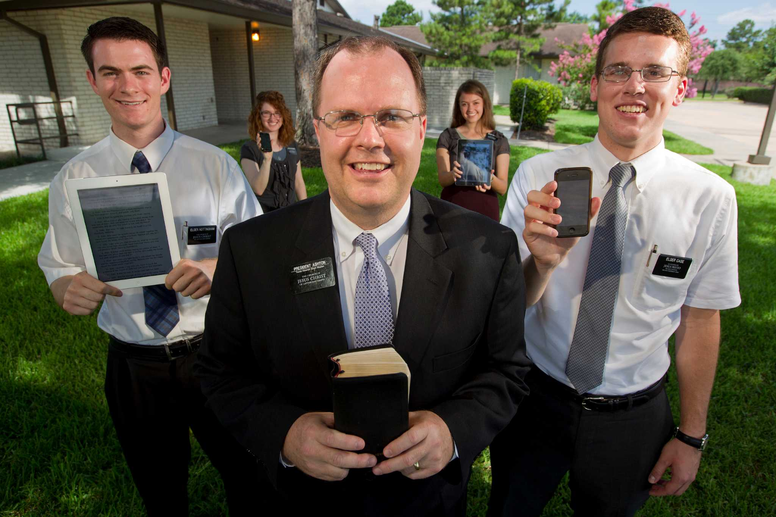
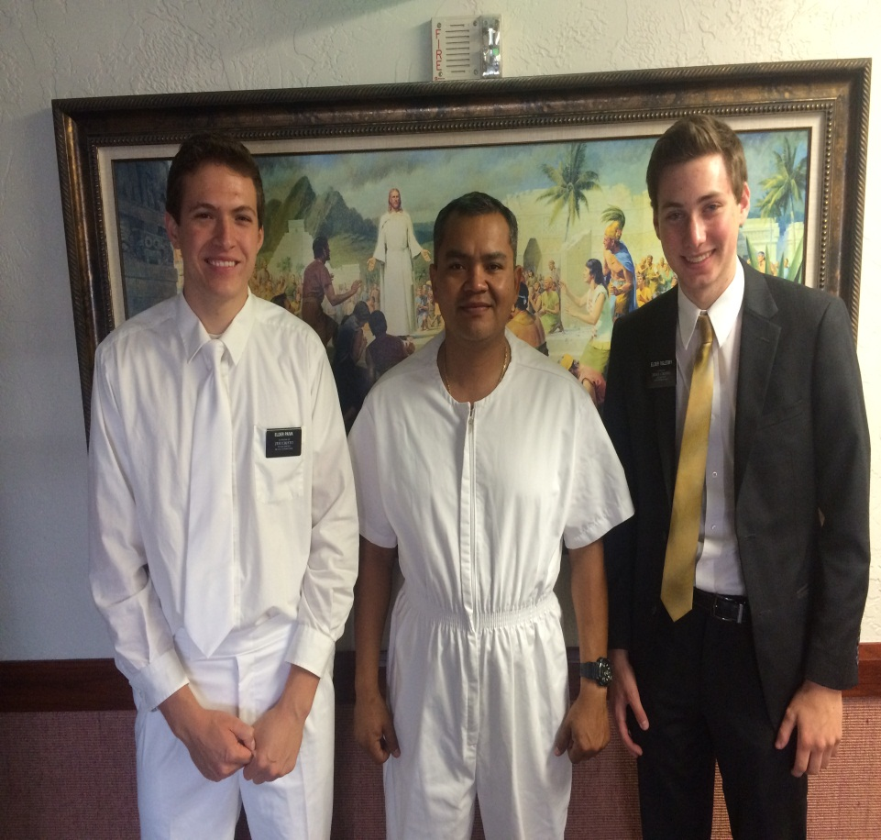

Slide 10
We Should All Be Missionaries
Every member of the Church is a missionary. We should be missionaries even if we are not formally called and set apart. We are responsible to teach the gospel by word and deed to all of our Heavenly Father’s children. The Lord has told us, “It becometh every man who hath been warned to warn his neighbor” (D&C 88:81). We have been told by a prophet that we should show our neighbors that we love them before we warn them (seeTeachings of Presidents of the Church: Spencer W. Kimball[2006], 262). They need to experience our friendship and fellowship.

