Slide 1
Chapter 32: Tithes and Offerings

Slide 2
Paying Tithes and Offerings
How does our willingness to pay tithes and offerings show gratitude to our Heavenly Father for all His blessings to us?
We have been given commandments to help us prepare in every way to live in the presence of our Heavenly Father. He has given us a way to thank Him for our blessings. Willingly paying tithes and offerings is one way we thank Him. As we pay these offerings, we show that we love Him and will obey His counsel.

Slide 4
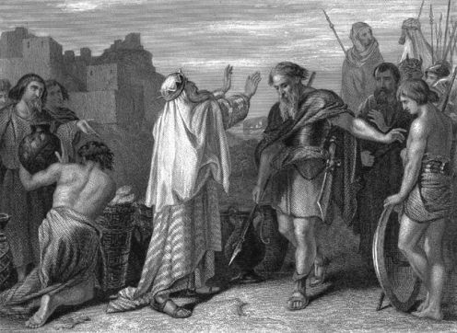
Obeying the Law of Tithing
Anciently, Abraham and Jacob obeyed the commandment to pay a tithe of one-tenth of their increase (see Hebrews 7:1–10; Genesis 14:19–20; 28:20–22).

Slide 5
In modern times the Prophet Joseph Smith prayed, “O Lord, show unto thy servants how much thou requirest of the properties of thy people for a tithing” (D&C 119, section introduction). The Lord answered: “This shall be the beginning of the tithing of my people. And after that, those who have thus been tithed shall pay one-tenth of all their interest annually; and this shall be a standing law unto them forever” (D&C 119:3–4).

Slide 6
In what ways is tithing a principle of faith more than a principle of finances?
What can parents do to teach their children to pay tithing and understand its importance?

Slide 7
We Should Give Willingly
It is important to give willingly. “When one pays his tithing without enjoyment he is robbed of a part of the blessing. He must learn to give cheerfully, willingly and joyfully, and his gift will be blessed” (Stephen L Richards,The Law of Tithing [pamphlet, 1983], 8).

Slide 8
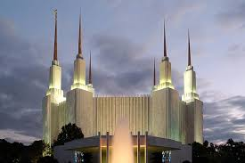
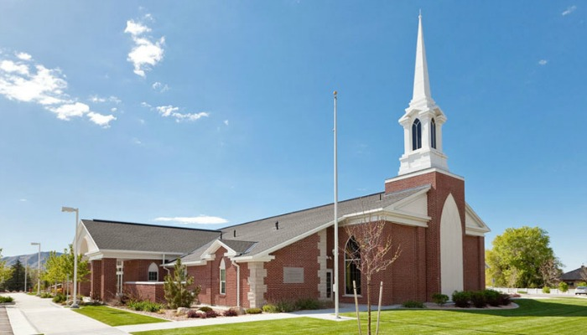
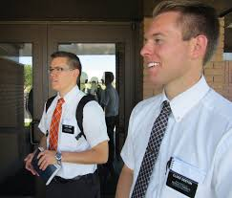
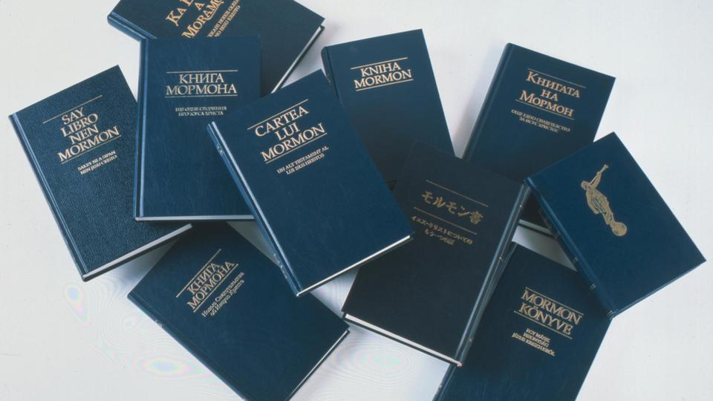
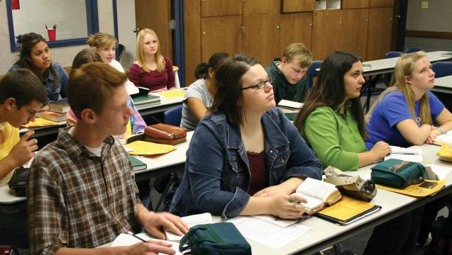
Tithing and Other Offerings
In what ways does the Church use tithing funds and other offerings?

Slide 9
Other Offerings
Fast Offerings. Church members fast each month by going without food and drink for two consecutive meals. They contribute at least the amount of money they would have spent for the meals. They may give as generously as they are able. This offering is called the fast offering. Bishops use these fast offerings to provide food, shelter, clothing, and medical care for the needy.

Slide 10
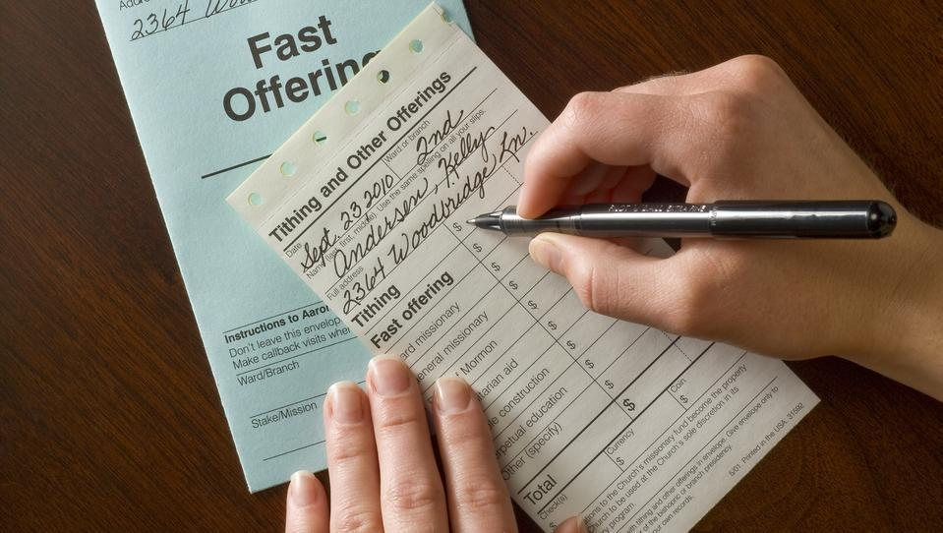

Slide 11
We Are Blessed When We Give Tithes and Offerings
The Lord promises to bless us as we faithfully pay our tithes and offerings. He said, “Bring ye all the tithes into the storehouse, that there may be meat in mine house, and prove me now herewith … if I will not open you the windows of heaven, and pour you out a blessing, that there shall not be room enough to receive it” (Malachi 3:10).

