Slide 1
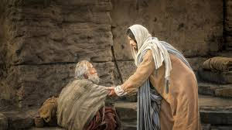
Chapter 30: Charity

Slide 2
What Is Charity?
The life of the Savior reflects His pure love for all people. He even gave His life for us. Charity is that pure love which our Savior Jesus Christ has. He has commanded us to love one another as He loves us. The scriptures tell us that charity comes from a pure heart (see 1 Timothy 1:5). We have pure love when, from the heart, we show genuine concern and compassion for all our brothers and sisters.

Slide 3
Charity Is the Greatest of All Virtues
The prophet Mormon tells us, “Wherefore, cleave unto charity, which is the greatest of all, for all things must fail—but charity is the pure love of Christ, and it endureth forever” (Moroni 7:46–47; see also1 Corinthians 13; 2 Nephi 26:30; Moroni 7:44–45, 48).

Slide 4
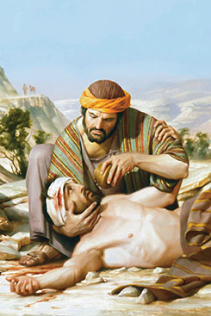
Charity Includes Giving to the Sick, Afflicted, and Poor
The parable of the good Samaritan teaches us that we should give to those in need, regardless of whether they are our friends or not (seeLuke 10:30–37; see also James E. Talmage, Jesus the Christ, 3rd ed. [1916], 430–32).

Slide 5
Jesus taught that we should give food to the hungry, shelter to those who have none, and clothes to the poor. When we visit the sick and those who are in prison, it is as if we were doing these things for Him instead. He promises that as we do these things, we will inherit His kingdom. (See Matthew 25:34–46.)

Slide 6
Charity Comes from the Heart

