Slide 1
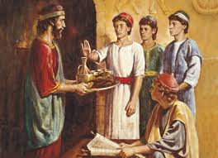
Chapter 29: The Lord’s Law of Health

Slide 2
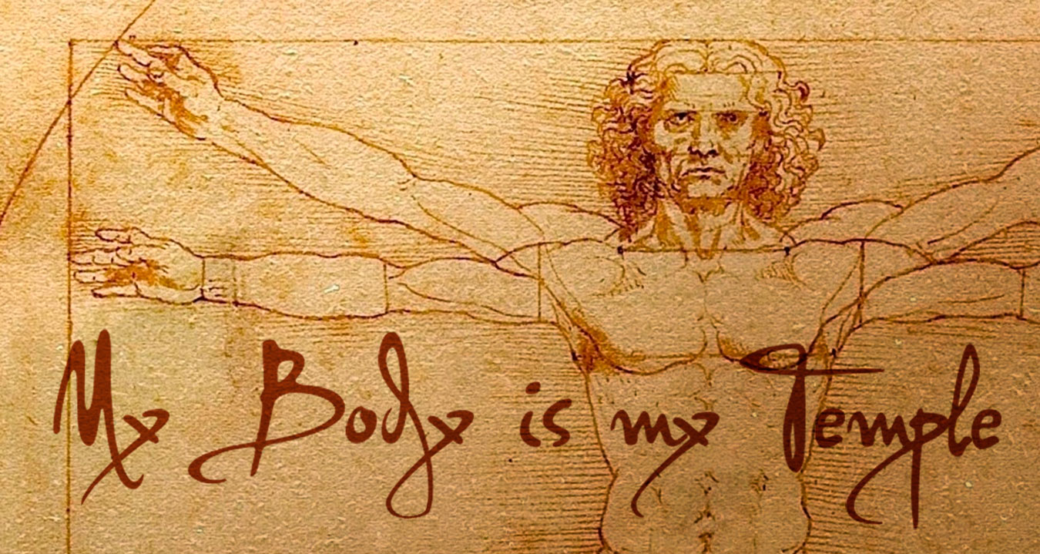
Our Bodies Are Temples of God
One of the great blessings we received when we came to earth was a physical body. We need a physical body to become like our Heavenly Father. Our bodies are so important that the Lord calls them temples of God (see 1 Corinthians 3:16–17; 6:19–20).

Slide 3
We must obey the Word of Wisdom to be worthy to enter the temple. If we do not obey the Word of Wisdom, the Lord’s Spirit withdraws from us. If we defile the “temple of God,” which is our body, we hurt ourselves physically and spiritually.

Slide 4
We Are Commanded Not to Take Certain Things into Our Bodies
What has the Lord commanded us not to take into our bodies?
The Lord commands us not to use wine and strong drinks, meaning drinks containing alcohol. The First Presidency has taught that strong drink often brings cruelty, poverty, disease, and plague into the home. It often is a cause of dishonesty, loss of chastity, and loss of good judgment. It is a curse to all who drink it. (See “Message of the First Presidency,” Improvement Era,Nov. 1942, 686.)

Slide 5
The Lord has also told us that “tobacco is not for the body” (D&C 89:8). It is harmful to our bodies and our spirits. We should not smoke cigarettes or cigars or use chewing tobacco. Scientists have shown that tobacco causes many diseases and can harm unborn children.
The Lord also counsels us against the use of “hot drinks” (D&C 89:9). Church leaders have said that this means coffee and tea, which contain harmful substances. We should avoid all drinks that contain harmful substances.

Slide 6
We Are Taught That Certain Things Are Good for Our Bodies
Fruits, vegetables, and wholesome herbs are good for us. We should use them with wisdom and thanksgiving.
The flesh of birds and animals is also provided for our food. However, we should eat meat sparingly (see D&C 49:18; 89:12). Fish is also good for us to eat.
Grains are good for us. Wheat is especially good for us.
How has the use of these things blessed you?

Slide 7
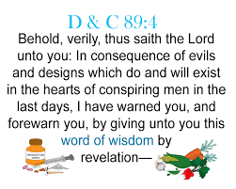
Work, Rest, and Exercise Are Important
In addition to Doctrine and Covenants 89, other scriptures tell us how to be healthy. They tell us that we should “cease to be idle; cease to be unclean; … cease to sleep longer than is needful; retire to thy bed early, that ye may not be weary; arise early, that your bodies and your minds may be invigorated” (D&C 88:124).

Slide 8
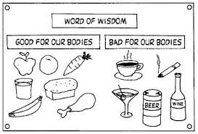
Promised Blessings for Living the Lord’s Law of Health
Our Heavenly Father has given us health laws to teach us how to care for our bodies. The scriptures tell us about God’s laws: “No temporal commandment gave I … , for my commandments are spiritual” (D&C 29:35). This means that His commandments concerning our physical state are for our spiritual good.

Slide 9
Additional Scriptures
Judges 13:13–14; Proverbs 20:1; Isaiah 5:11–12;Daniel 1 (avoid strong drink)
D&C 59:16–20 (things of the earth for the benefit of man)
Proverbs 23:20–21 (warning against drunkenness, gluttony, laziness)
D&C 136:24 (cease drunkenness)

