Slide 1
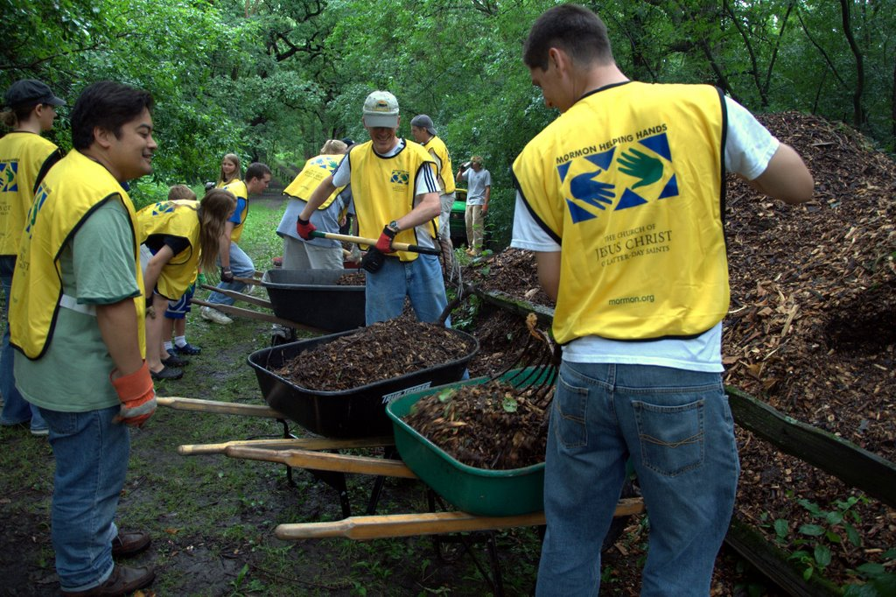
Chapter 28: Service

Slide 2
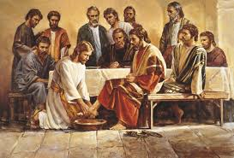
How We Can Serve
Think about ways people have served you and your family members.
Jesus said, “I am among you as he that serveth” (Luke 22:27). As true followers of Jesus, we also must serve others.

Slide 3
Service is helping others who need assistance. Christlike service grows out of genuine love for the Savior and of love and concern for those whom He gives us opportunities and direction to help. Love is more than a feeling; when we love others, we want to help them.

Slide 4
There are many ways to serve. We can help others economically, socially, physically, and spiritually. For example, we can share food or other articles with those who need them. We can help those in need by giving a generous fast offering. We can be a friend to a newcomer. We can plant a garden for an elderly person or care for someone who is sick. We can teach the gospel to someone who needs the truth or comfort someone who grieves.

Slide 5
Why the Savior Wants Us to Serve Others

Slide 6
“When ye are in the service of your fellow beings ye are only in the service of your God. …
“And if I, whom ye call your king, do labor to serve you, then ought not ye to labor to serve one another?” (Mosiah 2:17–18).

Slide 7
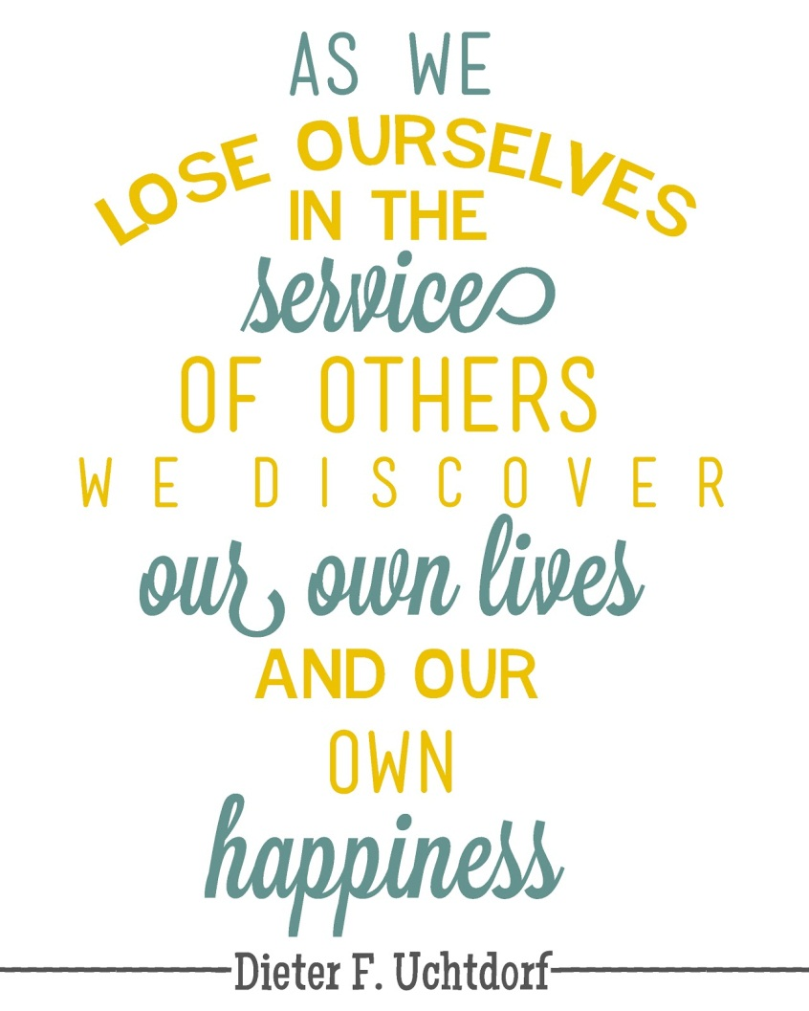

Slide 8
We Receive Blessings through Service
When we serve others we gain important blessings. Through service we increase our ability to love. We become less selfish. As we think of the problems of others, our own problems seem less serious. We must serve others to gain eternal life. God has said that those who live with Him must love and serve His children (seeMatthew 25:34–40).

Slide 9
Opportunities to Serve
If we have special talents, we should use them to serve others. God blesses us with talents and abilities to help improve the lives of others.

Slide 10
Jesus Christ Is the Perfect Example of Service
Jesus Christ loves all of us more than we can understand. When He was on earth He served the poor, the ignorant, the sinner, the despised. He taught the gospel to all who would listen, fed crowds of hungry people who came to hear Him, healed the sick, and raised the dead.

