Slide 1
Chapter 27: Work and Personal Responsibility

Slide 2
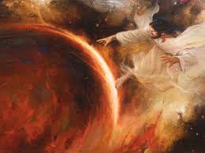
Our Heavenly Father and Jesus Christ have shown us by Their examples and teachings that work is important in heaven and on earth. God worked to create the heavens and the earth.
Then He placed Adam and Eve on the earth to take care of it and to have dominion over all living things.

Slide 3
We Are Commanded to Work
The Lord said to Adam, “In the sweat of thy face shalt thou eat bread” (Genesis 3:19).
The Lord said to the people of Israel, “Six days shalt thou labour” (Exodus 20:9).
In the early days of the restored Church, the Lord told the Latter-day Saints, “Now, I, the Lord, am not well pleased with the inhabitants of Zion, for there are idlers among them” (D&C 68:31).
A prophet of God has said, “Work is to be reenthroned as the ruling principle of the lives of our Church membership” (Heber J. Grant, Teachings of Presidents of the Church: Heber J. Grant [2002], 115).

Slide 4
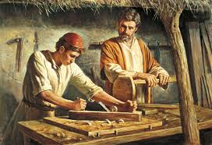

Slide 5
Family Responsibility
Parents work together to provide for the physical, spiritual, and emotional well-being of their family. They should never expect anyone to take care of this responsibility for them. The Apostle Paul wrote, “If any provide not for his own, and specially for those of his own house, he hath denied the faith” (1 Timothy 5:8).

Slide 6
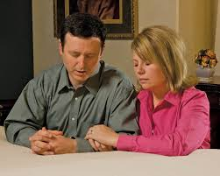
Couples should seek inspiration from the Lord and follow the counsel of the prophets when establishing individual responsibilities. Creating a home where principles of the gospel are taught daily and where love and order abound is as important as providing the basic necessities of food and clothing.

Slide 7
We Can Enjoy Our Work
To some people work is a drudgery. To others it is an exciting part of life. One way to enjoy life’s fullest benefits is to learn to love work.
Not all of us can choose the kind of work we do. Some of us labor for long hours for the bare necessities. It is difficult to enjoy such work. Yet the happiest people have learned to enjoy their work, whatever it is.

Slide 8
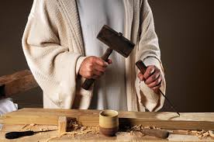
Our attitude toward work is very important. The following story shows how one man saw beyond his daily labor. A traveler passed a stone quarry and saw three men working. He asked each man what he was doing. Each man’s answer revealed a different attitude toward the same job. “I am cutting stone,” the first man answered. The second replied, “I am earning three gold pieces per day.” The third man smiled and said, “I am helping to build a house of God.”

Slide 9
God Condemns Idleness
The Lord is not pleased with those who are lazy or idle. He said, “The idler shall not have place in the church, except he repent and mend his ways” (D&C 75:29). He also commanded, “Thou shalt not be idle; for he that is idle shall not eat the bread nor wear the garments of the laborer” (D&C 42:42).

Slide 10
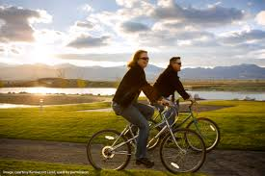
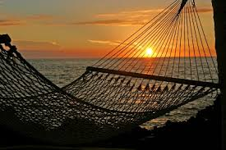
Work, Recreation, and Rest

Slide 11
The Blessings of Work
President David O. McKay said, “Let us realize that the privilege to work is a gift, that the power to work is a blessing, that the love of work is success” (Pathways to Happiness [1957], 381).

