Slide 1
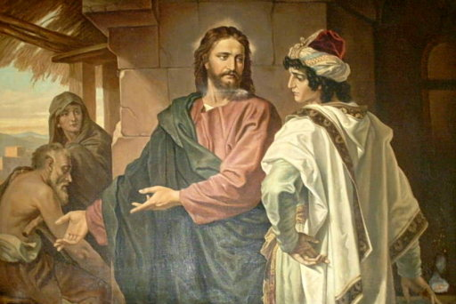
Chapter 26: Sacrifice

Slide 2
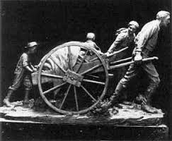
The Meaning of Sacrifice
Sacrifice means giving to the Lord whatever He requires of our time, our earthly possessions, and our energies to further His work. The Lord commanded, “Seek ye first the kingdom of God, and his righteousness” (Matthew 6:33).

Slide 3
Our willingness to sacrifice is an indication of our devotion to God. People have always been tried and tested to see if they will put the things of God first in their lives.
Why is it important to sacrifice as the Lord asks without expecting anything in return?

Slide 4
The Law of Sacrifice Was Practiced Anciently
From the time of Adam and Eve to the time of Jesus Christ, the Lord’s people practiced the law of sacrifice. They were commanded to offer as sacrifices the firstlings of their flocks.
These animals had to be perfect, without blemish. The ordinance was given to remind the people that Jesus Christ, the Firstborn of the Father, would come into the world.

Slide 6
Jesus did come and offer Himself as a sacrifice, just as the people had been taught He would. Because of His sacrifice, everyone will be saved from physical death by the Resurrection and all can be saved from their sins through faith in Jesus Christ

Slide 7
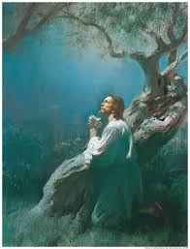
Christ’s atoning sacrifice marked the end of sacrifices by the shedding of blood. Such outward sacrifice was replaced by the ordinance of the sacrament. The ordinance of the sacrament was given to remind us of the Savior’s great sacrifice.

Slide 9
We Still Must Sacrifice
Even though sacrifice by the shedding of blood was ended, the Lord still asks us to sacrifice. But now He requires a different kind of offering. He said: “Ye shall offer up unto me no more the shedding of blood, … and your burnt offerings shall be done away. … And ye shall offer for a sacrifice unto me a broken heart and a contrite spirit” (3 Nephi 9:19–20).

Slide 11
We Must Be Willing to Sacrifice Everything We Have to the Lord
The Apostle Paul wrote that we should become living sacrifices, holy and acceptable unt
Lord’s disciples Peter and Andrew were willing to sacrifice everything for the sake of the kingdom of God. When Jesus said unto them, “Follow me, … they straightway left their nets, and followed him” (Matthew 4:19–20).

Slide 13
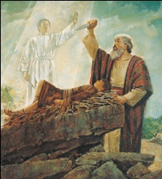
Abraham lived on the earth before Christ, in the days when sacrifices and burnt offerings were required. As a test of Abraham’s faith, the Lord commanded him to offer up his son Isaac as a sacrifice. Isaac was the only son of Abraham and Sarah. The command to offer him as a sacrifice was extremely painful for Abraham.

Slide 14
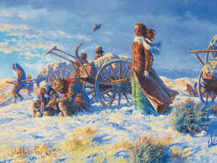
What examples of sacrifice have you observed in the lives of people you know? What examples of sacrifice have you seen in the lives of your ancestors? in the lives of early members of the Church? in the lives of people in the scriptures? What have you learned from these examples?

Slide 15
Sacrifice Helps Us Prepare to Live in the Presence of God
The Lord’s people have always sacrificed greatly and in many different ways. Some have suffered hardship and ridicule for the gospel. Some new converts to the Church have been cut off from their families. Lifetime friends have turned away. Some members have lost their jobs; some have lost their lives. But the Lord notices our sacrifices; He promises, “Every one that hath forsaken houses, or brethren, or sisters, or father, or mother, or wife, or children, or lands, for my name’s sake, shall receive an hundredfold, and shall inherit everlasting life” (Matthew 19:29).

