Slide 1
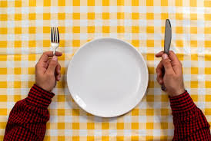
Chapter 25: Fasting

Slide 2
How to Fast Properly
What can we do to make fasting a joyful experience?
Since the time of Adam, God’s people have fasted to help them draw near to Him and to worship Him. Jesus showed the importance of fasting by His own example (see Luke 4:1–4). Through latter-day revelation we learn that the Lord still expects His people to fast and pray often (see D&C 88:76).
Fasting means to go without food and drink. Occasional fasting is good for our bodies and helps our minds become more active.
The Savior taught us that purposeful fasting is more than just going without food and drink. We must also concentrate on spiritual matters.

Slide 3
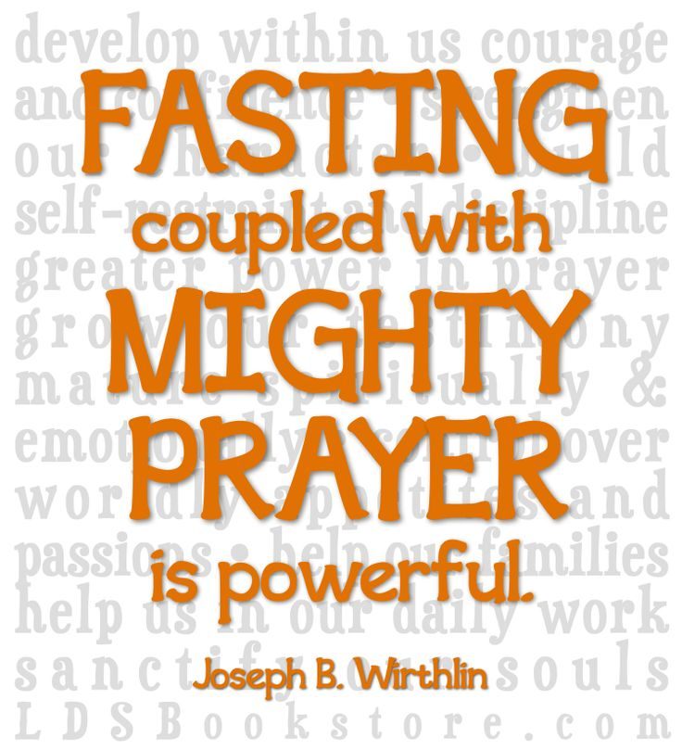

Slide 4
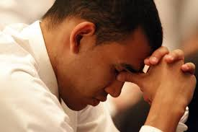
We Should Pray When We Fast
Prayer is a necessary part of fasting. Throughout the scriptures, prayer and fasting are mentioned together. Our fasting should be accompanied by sincere prayer, and we should begin and end our fasting with prayer.

Slide 5
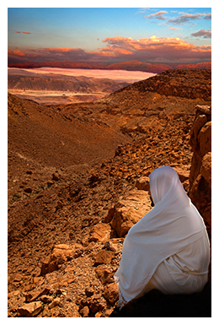
We Should Fast with a Purpose
Fasting can have many purposes. We can overcome weaknesses or problems by fasting and praying. Sometimes we may wish to fast and pray for help or guidance for others, such as a family member who is ill and needs a blessing (see Mosiah 27:22–23).

Slide 6
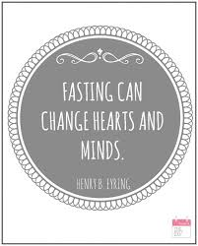
The Fast Day

Slide 7
One Sunday each month Latter-day Saints observe a fast day. On this day we neither eat nor drink for two consecutive meals. If we were to eat our evening meal on Saturday, then we would not eat or drink until the evening meal on Sunday.
All members who are physically able should fast. We should encourage our children to fast after they have been baptized, but we should never force them. The fast day is a special day for us to humble ourselves before the Lord in fasting and prayer. It is a day to pray for forgiveness from our sins and for the power to overcome our faults and to forgive others.

Slide 8
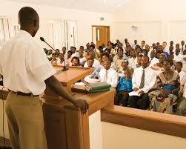

Slide 9
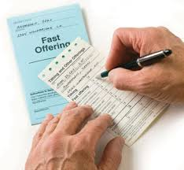
Fast Offerings
Why do we contribute fast offerings?
When we fast each month, the Lord asks us to help those in need. One way we do this is by giving through the proper priesthood authority the money we would have spent on food for the two meals. We should give as generously as we are able. Through our fast offerings we become partners with the Lord in administering to the needs of our less-fortunate brothers and sisters.

Slide 10
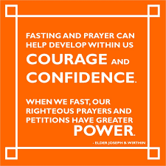
We Are Blessed When We Fast

