Slide 1
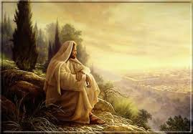
Chapter 24: The Sabbath Day

Slide 2
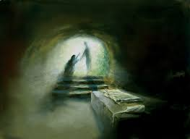
The Meaning of the Sabbath Day
The word Sabbath comes from a Hebrew word meaning rest. Before the Resurrection of Jesus Christ, the Sabbath day commemorated God’s day of rest after He finished the Creation. It was a sign of the covenant between God and His people.

Slide 3
We read in the book of Genesis that God created the heavens and the earth in six periods of time, which He called days: “And on the seventh day God ended his work which he had made; and he rested on the seventh day from all his work which he had made. And God blessed the seventh day, and sanctified it” (Genesis 2:2–3)

Slide 4
The Purpose of the Sabbath Day
How would you explain the purpose of the Sabbath day to someone who does not know about the Sabbath?
Jesus taught that the Sabbath day was made for our benefit (see Mark 2:27). The purpose of the Sabbath is to give us a certain day of the week on which to direct our thoughts and actions toward God. It is not a day merely to rest from work.

Slide 5
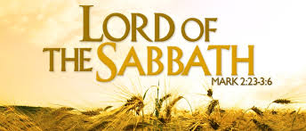

Slide 6
History of the Sabbath
The seventh day was consecrated by God as a Sabbath in the beginning of the earth (see Genesis 2:2–3). Since earliest times, the tradition of a sacred seventh day has been preserved among various peoples of the earth. God renewed a commandment concerning this day to the Israelites, saying, “Remember the sabbath day, to keep it holy” (Exodus 20:8). Keeping the Sabbath day was also a sign that the Israelites were His covenant people (see Exodus 31:12–13, 16; Isaiah 56:1–8;Jeremiah 17:19–27).

Slide 7
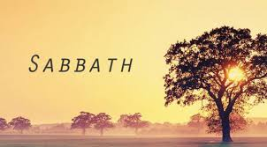
The Lord’s Day
Why was the Sabbath changed from the seventh day to the first day?

Slide 8
Until His Resurrection, Jesus Christ and His disciples honored the seventh day as the Sabbath. After His Resurrection, Sunday was held sacred as the Lord’s day in remembrance of His Resurrection on that day (see Acts 20:7; 1 Corinthians 16:2). From that time on, His followers observed the first day of the week as their Sabbath. In both cases there were six days of labor and one for rest and devotion.

Slide 9
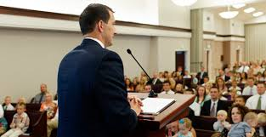
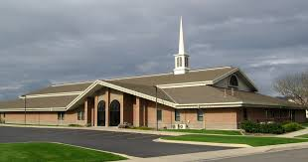
Keeping the Sabbath Day Holy

Slide 10
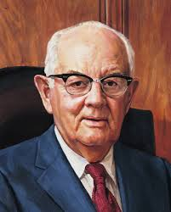
President Spencer W. Kimball cautioned, however, that if we merely lounge about doing nothing on the Sabbath, we are not keeping the day holy. The Sabbath calls for constructive thoughts and acts. (See Teachings of Presidents of the Church: Spencer W. Kimball [2006], 170.)

Slide 11
Blessings for Observing the Sabbath
“The fulness of the earth is yours, … whether for food or for raiment, or for houses, or for barns, or for orchards, or for gardens, or for vineyards;
“Yea, all things which come of the earth, in the season thereof, are made for the benefit and the use of man, both to please the eye and to gladden the heart;
“Yea, for food and for raiment, for taste and for smell, to strengthen the body and to enliven the soul” (D&C 59:16–19).

Slide 12
