Slide 1
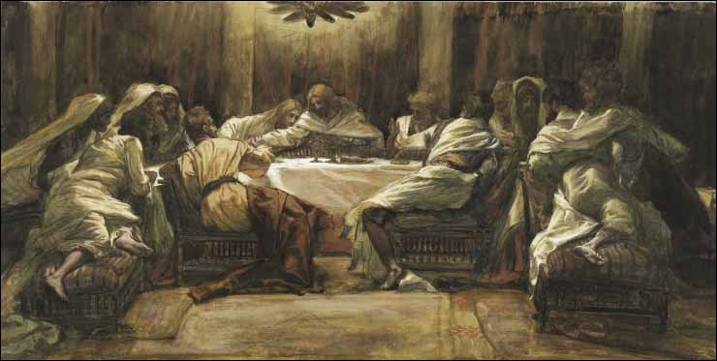
Chapter 23: The Sacrament

Slide 2
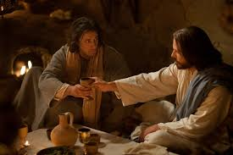
Christ Introduced the Sacrament
What do the emblems of the sacrament teach about the Atonement of Jesus Christ?

Slide 3
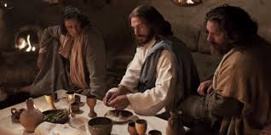
The sacrament is a holy priesthood ordinance that helps remind us of the Savior’s Atonement. During the sacrament, we partake of bread and water. We do this in remembrance of His flesh and His blood, which He gave as a sacrifice for us. As we partake of the sacrament, we renew sacred covenants with our Heavenly Father.

Slide 4
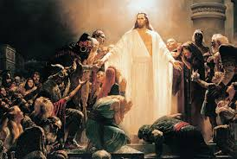
After His Resurrection, the Savior came to the Americas and taught the Nephites the same ordinance (see3 Nephi 18:1–11; 20:1–9). After the Church was restored in the latter days, Jesus once again commanded His people to partake of the sacrament in remembrance of Him, saying, “It is expedient that the church meet together often to partake of bread and wine in the remembrance of the Lord Jesus” (D&C 20:75).

Slide 5
How the Sacrament Is Administered
The sacrament is administered by those who hold the necessary priesthood authority. A priest or Melchizedek Priesthood holder breaks bread into pieces, kneels, and blesses it (see D&C 20:76). A deacon or other priesthood holder then passes the sacrament bread to the congregation.
Then the priest or Melchizedek Priesthood holder blesses the water, and it too is passed to the members. Jesus gave His disciples wine when He introduced the sacrament. However, in a latter-day revelation He has said that it doesn’t matter what we eat and drink during the sacrament as long as we remember Him (see D&C 27:2–3).

Slide 6
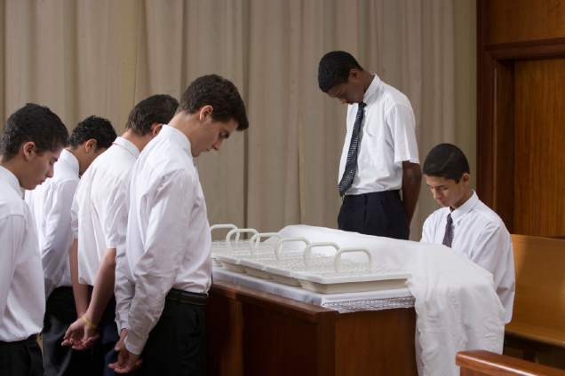
Carefully review the sacrament prayers. Think about the meaning of each phrase.

Slide 7
The Covenants We Renew during the Sacrament
Each time we partake of the sacrament, we renew covenants with the Lord. A covenant is a sacred promise between the Lord and His children. The covenants we make are clearly stated in the sacramental prayers. It is important to know what those covenants are and what they mean.
We covenant that we are willing to take upon ourselves the name of Jesus Christ. By this we show we are willing to be identified with Him and His Church. We commit to serve Him and our fellowman. We promise that we will not bring shame or reproach upon that name.

Slide 9
Our Attitude When Partaking of the Sacrament
Before partaking of the sacrament, we are to prepare ourselves spiritually. The Lord emphasizes that no one should partake of the sacrament unworthily. That means we must repent of our sins before taking the sacrament. The scriptures say, “If any have trespassed, let him not partake until he makes reconciliation” (D&C 46:4). The Lord instructed His twelve Nephite disciples, “Ye shall not suffer any one knowingly to partake of my flesh and blood unworthily, when ye shall minister it; for whoso eateth and drinketh my flesh and blood unworthily eateth and drinketh damnation to his soul” (3 Nephi 18:28–29).

Slide 10
