Slide 1
Chapter 22: The Gifts of the Spirit

Slide 2
The Gifts of the Spirit
What spiritual gifts does the Lord give us?

Slide 3
Following baptism, each of us had hands laid on our heads to receive the gift of the Holy Ghost. If we are faithful, we can have His influence continually with us. Through Him, each of us can be blessed with certain spiritual powers called gifts of the Spirit. These gifts are given to those who are faithful to Christ. “All these gifts come from God, for the benefit of the children of God” (D&C 46:26)

Slide 4
The scriptures mention many gifts of the Spirit. These gifts have been given to members of the true Church whenever it has been on the earth (see Mark 16:16–18). The gifts of the Spirit include the following:

Slide 5
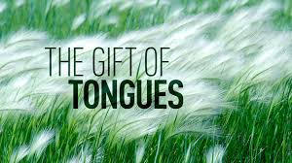
The Gift of Tongues (D&C 46:24)
Sometimes it is necessary to communicate the gospel in a language that is unfamiliar to us. When this happens, the Lord can bless us with the ability to speak that language. Many missionaries have received the gift of tongues

Slide 6
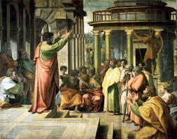
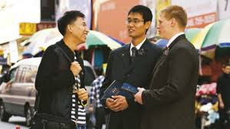
Pentecost And our missionaries today

Slide 7
The Gift of Interpretation of Tongues (D&C 46:25)
This gift is sometimes given to us when we do not understand a language and we need to receive an important message from God. For example, President David O. McKay had a great desire to speak to the Saints in New Zealand without an interpreter. He told them that he hoped that the Lord would bless them that they could understand him. He spoke in English. His message lasted about 40 minutes. As he spoke, he could tell by the expression on many of their faces and the tears in their eyes that they were receiving his message.

Slide 8
The Gift of Translation (D&C 5:4)

Slide 9
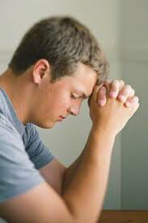
The Gift of Wisdom (D&C 46:17)
“If any of you lack wisdom, let him ask of God, that giveth to all men liberally, and upbraideth not; and it shall be given him.
“But let him ask in faith, nothing wavering. For he that wavereth is like a wave of the sea driven with the wind and tossed.
“For let not that man think that he shall receive any thing of the Lord” (James 1:5–7).

Slide 10
The Gift of Knowledge (D&C 46:18)
The Lord revealed, “If a person gains more knowledge and intelligence in this life through his diligence and obedience than another, he will have so much the advantage in the world to come” (D&C 130:19). The Lord has commanded us to learn as much as we can about His work. He wants us to learn about the heavens, the earth, things that have happened or will happen, things at home and in foreign lands (see D&C 88:78–79).

Slide 11
The Gift of Knowing That Jesus Christ Is the Son of God (D&C 46:13)
President David O. McKay taught: “It is given unto some, says the Lord in the Doctrine and Covenants, to know by the Holy Ghost that Jesus is the Son of God and that He was crucified for the sins of the world [see D&C 46:13]. It is to these I refer who stand firm upon the rock of revelation in the testimony that they bear to the world” (Teachings of Presidents of the Church: David O. McKay [2003], 166).

Slide 12
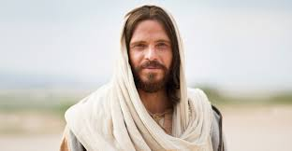

Slide 13
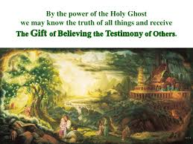
The Gift of Believing the Testimony of Others (D&C 46:14)
If the thing we are praying about is true, the Lord will speak peace to our minds (see D&C 6:22–23). In this way we can know when someone else, even the prophet, has received revelation. Nephi asked the Lord to let him see, feel, and know that his father’s dream was true (see 1 Nephi 10:17–19).

Slide 14
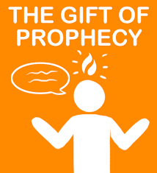
The Gift of Prophecy (D&C 46:22)
Those who receive true revelations about the past, present, or future have the gift of prophecy. Prophets have this gift, but we too can have it to help us govern our own lives (see 1 Corinthians 14:39).

Slide 15
The Gift of Healing (D&C 46:19–20)
Some have the faith to heal, and others have the faith to be healed. We can all exercise the faith to be healed when we are ill (see D&C 42:48).

Slide 16
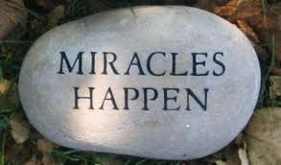
The Gift of Working Miracles (D&C 46:21)
The Lord has blessed His people many times in miraculous ways. When the Utah pioneers planted their first crops, a plague of locusts nearly destroyed them. The pioneers prayed that the Lord would save their crops, and He sent seagulls to devour the locusts.

Slide 17
The Gift of Faith (Moroni 10:11)
The brother of Jared had great faith. Because of his faith, he received other gifts. His faith was so great that the Savior appeared to him (see Ether 3:9–15). Without faith, no other gift can be given. Moroni promises, “Whoso believeth in Christ, doubting nothing, whatsoever he shall ask the Father in the name of Christ it shall be granted him” (Mormon 9:21). We should seek to increase our faith, find out our gifts, and use them.

Slide 18
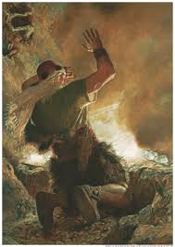

Slide 19
We Must Be Careful with Our Gifts of the Spirit
The Lord said, “A commandment I give unto them, that they shall not boast themselves of these things, neither speak them before the world; for these things are given unto you for your profit and for salvation” (D&C 84:73). We must remember that spiritual gifts are sacred (see D&C 6:10).

