Slide 1
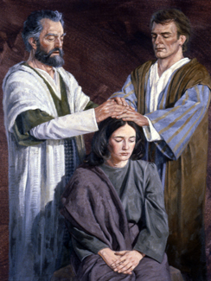
Chapter 21: The Gift of the Holy Ghost

Slide 2
The Holy Ghost
The Holy Ghost is a member of the Godhead. He is “a personage of Spirit” (D&C 130:22). He does not have a body of flesh and bones. His influence can be everywhere at once. His mission is to bear witness of the Father and the Son and of all truth. Furthermore, the Holy Ghost purifies, or sanctifies, us to prepare us to dwell in the presence of God. The Holy Ghost purifies our hearts so we no longer have the desire to do evil.

Slide 3
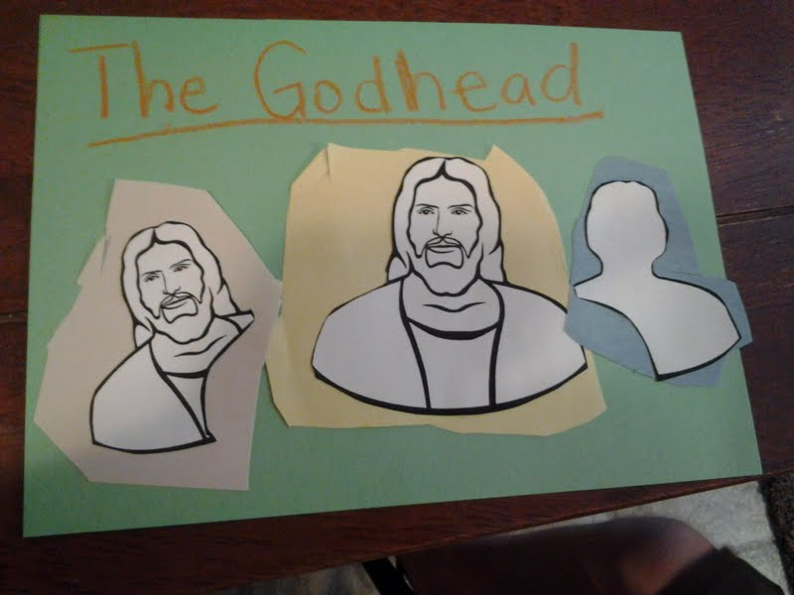

Slide 4
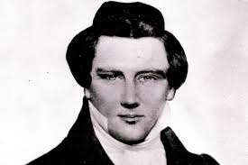
The Gift of the Holy Ghost
Joseph Smith said we believe in the gift of the Holy Ghost being enjoyed now as much as it was enjoyed in the days of the first Apostles. We believe in this gift in all its fulness, power, greatness, and glory. (See Teachings of Presidents of the Church: Joseph Smith [2007], 97–98.)

Slide 5
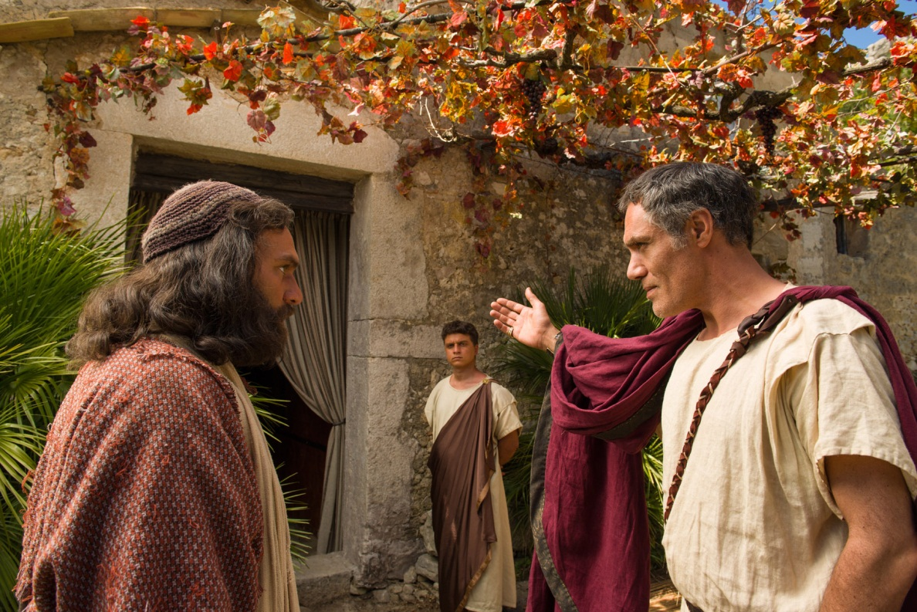
A person may be temporarily guided by the Holy Ghost without receiving the gift of the Holy Ghost (see D&C 130:23). However, this guidance will not be continuous unless the person is baptized and receives the laying on of hands for the gift of the Holy Ghost.

Slide 6
Today people who are not members of the Church learn by the power of the Holy Ghost that the Book of Mormon is true (see Moroni 10:4–5). But that initial testimony leaves them if they do not receive the gift of the Holy Ghost. They do not receive the continuing assurance that can come to those who have the gift of the Holy Ghost.

Slide 7
Receiving the Gift of the Holy Ghost
What must we do to receive the constant companionship of the Holy Ghost?

Slide 8
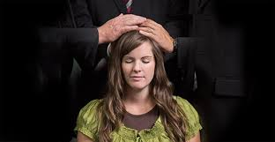
After people are baptized, they are confirmed members of the Church and given the gift of the Holy Ghost by the laying on of hands. The Lord said, “Whoso having faith you shall confirm in my church, by the laying on of the hands, and I will bestow the gift of the Holy Ghost upon them” (D&C 33:15).

Slide 9
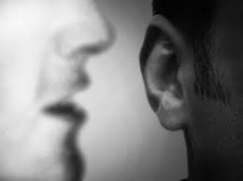
Recognizing the Influence of the Holy Ghost
The Holy Ghost usually communicates with us quietly. His influence is often referred to as a “still small voice” (see 1 Kings 19:9–12; Helaman 5:30; D&C 85:6). President Boyd K. Packer explained: “The Holy Ghost speaks with a voice that you feel more than you hear. … While we speak of ‘listening’ to the whisperings of the Spirit, most often one describes a spiritual prompting by saying, ‘I had a feeling …’” He continued: “This voice of the Spirit speaks gently, prompting you what to do or what to say, or it may caution or warn you” (in Conference Report, Oct. 1994, 77; or Ensign, Nov. 1994, 60).

Slide 10
One of God’s Greatest Gifts

