Slide 1
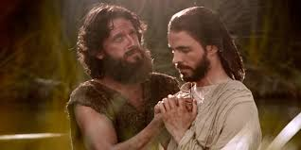
Chapter 20: Baptism

Slide 2
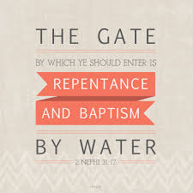
The Commandment to Be Baptized
Why must we be baptized?
One of the instructions the Lord gave His Apostles was, “Go ye therefore, and teach all nations, baptizing them in the name of the Father, and of the Son, and of the Holy Ghost: teaching them to observe all things whatsoever I have commanded you” (Matthew 28:19–20).

Slide 3
We Must Be Baptized for the Remission of Our Sins
From the scriptures we learn that John the Baptist “did baptize in the wilderness, and preach the baptism of repentance for the remission of sins” (Mark 1:4). The Apostle Peter taught, “Repent, and be baptized every one of you in the name of Jesus Christ for the remission of sins” (Acts 2:38). Following Paul’s conversion, Ananias said to him, “Arise, and be baptized, and wash away thy sins” (Acts 22:16).

Slide 4
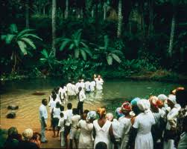

Slide 5
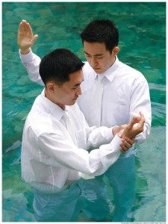
We Must Be Baptized to Become Members of the Church of Jesus Christ
“All those who humble themselves before God, and desire to be baptized … that … have truly repented of all their sins … shall be received by baptism into his church” (D&C 20:37).

Slide 6
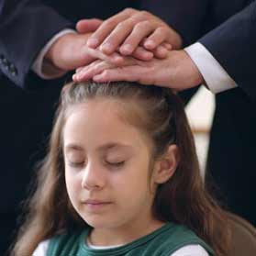
We Must Be Baptized before We Can Receive the Gift of the Holy Ghost
The Lord said, “If thou wilt turn unto me, and … repent of all thy transgressions [sins], and be baptized, even in water, in the name of mine Only Begotten Son, … ye shall receive the gift of the Holy Ghost” (Moses 6:52).

Slide 7
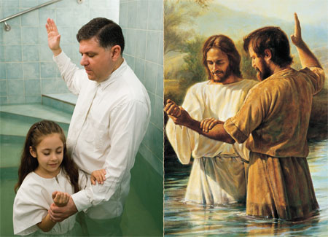
We Must Be Baptized to Show Obedience
Jesus Christ was without sin, yet He was baptized. He said His baptism was necessary “to fulfil all righteousness” (Matthew 3:15)

Slide 8
We Must Be Baptized to Enter the Celestial Kingdom
Jesus said, “Whoso believeth in me, and is baptized … shall inherit the kingdom of God. And whoso believeth not in me, and is not baptized, shall be damned” (3 Nephi 11:33–34). Baptism is the gateway through which we enter the path to the celestial kingdom (see2 Nephi 31:17–18).

Slide 9
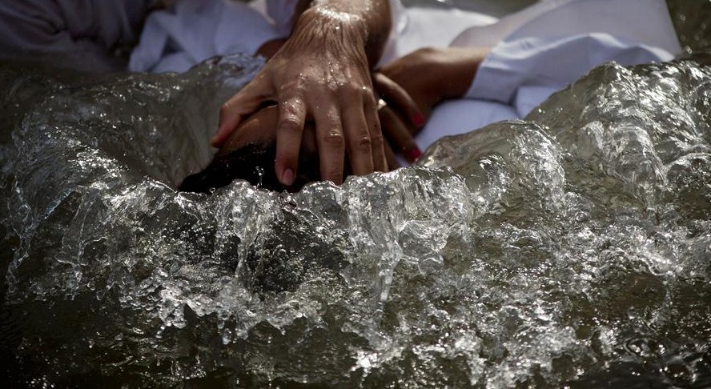
The Correct Mode of Baptism
Paul said:
“Know ye not, that so many of us as were baptized into Jesus Christ were baptized into his death?
“Therefore we are buried with him by baptism into death: that like as Christ was raised up from the dead by the glory of the Father, even so we also should walk in newness of life.
“For if we have been planted together in the likeness of his death, we shall be also in the likeness of his resurrection” (Romans 6:3–5).

Slide 10
Baptism at the Age of Accountability
The prophet Mormon said that it is mockery before God to baptize little children, because they are not capable of sinning. Likewise, baptism is not required of people who are mentally incapable of knowing right and wrong (see Moroni 8:9–22).

Slide 11
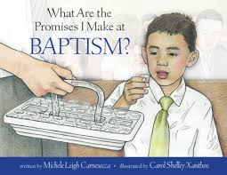
We Make Covenants When We Are Baptized
“Behold, here are the waters of Mormon. … And now, as ye are desirous to come into the fold of God, and to be called his people, … what have you against being baptized in the name of the Lord, as a witness before him that ye have entered into a covenant with him, that ye will serve him and keep his commandments, that he may pour out his Spirit more abundantly upon you?” (Mosiah 18:8, 10). The people clapped their hands for joy and said it was their desire to be baptized. Alma baptized them in the Waters of Mormon. (See Mosiah 18:7–17.)

Slide 12
Baptism Gives Us a New Beginning
“Inasmuch as ye were born into the world by water, and blood, and the spirit, which I have made, and so became of dust a living soul, even so ye must be born again into the kingdom of heaven, of water, and of the Spirit, and be cleansed by blood, even the blood of mine Only Begotten” (Moses 6:59).

