Slide 1
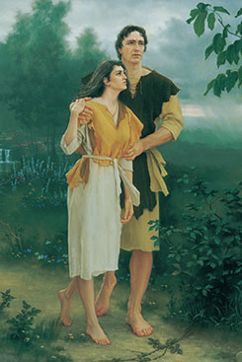
Chapter 6: The Fall of Adam and Eve.

Slide 2
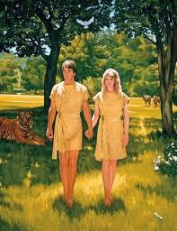
Adam and Eve Were the First to Come to Earth.
God prepared this earth as a home for His children. Adam and Eve were chosen to be the first people to live on the earth (see Moses 1:34; 4:26). Their part in our Father’s plan was to bring mortality into the world. They were to be the first parents. (See D&C 107:54–56.)

Slide 3
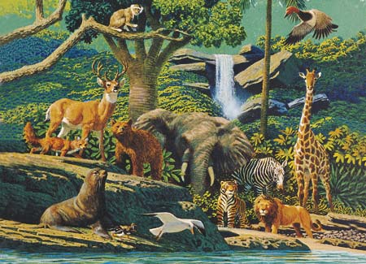
The Garden of Eden.
When Adam and Eve were placed in the Garden of Eden, they were not yet mortal. In this state, “they would have had no children” (2 Nephi 2:23). There was no death. They had physical life because their spirits were housed in physical bodies made from the dust of the earth (see Moses 6:59; Abraham 5:7).

Slide 4
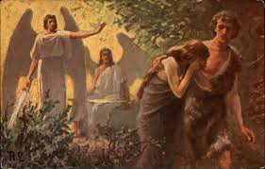
Adam and Eve’s Separation from God.
Because Adam and Eve had eaten the fruit of the tree of knowledge of good and evil, the Lord sent them out of the Garden of Eden into the world. Their physical condition changed as a result of their eating the forbidden fruit. As God had promised, they became mortal. They and their children would experience sickness, pain, and physical death.

Slide 5
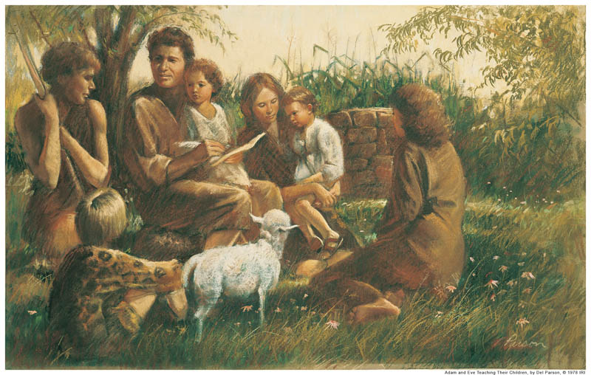
Great Blessings Resulted from the Transgression.
Some people believe Adam and Eve committed a serious sin when they ate of the tree of knowledge of good and evil. However, latter-day scriptures help us understand that their Fall was a necessary step in the plan of life and a great blessing to all of us. Because of the Fall, we are blessed with physical bodies, the right to choose between good and evil, and the opportunity to gain eternal life. None of these privileges would have been ours had Adam and Eve remained in the garden.

