Slide 1
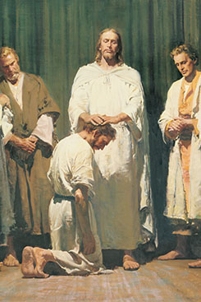
Chapter 16: The Church of Jesus Christ in Former Times.

Slide 2
Some Features That Identify the Church of Jesus Christ.
Revelation.
When Jesus established His Church, He personally instructed and directed its leaders. He, in turn, received His instructions from His Father in Heaven. (See Hebrews 1:1–2.) Thus the Church of Jesus Christ was directed by God and not by men.

Slide 3
Some Features That Identify the Church of Jesus Christ.
Authority from God.
The ordinances and principles of the gospel cannot be administered and taught without the priesthood. The Father gave this authority to Jesus Christ (see Hebrews 5:4–6), who in turn ordained His Apostles and gave them the power and authority of the priesthood (seeLuke 9:1–2; Mark 3:14). He reminded them, “Ye have not chosen me, but I have chosen you, and ordained you” (John 15:16).

Slide 4
Some Features That Identify the Church of Jesus Christ.
The Church Organization.
The Church of Jesus Christ was a carefully organized unit. It was compared to a building that was “built upon the foundation of the apostles and prophets, Jesus Christ himself being the chief corner stone” (Ephesians 2:20).

Slide 5
Some Features That Identify the Church of Jesus Christ.
First Principles and Ordinances.
The Apostles taught two basic principles: faith in the Lord Jesus Christ and repentance. After new converts had faith in Jesus Christ as the Son of God and their Redeemer and had repented of their sins, they received two ordinances: baptism by immersion and the laying on of hands for the gift of the Holy Ghost (see Acts 19:1–6). These were the first principles and ordinances of the gospel. Jesus had taught, “Except a man be born of water and of the Spirit, he cannot enter into the kingdom of God” (John 3:5).

Slide 6
Some Features That Identify the Church of Jesus Christ.
Ordinances Performed for the Dead.
Jesus has provided for everyone to hear the gospel, whether on earth or after death. Between His death and Resurrection, Jesus went among the spirits of those who had died. He organized missionary work among those who were dead. He appointed righteous messengers and gave them power to teach the gospel to all the spirits of people who had died.

Slide 7
Some Features That Identify the Church of Jesus Christ.
Spiritual Gifts.
All faithful members of the Church were entitled to receive gifts of the Spirit. These were given to them according to their individual needs, capacities, and assignments. Some of these gifts were faith, including the power to heal and to be healed; prophecy; and visions. (The gifts of the Spirit are discussed in more detail in chapter 22.) Spiritual gifts always exist in the true Church of Jesus Christ (see 1 Corinthians 12:4–11;Moroni 10:8–18; D&C 46:8–29).

Slide 8
The Church of Jesus Christ in the Americas.
After Jesus was resurrected, He visited the people in the Americas and organized His Church among them, teaching the people for three days and then returning often for some time thereafter (see 3 Nephi 11–28). Then He left them and ascended into heaven. For over 200 years they lived righteously and were among the happiest people whom God had created (see 4 Nephi 1:16).

Slide 9
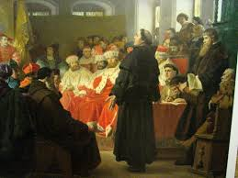
Apostasy from the True Church.
Throughout history, evil people have tried to destroy the work of God. This happened while the Apostles were still alive and supervising the young, growing Church. Some members taught ideas from their old pagan or Jewish beliefs instead of the simple truths taught by Jesus. Some rebelled openly.

Slide 10
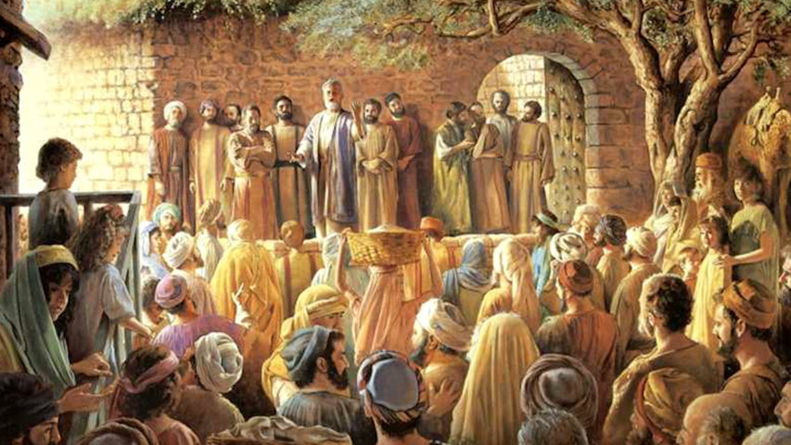
A Restoration Foretold.
God had foreseen the Apostasy and prepared for the gospel to be restored. The Apostle Peter spoke of this to the Jews: “He shall send Jesus Christ, which before was preached unto you: whom the heaven must receive until the times of restitution of all things, which God hath spoken by the mouth of all his holy prophets since the world began” (Acts 3:20–21).

