Slide 1
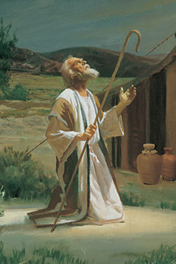
Chapter 15: The Lord’s Covenant People.

Slide 2
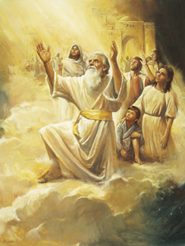
The Nature of Covenants.
From the beginning, the Lord has made covenants with His children on earth. When His people make covenants (or promises) with Him, they know what He expects of them and what blessings they may expect from Him. They can better carry out His work on earth.

Slide 3
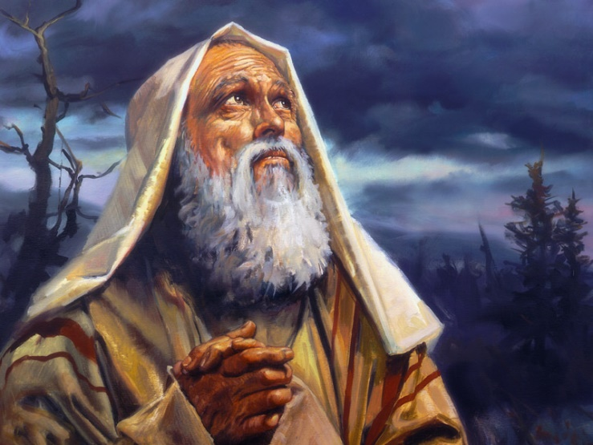
God’s Covenant with Abraham and His Descendants.
Abraham, an Old Testament prophet, was a very righteous man. He refused to worship his father’s idols. He kept all of the Lord’s commandments. Because of Abraham’s righteousness, the Lord made a covenant with him and his descendants.

Slide 4
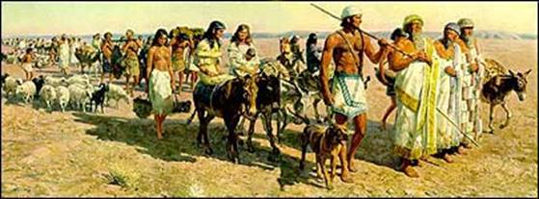
Members of the Church Are a Covenant People.
The blood descendants of Abraham are not the only people whom God calls His covenant people. In speaking to Abraham, God said, “As many as receive this Gospel shall be called after thy name, and shall be accounted thy seed [lineage], and shall rise up and bless thee, as their father” (Abraham 2:10).

Slide 5
The New and Everlasting Covenant.
The fulness of the gospel is called the new and everlasting covenant. It includes the covenants made at baptism, during the sacrament, in the temple, and at any other time. The Lord calls it everlasting because it is ordained by an everlasting God and because the covenant will never be changed.

