Slide 1
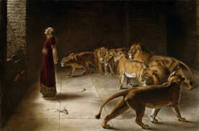
Chapter 9: Prophets of God

Slide 2
Prophets Are God’s Representatives on the Earth
Many people live in darkness, unsure of God’s will. They believe that the heavens are closed and that people must face the world’s perils alone. How fortunate are the Latter-day Saints! We know that God communicates to the Church through His prophet. With grateful hearts, Saints the world over sing the hymn, “We thank thee, O God, for a prophet to guide us in these latter days”

Slide 3
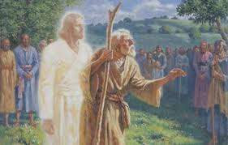

Slide 4
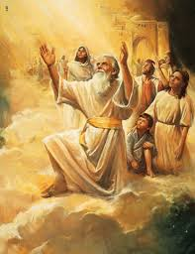
A prophet is a man called by God to be His representative on earth. When a prophet speaks for God, it is as if God were speaking (see D&C 1:38). A prophet is also a special witness for Christ, testifying of His divinity and teaching His gospel.

Slide 5
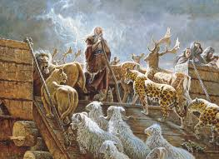
A prophet may come from various stations in life. He may be young or old, highly educated or unschooled. He may be a farmer, a lawyer, or a teacher. Ancient prophets wore tunics and carried staffs.

Slide 6
Through the Ages God Has Called Prophets to Lead Mankind
In what ways have prophets guided God’s children in the past?
There have been prophets on the earth since the days of Adam. Experiences of these great men excite and inspire us. Moses, an Old Testament prophet, led thousands of his people out of Egypt and slavery to the promised land. He wrote the first five books of the Old Testament and recorded the Ten Commandments. Nephi, a Book of Mormon prophet, journeyed from Jerusalem to the Americas 600 years before the birth of Christ.

Slide 7
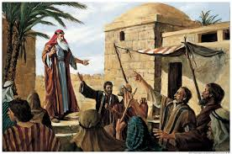

Slide 8
We Have a Living Prophet on the Earth Today
We have a prophet living on the earth today. This prophet is the President of The Church of Jesus Christ of Latter-day Saints. He has the right to revelation for the entire Church. He holds “the keys of the kingdom,” meaning that he has the authority to direct the entire Church and kingdom of God on earth, including the administration of priesthood ordinances (see Matthew 16:19).

Slide 9
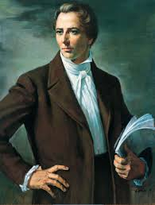

Slide 10
“The Lord will never permit me or any other man who stands as President of this Church to lead you astray. It is not in the programme. It is not in the mind of God. If I were to attempt that, the Lord would remove me out of my place” (Teachings of Presidents of the Church: Wilford Woodruff [2004], 199).

Slide 11
We Should Sustain the Lord’s Prophet
Many people find it easy to believe in the prophets of the past. But it is much greater to believe in and follow the living prophet. We raise our hands to sustain the President of the Church as prophet, seer, and revelator.
How can we sustain the prophet? We should pray for him. His burdens are heavy, and he needs to be strengthened by the prayers of the Saints.
We should study his words. We can listen to his conference addresses. We can also subscribe to theEnsign or Liahona so we can read his conference addresses and other messages he gives.

Slide 12
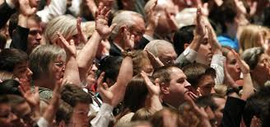

Slide 13
“Thou shalt give heed unto all his [the prophet’s] words and commandments which he shall give unto you as he receiveth them, walking in all holiness before me;
“For his word ye shall receive, as if from mine own mouth, in all patience and faith” (D&C 21:4–5).

Slide 14
Great Blessings Follow Obedience to the Prophet
If we obey, the Lord promises, “The gates of hell shall not prevail against you; yea, and the Lord God will disperse the powers of darkness from before you, and cause the heavens to shake for your good, and his name’s glory” (D&C 21:6). When we do as our prophet directs, blessings pour down from heaven.
In order to stand, the true Church must be “built upon the foundation of the apostles and prophets, Jesus Christ himself being the chief corner stone” (Ephesians 2:20). We are blessed in this insecure world to have a prophet through whom the Lord reveals His will.

Slide 15
