Slide 1
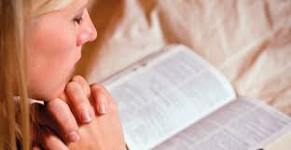
Chapter 8: Praying to Our Heavenly Father

Slide 2
What Is Prayer?
Jesus taught, “Ye must always pray unto the Father in my name” (3 Nephi 18:19).
Prayer is one of the greatest blessings we have while we are here on earth. Through prayer we can communicate with our Heavenly Father and seek His guidance daily.
Prayer is a sincere, heartfelt talk with our Heavenly Father. We should pray to God and to no one else. We do not pray to any other being or to anything made by man or God (see Exodus 20:3–5).

Slide 3
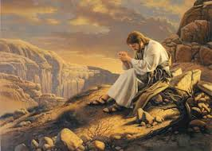

Slide 4
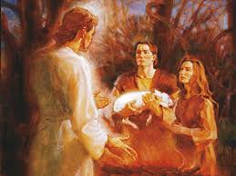
Why Do We Pray?
Prayer has been an important part of the gospel from the beginning of the world. An angel of the Lord commanded Adam and Eve to repent and call upon God in the name of the Son (see Moses 5:8).

Slide 5
We should pray for strength to resist the temptations of Satan and his followers (see 3 Nephi 18:15; D&C 10:5). We should pray to confess our sins to God and ask Him to forgive us (see Alma 38:14).

Slide 6
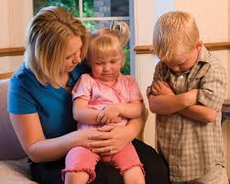
We should pray for the Lord’s guidance and help in our daily lives. We need to pray for our families and friends, our neighbors, our crops and our animals, our daily work, and our other activities. We should pray for protection from our enemies. (See Alma 34:17–27.)

Slide 7
We should pray to express love to our Heavenly Father and to feel closer to Him. We should pray to our Father to thank Him for our welfare and comfort and for all things He gives us each day (see 1 Thessalonians 5:18). We need to pray to ask our Heavenly Father for strength to live the gospel.

Slide 8
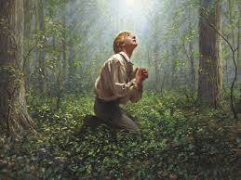

Slide 9
When Should We Pray?
At times we may not feel like praying. We may be angry or discouraged or upset. At these times we should make a special effort to pray (see 2 Nephi 32:8–9).
We should each pray privately at least every night and every morning. The scriptures speak of praying morning, midday, and evening (see Alma 34:21).
We are commanded to have family prayers so that our families may be blessed (see 3 Nephi 18:21). Our Church leaders have counseled us to pray as families each morning and night.

Slide 10
How Should We Pray?
No matter where we are, whether we stand or kneel, whether we pray vocally or silently, whether we pray privately or in behalf of a group, we should always pray in faith, “with a sincere heart, with real intent” (Moroni 10:4).
As we pray to our Heavenly Father, we should tell Him what we really feel in our hearts, confide in Him, ask Him for forgiveness, plead with Him, thank Him, express our love for Him.

Slide 12
How Are Prayers Answered?
Why do you think answers to prayers are not always readily apparent? Why do you think answers to prayers do not always come when we want or in the way we want?

Slide 13
As we live the gospel of Jesus Christ and pray always, we will have joy and happiness. “Be thou humble; and the Lord thy God shall lead thee by the hand, and give thee answer to thy prayers” (D&C 112:10).

