Slide 1
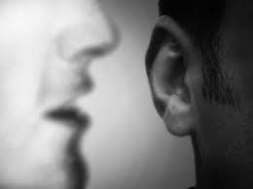
Chapter 7: The Holy Ghost

Slide 2
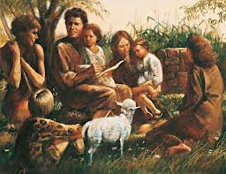
The Holy Ghost Came to Adam and Eve
After Adam and Eve left the Garden of Eden, they began to till the earth and work at other tasks for their living. They had many children, and their sons and daughters also married and had children (see Moses 5:1–3).

Slide 3
Thus, spirit children of our Heavenly Father began leaving His presence to come to the earth as they had been promised (see Abraham 3:24–25). As they came to earth, the memory of their heavenly home was taken from them. But our Father did not shut them away from His influence. He sent the Holy Ghost to comfort and help and guide all of His spirit children.

Slide 4
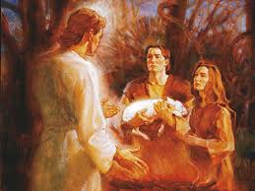
Adam and Eve called upon Heavenly Father in prayer. He spoke to them and gave them commandments, which they obeyed. An angel of the Lord came and taught Adam and Eve the plan of salvation. The Lord sent the Holy Ghost to testify of the Father and of the Son and to teach Adam and Eve the gospel. (See Moses 5:4–9.)

Slide 5
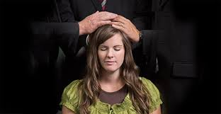
Attributes of the Holy Ghost
How does the Holy Ghost differ from the Father and the Son? Why is that difference important to us?

Slide 6
The Holy Ghost is a member of the Godhead (see 1 John 5:7; D&C 20:28). He is a “personage of Spirit” (D&C 130:22). He can be in only one place at a time, but His influence can be everywhere at the same time.
Heavenly Father, Jesus Christ, and the Holy Ghost are called the Godhead. They are unified in purpose. Each has an important assignment in the plan of salvation. Our Heavenly Father is our Father and ruler. Jesus Christ is our Savior. The Holy Ghost is the revealer and testifier of all truth.

Slide 7
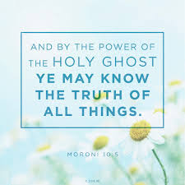
The Mission of the Holy Ghost

Slide 8
The Holy Ghost will witness to us that Jesus is our Savior and Redeemer (see 3 Nephi 28:11; D&C 20:27). He will reveal to us that our Heavenly Father is the Father of our spirits. He will help us understand that we can become exalted like our Heavenly Father. (See Romans 8:16–17.) The prophets of the Lord have promised, “By the power of the Holy Ghost ye may know the truth of all things” (Moroni 10:5).

Slide 9
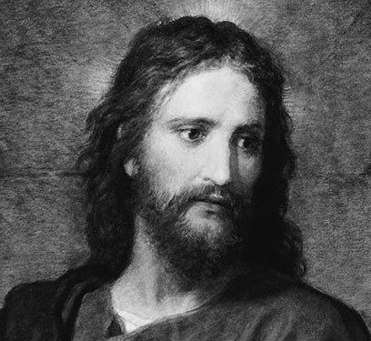
Without the Holy Ghost, we could not know that Jesus is the Christ. The Apostle Paul wrote, “No man can say that Jesus is the Lord, but by the Holy Ghost” (1 Corinthians 12:3). The Savior Himself said, “And this is life eternal, that they might know thee the only true God, and Jesus Christ, whom thou hast sent” (John 17:3). It is by the power of the Holy Ghost that we are led to understand and live the gospel of Jesus Christ.

Slide 10
“When a man has the manifestation from the Holy Ghost, it leaves an indelible impression on his soul, one that is not easily erased. It is Spirit speaking to spirit, and it comes with convincing force. A manifestation of an angel, or even of the Son of God himself, would impress the eye and mind, and eventually become dimmed, but the impressions of the Holy Ghost sink deeper into the soul and are more difficult to erase” (Answers to Gospel Questions, comp. Joseph Fielding Smith Jr., 5 vols. [1957–66], 2:151).

