Slide 1
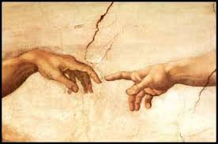
Chapter 5: The Creation

Slide 2
God’s Plan for Us
When we lived as spirit children with our heavenly parents, our Heavenly Father told us about His plan for us to become more like Him. We shouted for joy when we heard His plan (see Job 38:7). We were eager for new experiences. In order for these things to happen, we needed to leave our Father’s presence and receive mortal bodies. We needed another place to live where we could prepare to become like Him. Our new home was called earth.

Slide 3
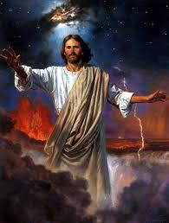
Jesus Created the Earth

Slide 4
Jesus Christ created this world and everything in it. He also created many other worlds. He did so through the power of the priesthood, under the direction of our Heavenly Father. God the Father said, “Worlds without number have I created; … and by the Son I created them, which is mine Only Begotten” (Moses 1:33). We have other testimonies of this truth. Joseph Smith and Sidney Rigdon saw Jesus Christ in a vision. They testified “that by him, and through him, and of him, the worlds are and were created, and the inhabitants thereof are begotten sons and daughters unto God”

Slide 5
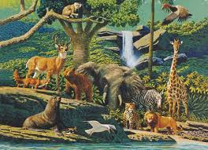
Carrying Out the Creation

Slide 6
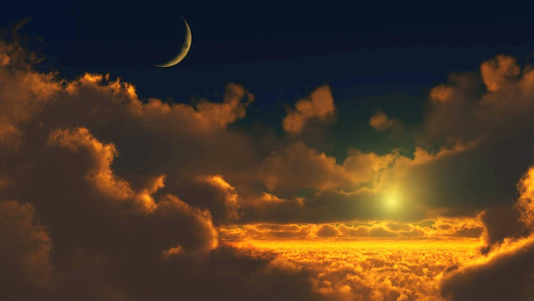
Under the direction of the Father, Christ formed and organized the earth. He divided light from darkness to make day and night. He formed the sun, moon, and stars. He divided the waters from the dry land to make seas, rivers, and lakes. He made the earth beautiful and productive. He made grass, trees, flowers, and other plants of all kinds. These plants contained seeds from which new plants could grow. Then He created the animals—fish, cattle, insects, and birds of all kinds. These animals had the ability to reproduce their own kind.

Slide 7
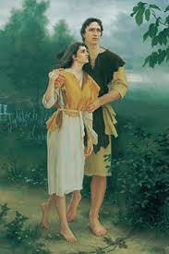
And so the first man, Adam, and the first woman, Eve, were formed and given bodies that resembled those of our heavenly parents. “In the image of God created he him; male and female created he them” (Genesis 1:27). When the Lord finished His creations, He was pleased and knew that His work was good, and He rested for a time.

Slide 8
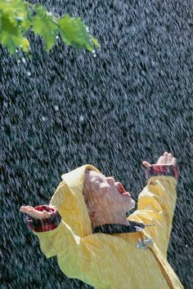
God’s Creations Show His Love
We are now living in this beautiful world. Think of the sun, which gives us warmth and light. Think of the rain, which makes plants grow and makes the world feel clean and fresh. Think of how good it is to hear a bird singing or a friend laughing. Think of how wonderful our bodies are—how we can work and play and rest. When we consider all of these creations, we begin to understand what wise, powerful, and loving beings Jesus Christ and our Heavenly Father are. They have shown great love for us by providing for all of our needs.
Even though God’s creations are many, He knows and loves them all. He said, “All things are numbered unto me, for they are mine and I know them” (Moses 1:35).

