Slide 1
Chapter 4: Freedom to Choose
If someone asked you why it is important to have agency, what would you say?

Slide 2
Agency Is an Eternal Principle
“Thou mayest choose for thyself, for it is given unto thee” (Moses 3:17).
God has told us through His prophets that we are free to choose between good and evil. We may choose liberty and eternal life by following Jesus Christ. We are also free to choose captivity and death by following Satan. (See 2 Nephi 2:27.) The right to choose between good and evil and to act for ourselves is called agency.

Slide 3
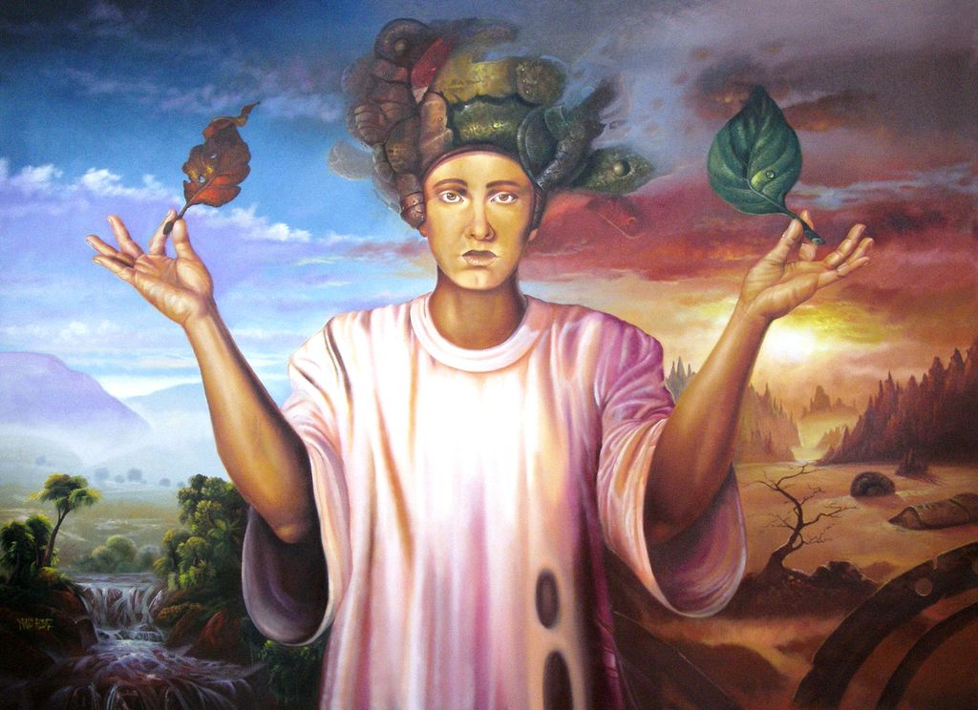
In our premortal life we had moral agency. One purpose of earth life is to show what choices we will make (see 2 Nephi 2:15–16). If we were forced to choose the right, we would not be able to show what we would choose for ourselves. Also, we are happier doing things when we have made our own choices.

Slide 4
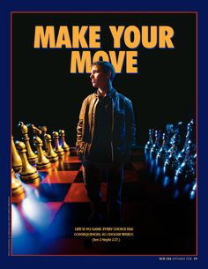
Agency was one of the principal issues to arise in the premortal Council in Heaven. It was one of the main causes of the conflict between the followers of Christ and the followers of Satan. Satan said, “Behold, here am I, send me, I will be thy son, and I will redeem all mankind, that one soul shall not be lost, and surely I will do it; wherefore give me thine honor” (Moses 4:1)

Slide 5
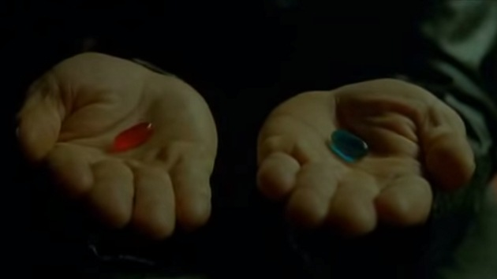
Agency Is a Necessary Part of the Plan of Salvation
Agency makes our life on earth a period of testing. When planning the mortal creation of His children, God said, “We will prove [test] them herewith, to see if they will do all things whatsoever the Lord their God shall command them” (Abraham 3:25)

Slide 6
We began to make choices as spirit children in our Heavenly Father’s presence. Our choices there made us worthy to come to earth. Our Heavenly Father wants us to grow in faith, power, knowledge, wisdom, and all other good things. If we keep His commandments and make right choices, we will learn and understand. We will become like Him. (See D&C 93:28.)

Slide 7
Agency Requires That There Be a Choice
We cannot choose righteousness unless the opposites of good and evil are placed before us. Lehi, a great Book of Mormon prophet, told his son Jacob that in order to bring about the eternal purposes of God, there must be “an opposition in all things. If not so, … righteousness could not be brought to pass, neither wickedness, neither holiness nor misery, neither good nor bad” (2 Nephi 2:11).

Slide 9
Even though we are free to choose our course of action, we are not free to choose the consequences of our actions. The consequences, whether good or bad, follow as a natural result of any choice we make (see Galatians 6:7; Revelation 22:12).
Heavenly Father has told us how to escape the captivity of Satan. We must watch and pray always, asking God to help us withstand the temptations of Satan (see 3 Nephi 18:15). Our Heavenly Father will not allow us to be tempted beyond our power to resist (see 1 Corinthians 10:13; Alma 13:28).

