Slide 1
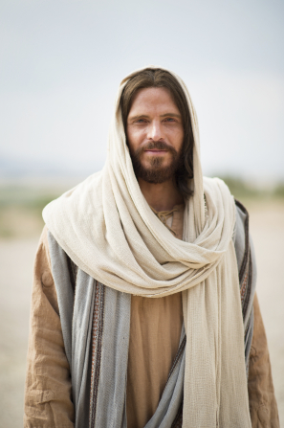
Chapter 3: Jesus Christ, Our Chosen Leader and Savior
« For I know that my redeemer liveth, and that he shallstand at the latter day upon the earth:
And though after my skin worms destroy this body, yet in my flesh shall I see God:
»
Job 19:25

Slide 2
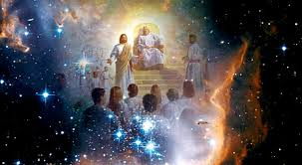
A Savior and Leader Was Needed
When the plan for our salvation was presented to us in the premortal spirit world, we were so happy that we shouted for joy (see Job 38:7).

Slide 3
We understood that we would have to leave our heavenly home for a time. We would not live in the presence of our Heavenly Father. While we were away from Him, all of us would sin and some of us would lose our way. Our Heavenly Father knew and loved each one of us. He knew we would need help, so He planned a way to help us.

Slide 4
We needed a Savior to pay for our sins and teach us how to return to our Heavenly Father. Our Father said, “Whom shall I send?” (Abraham 3:27). Jesus Christ, who was called Jehovah, said, “Here am I, send me” (Abraham 3:27; see also Moses 4:1–4).

Slide 5
Satan, who was called Lucifer, also came, saying, “Behold, here am I, send me, I will be thy son, and I will redeem all mankind, that one soul shall not be lost, and surely I will do it; wherefore give me thine honor” (Moses 4:1). Satan wanted to force us all to do his will. Under his plan, we would not be allowed to choose. He would take away the freedom of choice that our Father had given us. Satan wanted to have all the honor for our salvation. Under his proposal, our purpose in coming to earth would have been frustrated

Slide 6
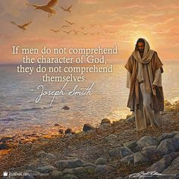
Jesus Christ Became Our Chosen Leader and Savior
After hearing both sons speak, Heavenly Father said, “I will send the first” (Abraham 3:27).

Slide 8
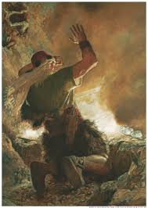
One scripture tells us that long before Jesus was born, He appeared to a Book of Mormon prophet known as the brother of Jared and said: “Behold, I am he who was prepared from the foundation of the world to redeem my people. Behold, I am Jesus Christ. … In me shall all mankind have life, and that eternally, even they who shall believe on my name” (Ether 3:14).

Slide 9
The War in Heaven
Because our Heavenly Father chose Jesus Christ to be our Savior, Satan became angry and rebelled. There was war in heaven. Satan and his followers fought against Jesus Christ and His followers. The Savior’s followers “overcame [Satan] by the blood of the Lamb, and by the word of their testimony”

Slide 10
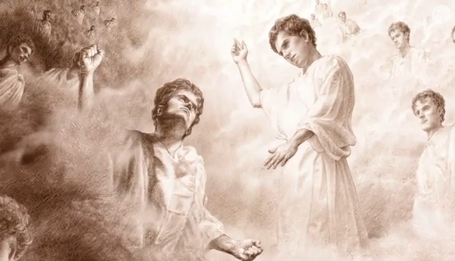
In this great rebellion, Satan and all the spirits who followed him were sent away from the presence of God and cast down from heaven. A third part of the hosts of heaven were punished for following Satan (see D&C 29:36). They were denied the right to receive mortal bodies.

Slide 11
We Have the Savior’s Teachings to Follow
Think about how the Savior’s teachings have influenced you.

