Slide 1
Chapter 2: Our Heavenly Family

Slide 2
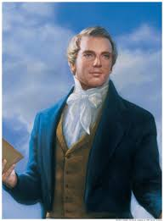
We Are Children of Our Heavenly Father
God is not only our Ruler and Creator; He is also our Heavenly Father. All men and women are literally the sons and daughters of God. “Man, as a spirit, was begotten and born of heavenly parents, and reared to maturity in the eternal mansions of the Father, prior to coming upon the earth in a temporal [physical] body” (Teachings of Presidents of the Church: Joseph F. Smith[1998], 335).

Slide 3
We Developed Personalities and Talents While We Lived in Heaven
The scriptures teach us that the prophets prepared themselves to become leaders on earth while they were still spirits in heaven (see Alma 13:1-3). Before they were born into mortal bodies, God foreordained (chose) them to be leaders on earth. Jesus, Adam, and Abraham were some of these leaders. (See Abraham 3:22–23.)Joseph Smith taught that “every man who has a calling to minister to the inhabitants of the world was [fore]ordained to that very purpose”

Slide 4
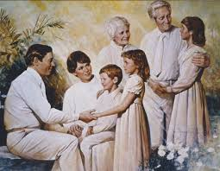

Slide 5
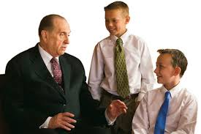
We possessed different talents and abilities, and we were called to do different things on earth. We can learn more about our “eternal possibilities” when we receive our patriarchal blessings (see Thomas S. Monson, in Conference Report, Oct. 1986, 82; or Ensign, Nov. 1986, 66).

Slide 6
Our Heavenly Father Presented a Plan for Us to Become Like Him
How does earth life help prepare us to become like our Heavenly Father?
Our Heavenly Father called a Grand Council to present His plan for our progression. We learned that if we followed His plan, we would become like Him. We would be resurrected; we would have all power in heaven and on earth; we would become heavenly parents and have spirit children just as He does (see D&C 132:19–20).

Slide 7
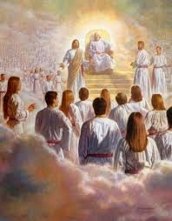

Slide 8
We learned that He would provide an earth for us where we would prove ourselves (see Abraham 3:24–26). A veil would cover our memories, and we would forget our heavenly home. This would be necessary so we could exercise our agency to choose good or evil without being influenced by the memory of living with our Heavenly Father.

Slide 9
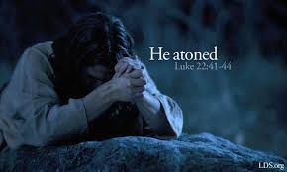
At this council we also learned that because of our weakness, all of us except little children would sin (see D&C 29:46–47). We learned that a Savior would be provided for us so we could overcome our sins and overcome death with resurrection. We learned that if we placed our faith in Him, obeying His word and following His example, we would be exalted and become like our Heavenly Father. We would receive a fulness of joy.

Slide 10
Additional Scriptures
Hebrews 12:9 (God is the Father of our spirits)
Job 38:4–7 (premortal life implied)
Abraham 3:22–28 (vision of premortal life)
Jeremiah 1:5 (vision of premortal life)
D&C 29:31–38 (vision of premortal life)
Moses 3:4–7 (spiritual and temporal creations)
1 Corinthians 15:44 (spiritual and temporal creations)
D&C 76:23–24 (begotten sons and daughters)
D&C 132:11–26 (plan for progression)

