Slide 1
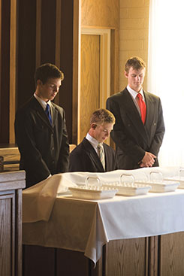
Chapter 14: Priesthood Organization.

Slide 2
The Priesthood Is on the Earth Today.
The Church of Jesus Christ of Latter-day Saints is governed by the priesthood. The priesthood, which is always associated with God’s work, “continueth in the church of God in all generations, and is without beginning of days or end of years” (D&C 84:17).

Slide 3
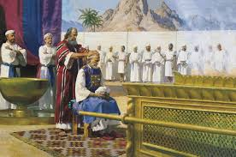
Two Divisions of Priesthood
The priesthood is divided into two parts: the Melchizedek Priesthood and the Aaronic Priesthood (see D&C 107:1). “The first is called the Melchizedek Priesthood … because Melchizedek was such a great high priest.
Before his day it was called the Holy Priesthood, after the Order of the Son of God.

Slide 4
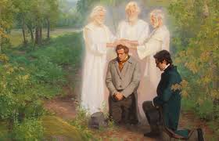
Keys of the Priesthood.
There is a difference between being ordained to an office in the priesthood and receiving keys of the priesthood. President Joseph F. Smith taught.
“The Priesthood in general is the authority given to man to act for God. Every man ordained to any degree of the Priesthood has this authority delegated to him.

Slide 5
The Offices and Duties of the Aaronic Priesthood.
When the Aaronic Priesthood is conferred on a man or boy, he is ordained to an office in that priesthood. The offices in the Aaronic Priesthood are deacon, teacher, priest, and bishop. Each office carries duties and responsibilities.

Slide 6
The Offices and Duties of the Melchizedek Priesthood.
Elder.
Elders are called to teach, expound, exhort, baptize, and watch over the Church (see D&C 20:42). All Melchizedek Priesthood holders are elders. They have the authority to bestow the gift of the Holy Ghost by the laying on of hands (see D&C 20:43).

Slide 7
The Offices and Duties of the Melchizedek Priesthood.
High Priest.
A high priest is given the authority to officiate in the Church and administer spiritual things (see D&C 107:10, 12). He may also officiate in all lesser offices (see D&C 68:19). Stake presidents, mission presidents, high councilors, bishops, and other leaders of the Church are ordained high priests.

Slide 8
The Offices and Duties of the Melchizedek Priesthood.
Patriarch.
Patriarchs are ordained by General Authorities, or by stake presidents when they are authorized by the Council of the Twelve, to give patriarchal blessings to members of the Church. These blessings give us some understanding of our callings on earth. They are the word of the Lord personally to us. Patriarchs are also ordained high priests. (See D&C 107:39–56.)

Slide 9
The Offices and Duties of the Melchizedek Priesthood.
Seventy
Seventies are special witnesses of Jesus Christ to the world and assist in building up and regulating the Church under the direction of the First Presidency and Quorum of the Twelve Apostles (see D&C 107:25, 34, 38, 93–97).

Slide 10
The Offices and Duties of the Melchizedek Priesthood.
Apostle
An Apostle is a special witness of the name of Jesus Christ in all the world (see D&C 107:23). The Apostles administer the affairs of the Church throughout the world. Those who are ordained to the office of Apostle in the Melchizedek Priesthood are usually set apart as members of the Quorum of the Twelve Apostles. Each one is given all the keys of the kingdom of God on earth, but only the senior Apostle, who is President of the Church, actively exercises all of the keys. The others act under his direction.

Slide 11
The Quorums of the Aaronic Priesthood.
The Lord has instructed that the holders of the priesthood be organized into quorums. A quorum is a body of brethren holding the same priesthood office.

Slide 12
The Quorums of the Melchizedek Priesthood.
At the general Church level, the members of the First Presidency form a quorum, as do the Twelve Apostles. The Seventies are also organized in quorums.

Slide 13
The Quorums of the Melchizedek Priesthood.
Elders Quorum
Each elders quorum “is instituted for standing ministers; nevertheless they may travel, yet they are ordained to be standing ministers” (D&C 124:137). They do most of their work near their homes. The quorum is to consist of up to 96 elders, presided over by a quorum presidency. When this number is exceeded, the quorum may be divided.

Slide 14
The Quorums of the Melchizedek Priesthood.
High Priests Quorum
Each quorum includes all high priests residing within the boundaries of a stake, including patriarchs and bishops. The stake president and his counselors are the presidency of this quorum. The high priests in each ward are organized into a group with a group leader.

Slide 15
Importance of Priesthood Quorums.
When ordained to the priesthood, a man or boy automatically becomes a member of a priesthood quorum. From then on through life, it is expected that he will hold membership in a quorum of the priesthood according to his office (see Boyd K. Packer, “What Every Elder Should Know—and Every Sister as Well: A Primer on Principles of Priesthood Government,” Ensign, Feb. 1993, 9).

Slide 16
Auxiliaries to the Priesthood.
All organizations in the Church work under the direction of priesthood leaders and help them carry out the work of the Lord. For example, the presidencies in a ward’s Relief Society, Young Women, Young Men, Primary, and Sunday School organizations serve under the direction of the bishopric. These organizations are called auxiliaries to the priesthood.

