Slide 1
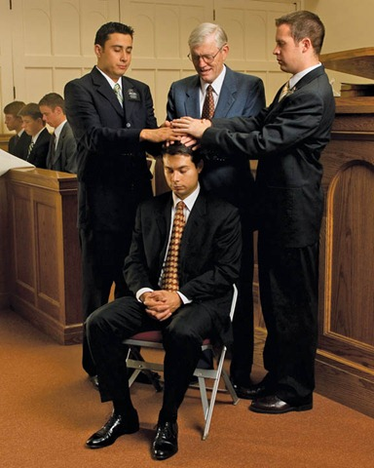
Chapter 13: The Priesthood

Slide 2
What Is the Priesthood?
The priesthood is the eternal power and authority of God. Through the priesthood He created and governs the heavens and the earth. By this power the universe is kept in perfect order. Through this power He accomplishes His work and glory, which is “to bring to pass the immortality and eternal life of man” (Moses 1:39).

Slide 3
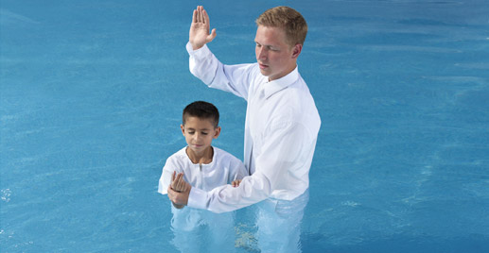
Why Do We Need the Priesthood on the Earth?
We must have priesthood authority to act in the name of God when performing the sacred ordinances of the gospel, such as baptism, confirmation, administration of the sacrament, and temple marriage.

Slide 4
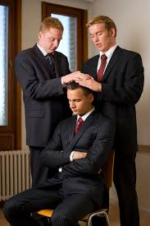
How Do Men Receive the Priesthood?
The Lord has prepared an orderly way for His priesthood to be given to His sons on the earth. A worthy male member of the Church receives the priesthood “by the laying on of hands by those who are in authority, to preach the Gospel and administer in the ordinances thereof” (Articles of Faith 1:5).

Slide 5
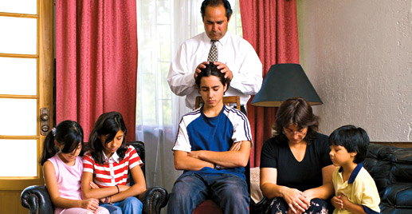
How Do Men Properly Use the Priesthood?
The priesthood should be used to bless the lives of our Heavenly Father’s children here on earth. Priesthood holders should preside in love and kindness. They should not force their families and others to obey them. The Lord has told us that the power of the priesthood cannot be controlled except in righteousness (see D&C 121:36).

Slide 6
What Blessings Come When We Use the Priesthood Properly?
The Lord has promised great blessings to righteous priesthood holders who use the priesthood to bless others.
The Holy Ghost shall be thy constant companion, and thy scepter an unchanging scepter of righteousness and truth; and thy dominion shall be an everlasting dominion, and without compulsory means it shall flow unto thee forever and ever” (D&C 121:45–46).

