Slide 1
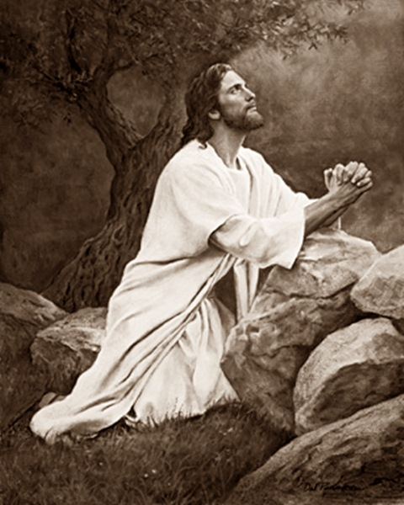
Chapter 12: The Atonement

Slide 2
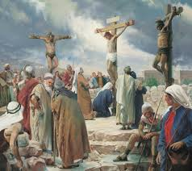
The Atonement Is Necessary for Our Salvation.
Jesus Christ “came into the world … to be crucified for the world, and to bear the sins of the world, and to sanctify the world, and to cleanse it from all unrighteousness; that through him all might be saved” (D&C 76:41–42). The great sacrifice He made to pay for our sins and overcome death is called the Atonement.

Slide 3
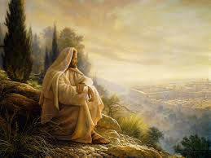
Jesus Christ Was the Only One Who Could Atone for Our Sins.
There are several reasons why Jesus Christ was the only person who could be our Savior. One reason is that Heavenly Father chose Him to be the Savior. He was the Only Begotten Son of God and thus had power over death.

Slide 4
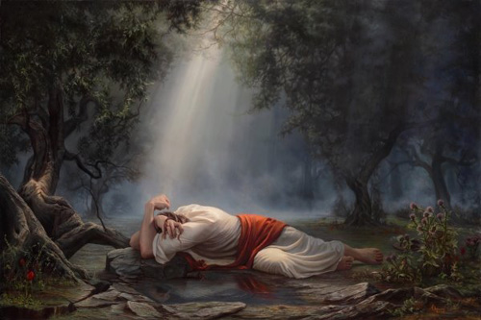
Christ Suffered and Died to Atone for Our Sins.
The Savior atoned for our sins by suffering in Gethsemane and by giving His life on the cross. It is impossible for us to fully understand how He suffered for all of our sins. In the Garden of Gethsemane, the weight of our sins caused Him to feel such agony that He bled from every pore (see D&C 19:18–19).

Slide 5
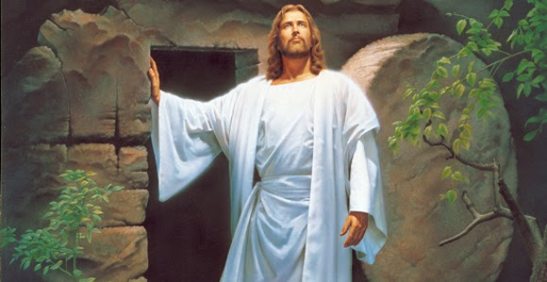
The Atonement and Resurrection Bring Resurrection to All.
On the third day after His Crucifixion, Christ took up His body again and became the first person to be resurrected. When His friends went to seek Him, the angels who guarded His tomb told them, “He is not here: for he is risen, as he said” (Matthew 28:6)

Slide 6
The Atonement Makes It Possible for Those Who Have Faith in Christ to Be Saved from Their Sins.
The Savior’s Atonement makes it possible for us to overcome spiritual death. Although all people will be resurrected, only those who accept the Atonement will be saved from spiritual death (see Articles of Faith 1:3).

