Slide 1
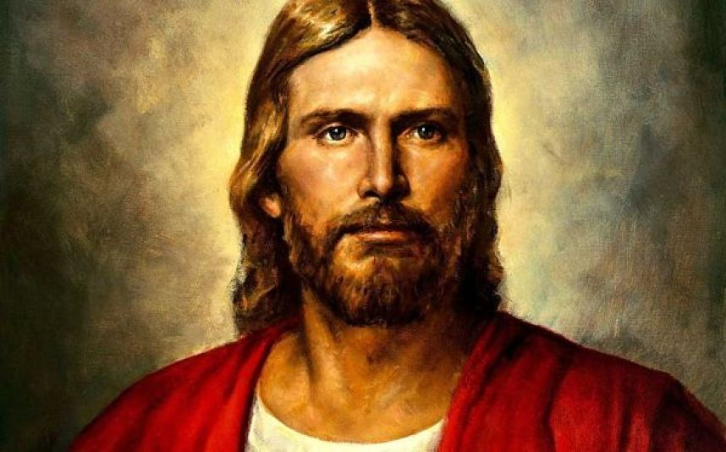
Chapter 11: The Life of Christ

Slide 2
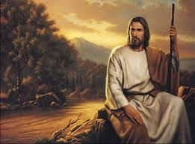
The Life of Christ Was Predicted Long before His Birth.
Every person who comes to earth depends on Jesus Christ to fulfill the promise He made in heaven to be our Savior. Without Him, the plan of salvation would have failed. Because His mission was necessary, all of the prophets from Adam to Christ testified that He would come (see Acts 10:43).

Slide 3
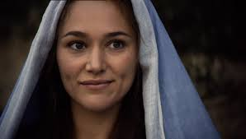
He Was the Only Begotten of the Father.
The story of the birth and life of the Savior is found in the New Testament in the books of Matthew, Mark, Luke, and John. From their accounts we learn that Jesus was born of a virgin named Mary.

Slide 4
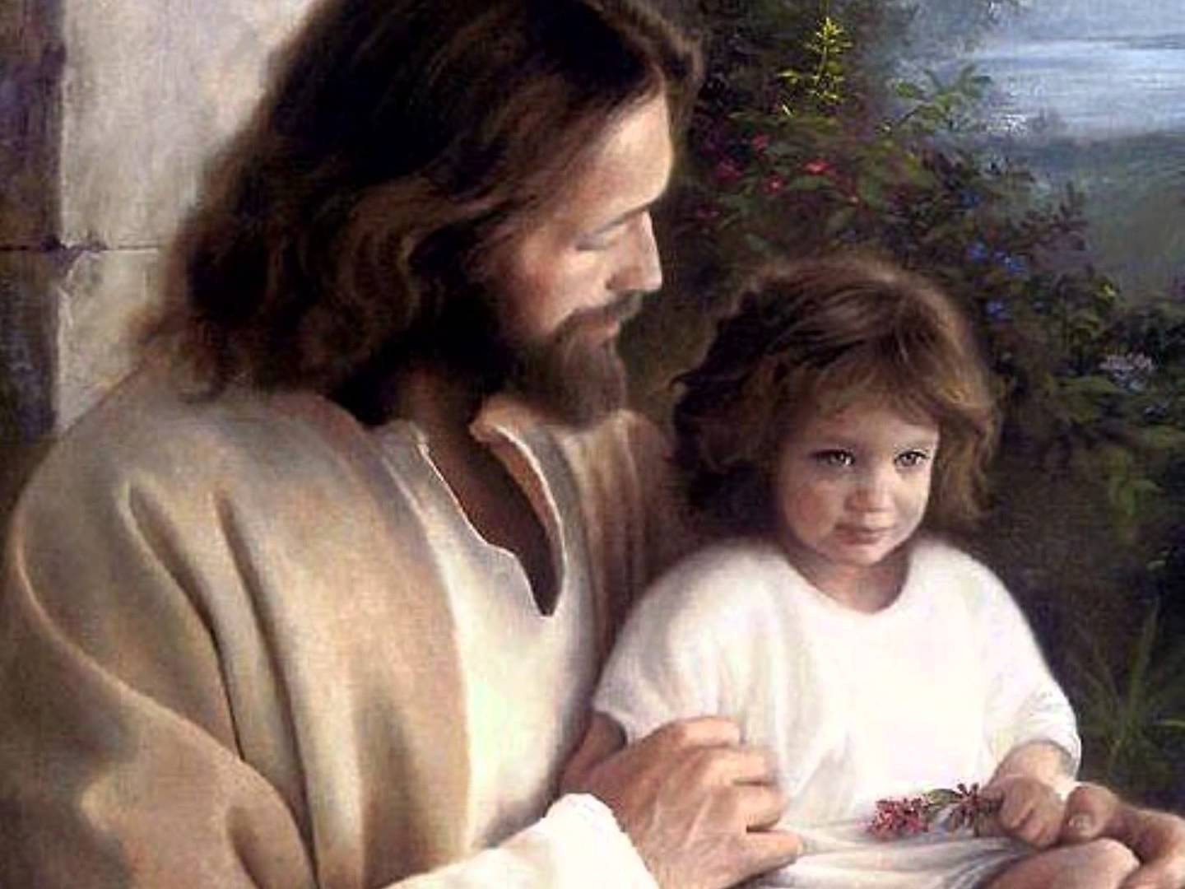
He Led a Perfect Life.
From His youth, Jesus obeyed all that was required of Him by our Heavenly Father. Under the guidance of Mary and Joseph, Jesus grew much as other children grow. He loved and obeyed the truth. Luke tells us, “And the child grew, and waxed strong in spirit, filled with wisdom: and the grace of God was upon him” (Luke 2:40; see also D&C 93:12–14).

Slide 5
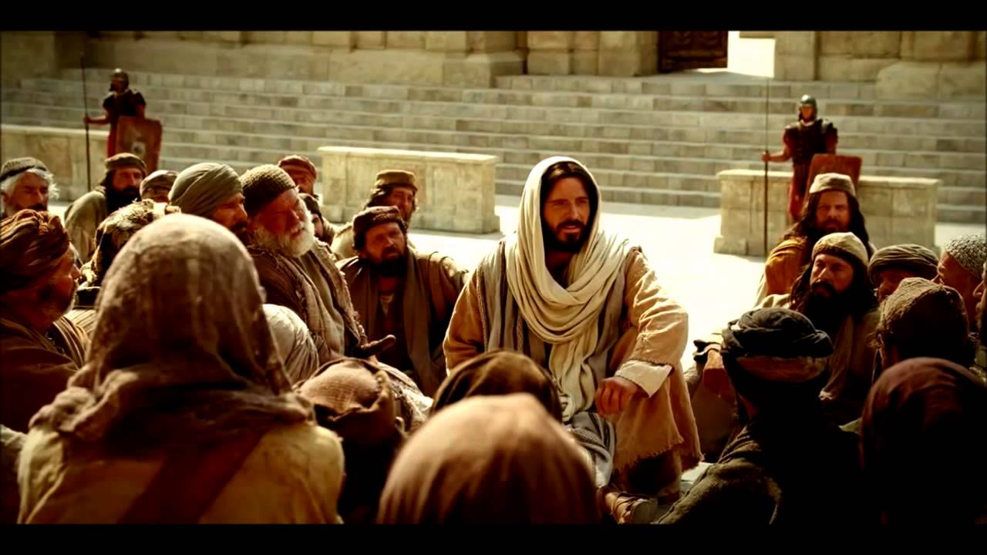
He Taught Us How to Love and Serve One Another
After His fast and His encounter with Satan, Jesus began His public ministry. He came to earth not only to die for us but also to teach us how to live. He taught that there are two great commandments: first, to love God with all our heart, mind, and strength; and second, to love others as we love ourselves (see Matthew 22:36–39).

Slide 6
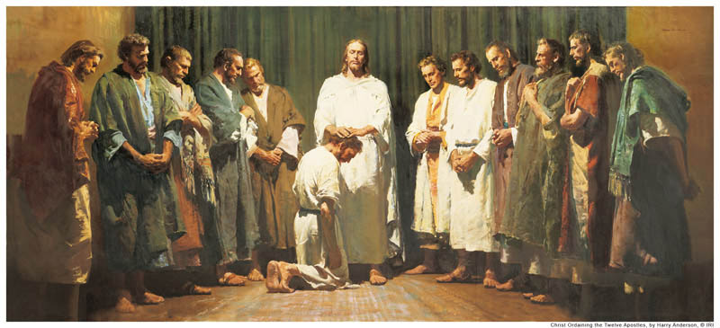
He Organized the Only True Church.
Jesus wanted His gospel taught to people all over the earth, so He chose twelve Apostles to testify of Him. They were the original leaders of His Church. They received the authority to act in His name and do the works they had seen Him do.

Slide 7
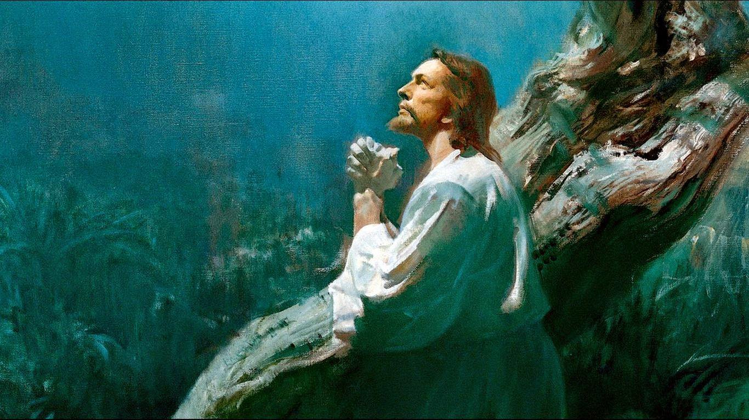
He Redeemed Us from Our Sins and Saved Us from Death.
Near the end of His mortal ministry, Jesus prepared to make the ultimate sacrifice for all the sins of mankind. He had been condemned to die because He had testified to the people that He was the Son of God.

Slide 8
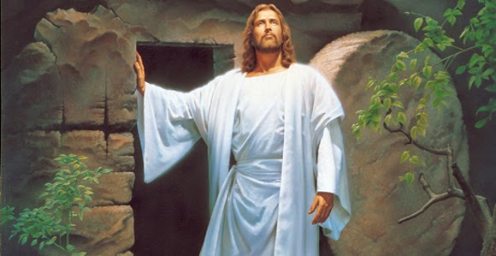
His Sacrifice Showed His Love for His Father and for Us.
Jesus taught: “Greater love hath no man than this, that a man lay down his life for his friends. Ye are my friends, if ye do whatsoever I command you” (John 15:13–14). He willingly and humbly went through the sorrow in Gethsemane and the suffering on the cross so we could receive all the blessings of the plan of salvation.

