Slide 1
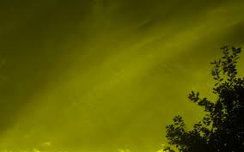
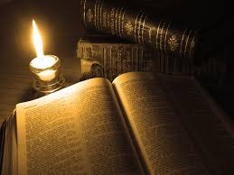
Chapter 10: Scriptures

Slide 2
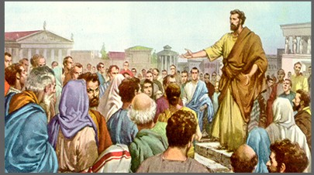
The Scriptures Are Available to Us Today
When the Lord’s servants speak or write under the influence of the Holy Ghost, their words become scripture (see D&C 68:4).

Slide 3
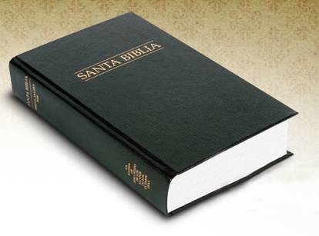
The Bible
The Bible is a collection of sacred writings containing God’s revelations to man. These writings cover many centuries, from the time of Adam through the time when the Apostles of Jesus Christ lived.

Slide 4
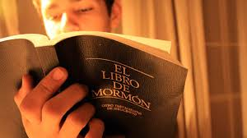
The Book of Mormon
The Book of Mormon is a sacred record of some of the people who lived on the American continents between about 2000 B.C. and A.D. 400. It contains the fulness of the gospel of Jesus Christ (see D&C 20:9; 42:12; 135:3).

Slide 5
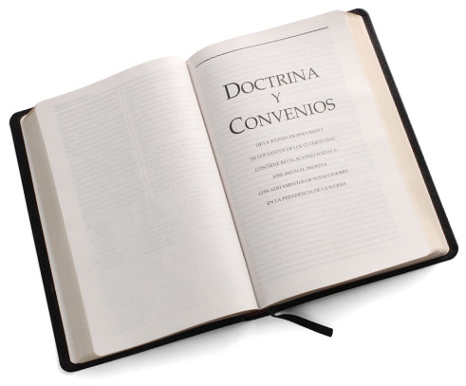
The Doctrine and Covenants
The Doctrine and Covenants is a collection of modern revelations. In section 1 of the Doctrine and Covenants, the Lord reveals that the book is published to the inhabitants of the earth to prepare them for His coming.

Slide 6
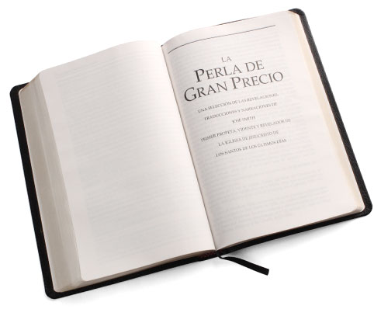
The Pearl of Great Price
The Pearl of Great Price contains the book of Moses, the book of Abraham, and some inspired writings of Joseph Smith. The book of Abraham was translated by the Prophet Joseph Smith from a papyrus scroll taken from the Egyptian catacombs.

Slide 7
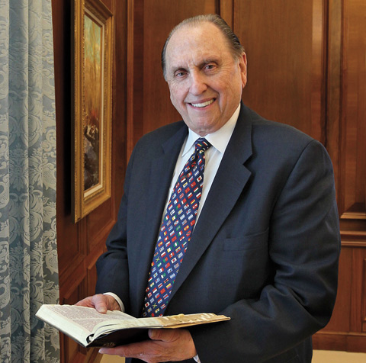
Words of Our Living Prophets
In addition to these four books of scripture, the inspired words of our living prophets become scripture to us. Their words come to us through conferences, the Liahona or Ensign magazine, and instructions to local priesthood leaders.

Slide 8
Studying the Scriptures
What blessings can we receive when we study the scriptures?
We should each study the scriptures every day. We should share these truths with our children. We should read the standard works with our children so they will learn to love them and use them for the truths they contain.

