Slide 1
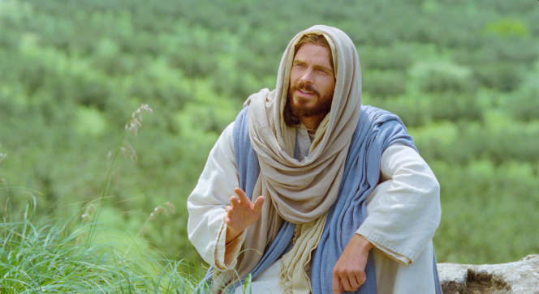
Chapter 2: “My Peace I Give unto You”
“Peace can come to an individual only by an unconditional surrender—surrender to him who is the Prince of peace, who has the power to confer peace.”

Slide 2
From the Life of Howard W. Hunter
One of President Howard W. Hunter’s associates in the Quorum of the Twelve described him as a man of “extraordinary patience that comes from great inner peace.”1 President Hunter spoke often about inner peace, teaching that a person can receive it only by turning to God—by trusting Him, exercising faith, and striving to do His will. Such peace helped sustain him through many difficult times.

Slide 3
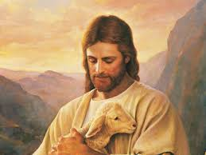
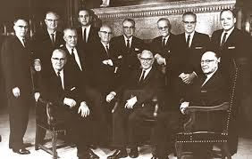
“Peace can come to an individual only by an unconditional surrender—surrender to him who is the Prince of peace, who has the power to confer peace.

Slide 4
Jesus Christ is our source of true peace.
In foretelling the birth of Christ more than 700 years before it occurred, the prophet Isaiah used titles expressing great admiration. … One of these titles that is of particular interest in our present world is “Prince of Peace” (Isa. 9:6). “Of the increase of his government and peace there shall be no end,” Isaiah declared (v. 7). What a thrilling hope for a war-weary, sin-laden world!4The peace for which the world longs is a time of suspended hostilities; but men do not realize that peace is a state of existence that comes to man only upon the terms and conditions set by God, and in no other way.

Slide 5
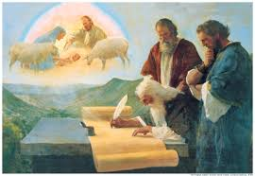
Isa. 26:3 , John 14:27, John16:36,

Slide 6
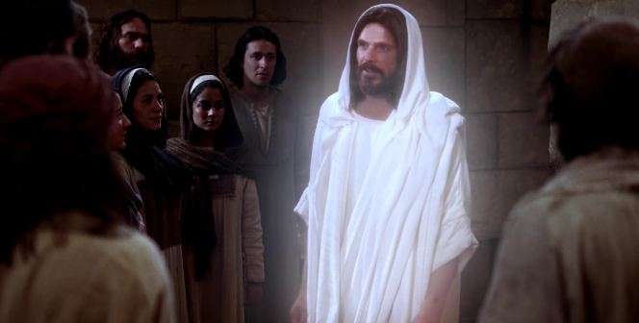
We cultivate peace as we live the principles of the gospel.
There is but one guiding hand in the universe, only one truly infallible light, one unfailing beacon to the world. That light is Jesus Christ, the light and life of the world, the light which one Book of Mormon prophet described as “a light that is endless, that can never be darkened.” (Mosiah 16:9.)
“I am the way, the truth, and the life.” (John 14:6.) …

Slide 7
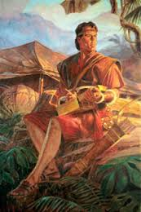
“Love your enemies, bless them that curse you, do good to them that hate you, and pray for them which despitefully use you, and persecute you.” (Matt. 5:44.)
“My beloved brethren,” continued Nephi, “this is the way; and there is none other way.” (2 Nephi 31:20–21.)

Slide 8
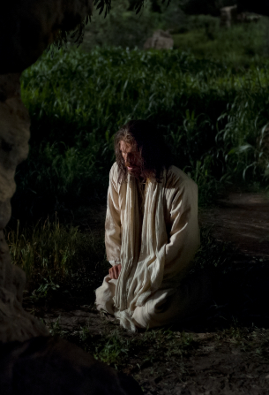
The Savior can help us find peace regardless of the turmoil around us.
Jesus was not spared grief and pain and anguish and buffeting. No tongue can speak the unutterable burden he carried, nor have we the wisdom to understand the prophet Isaiah’s description of him as “a man of sorrows.”

