Slide 1
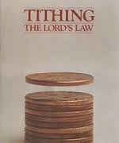
Chapter 9: The Law of Tithing
“A testimony of the law of tithing comes from living it.”

Slide 2
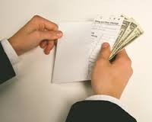
From the Life of Howard W. Hunter
Shortly before Howard W. Hunter and Claire Jeffs were to be married, Howard went to his bishop to obtain a temple recommend. He was surprised that during the interview, the bishop questioned whether he could support a wife and family on his income. Howard recalled, “When I told him how much I was making, he said the reason for his doubt as to my ability to support a wife was based on the amount of tithing I had paid.”

Slide 3
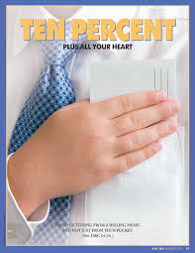
“The payment of tithing strengthens faith, increases spirituality and spiritual capacity, and solidifies testimony.”

Slide 4
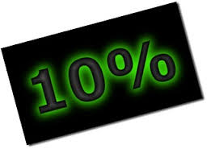
The Lord’s definition of the law of tithing is simple.
The law [of tithing] is simply stated as “one-tenth of all their interest” (D&C 119:4). Interest means profit, compensation, increase. It is the wage of one employed, the profit from the operation of a business, the increase of one who grows or produces, or the income to a person from any other source. The Lord said it is a standing law “forever” as it has been in the past.

Slide 5
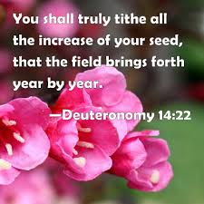

Slide 6
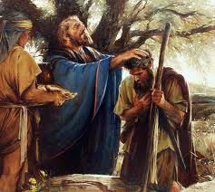
The law of tithing existed from the beginning and continues today.
The first distinct mention of the word “tithe” in the Bible is in the very first book of the Old Testament. Abram … was met by Melchizedek, king of Salem and priest of the Most High God. Melchizedek blessed him, and Abram “gave him tithes of all.” (Gen. 14:20.)

Slide 7
We make a gift and also pay an obligation with our tithes.
The tithe is God’s law for his children, yet the payment is entirely voluntary. In this respect it does not differ from the law of the Sabbath or from any other of his laws. We may refuse to obey any or all of them. Our obedience is voluntary, but our refusal to pay does not abrogate or repeal the law.

Slide 8
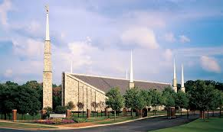
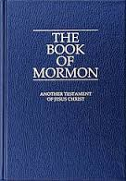
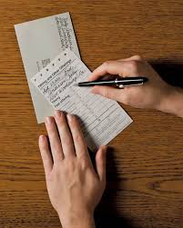
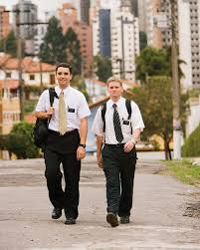

Slide 9
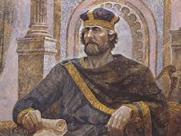
An offering to the Lord should cost the giver something of value.
In 2 Samuel 24:18–25 we read that David would not make an offering unto the Lord of that which cost him nothing. He no doubt reasoned that unless the gift cost the giver something of value, it was not fit or appropriate to be an offering for the Lord.

Slide 10
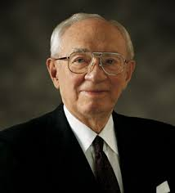
Paying tithing brings great blessings.
President Gordon B. Hinckley said: The Lord gave the law [of tithing]. If we follow his law, we prosper, but when we find what we think is a better way, we meet failure. As I travel about the Church and see the results of the payment of tithes, I come to the conclusion that it is not a burden, but a great blessing.

