Slide 1
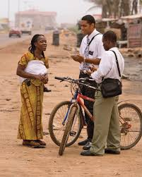
Chapter 8: Taking the Gospel to All the World
“We are in the work of saving souls, of inviting people to come unto Christ.”

Slide 2
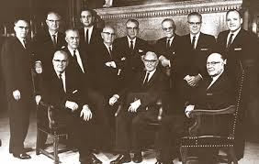
From the Life of Howard W. Hunter
n 1979, Elder Howard W. Hunter, then a member of the Quorum of the Twelve Apostles, said: “I fully believe that in the near future we will see some of the greatest advancements in spreading the gospel to all nations that have ever taken place in this dispensation or any previous dispensation. I am sure that we will be able to look back in retrospect … and record as Luke did, ‘And the word of God increased’ (Acts 6:7).”1

Slide 3
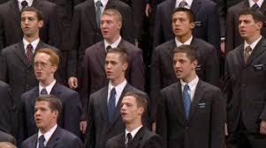
He restored gospel is for all people, based on the conviction that all are children of the same God.
The gospel of Jesus Christ, which gospel we teach and the ordinances of which we perform, is a global faith with an all-embracing message. It is neither confined nor partial nor subject to history or fashion. Its essence is universally and eternally true. Its message is for all the world, restored in these latter days to meet the fundamental needs of every nation, kindred, tongue, and people on the earth. It has been established again as it was in the beginning—to build brotherhood, to preserve truth, and to save souls

Slide 4
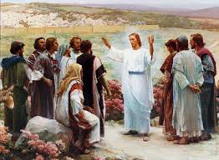
The Church has a mission to teach the gospel to all nations.
The Church, being the kingdom of God on earth, has a mission to all nations. “Go ye therefore, and teach all nations, baptizing them in the name of the Father, and of the Son, and of the Holy Ghost

Slide 5
Teaching them to observe all things whatsoever I have commanded you” (Matt. 28:19–20). These words from the lips of the Master know no national boundaries; they are not limited to any race or culture. One nation is not favored above another. The admonition is clear—“teach all nations.”

Slide 6
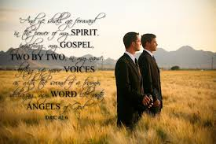
“We are in the work of saving souls.”

Slide 7
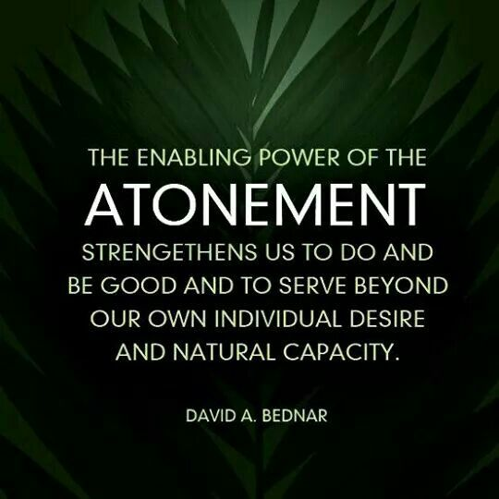
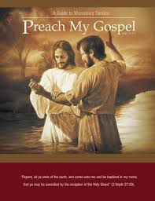
Those who have experienced the blessings of the Atonement of Jesus Christ are under obligation to bear testimony of Him.
What does the Atonement have to do with missionary work? Any time we experience the blessings of the Atonement in our lives, we cannot help but have a concern for the welfare of [others].

Slide 8
Examples abound in the Book of Mormon that illustrate this principle. When Lehi partook of the fruit of the tree, symbolic of partaking of the Atonement, he said, “I began to be desirous that my family should partake” (1 Nephi 8:12). When Enos experienced his conversion and received a forgiveness of his sins, because of his faith in Jesus Christ he said, “I began to feel a desire for the welfare of my brethren, the Nephites” (Enos 1:9). Then he prayed for the Lamanites, the implacable enemies to the Nephites. Then there is the example of the four sons of Mosiah—Ammon, Aaron, Omner, and Himni—who received a forgiveness of sins through the Atonement and then labored for years among the Lamanites to bring them to Christ.

Slide 9
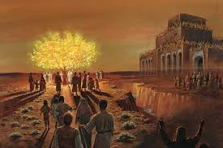
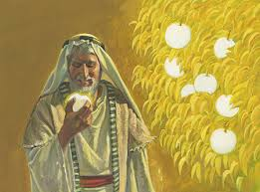
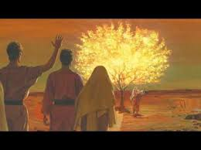

Slide 10
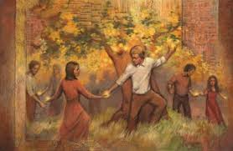

Slide 11
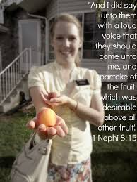
1 Nephi 8:12

