Slide 1
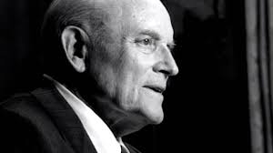
Chapter 7: Continuous Revelation through Living Prophets
“We are guided by a living prophet of God—one who receives revelation from the Lord.”

Slide 2
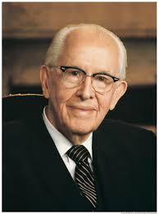
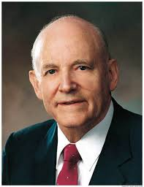
From the Life of Howard W. Hunter
After being sustained as President of the Church in the October 1994 general conference, Howard W. Hunter expressed his feelings about his sacred responsibilities: “My beloved brothers and sisters, thank you for your sustaining vote. I come before you humbly and meekly, saddened by the recent passing of our beloved prophet, President Ezra Taft Benson. My heart is tender upon the passing of my dear friend, particularly in light of the new responsibilities that have come to me.

Slide 3
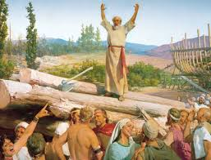
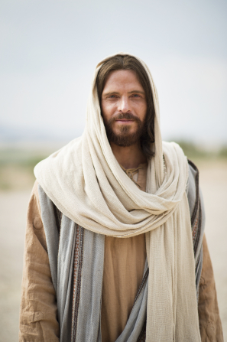
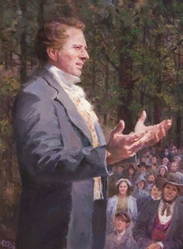
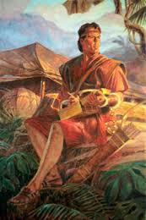
In each dispensation, God has raised up prophets as His spokesmen.
As one turns the pages of the Old Testament, there appear the writings of great men of ages past who are referred to as the prophets. The books of the New Testament contain, among other things, the writings, teachings, and history of men of a later dispensation, who have been designated as prophets. We also have the record of the prophets of the western part of the world, who raised their voices, proclaiming the word of the Lord, protesting unrighteousness, and teaching the principles of the gospel. All of these have left their witness.

Slide 4
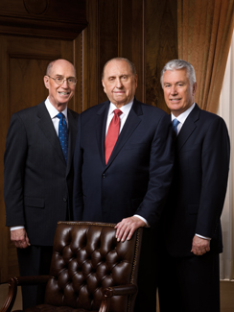
God provides guidance for His children through a living prophet today.
A distinctive sign of the last days that will precede the eventual second coming of the Lord was seen in vision by that same Apostle who recorded the book of Revelation. He said: “I saw another angel fly in the midst of heaven, having the everlasting gospel to preach unto them that dwell on the earth, and to every nation, and kindred, and tongue, and people.” (Rev. 14:6.)

Slide 5
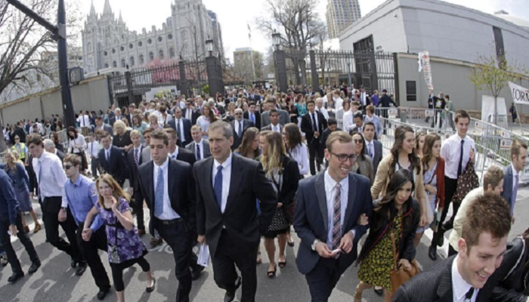
In this day of spiritual famine, we can find spiritual abundance by heeding the voice of the prophet.
Famine was one of the common scourges of Old Testament times, and people understood the devastating consequences of crop failure and starving people. Amos brought this understanding into sharp focus by his prediction of a spiritual famine. He said: “… not a famine of bread, nor a thirst for water, but of hearing the words of the Lord” [Amos 8:11].

Slide 6
If we follow the teachings of the living prophets, we will not go amiss.
To peoples of past dispensations and ages, the most important prophet was the one then living, teaching, and revealing the will of the Lord in their time. In each of the past dispensations, prophets have been raised up by the Lord as his spokesmen to the people of that particular age and for the specific problems of that age.

Slide 7
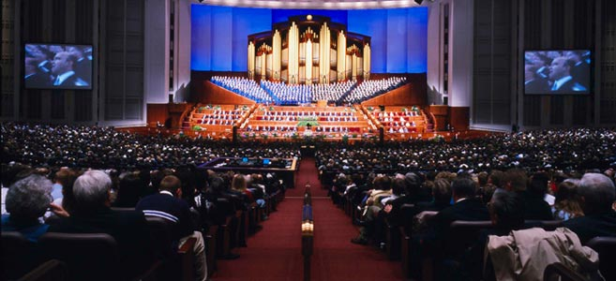
In general conference, we receive inspired counsel from prophets, seers, and revelators.
As I have pondered the messages of [general] conference, I have asked myself this question: How can I help others partake of the goodness and blessings of our Heavenly Father? The answer lies in following the direction received from those we sustain as prophets, seers, and revelators, and others of the General Authorities. Let us study their words, spoken under the Spirit of inspiration, and refer to them often. The Lord has revealed his will to the Saints in this conference.

