Slide 1
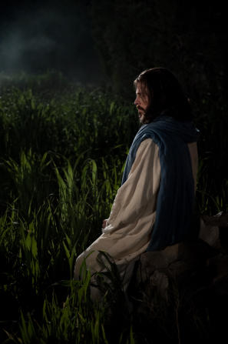
Chapter 6: The Atonement and Resurrection of Jesus Christ
“We shall rise from mortal death to have life everlasting, because of the atoning sacrifice and resurrection of the Savior.”

Slide 2
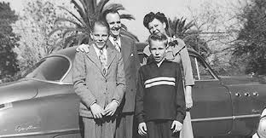
From the Life of Howard W. Hunter
On March 20, 1934, Howard and Claire Hunter’s first child was born, a son they named Howard William Hunter Jr. and called Billy. During the summer they noticed that Billy seemed lethargic. Doctors diagnosed him with anemia, and Howard twice gave blood for transfusions, but Billy’s condition did not improve. Further tests revealed a severe intestinal problem that was causing Billy to lose blood. Doctors performed surgery, with Howard lying beside his son to give blood, but the results were not encouraging. Three days later, on October 11, 1934, little Billy died quietly as his parents sat beside his bed. “We were grief-stricken and numb as we left the hospital into the night,” Howard wrote.

Slide 3
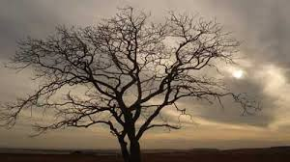
Through the experiences of Billy’s death and the deaths of other loved ones, President Hunter was sustained by his testimony of the Savior’s Atonement and Resurrection. “It is our firm belief that [the Atonement] is a reality,” he testified, “and nothing is more important in the entire divine plan of salvation than the atoning sacrifice of Jesus Christ. We believe that salvation comes because of the atonement. In its absence the whole plan of creation would come to naught. … Without this atoning sacrifice, temporal death would be the end, and there would be no resurrection and no purpose in our spiritual lives. There would be no hope of eternal life.”

Slide 4
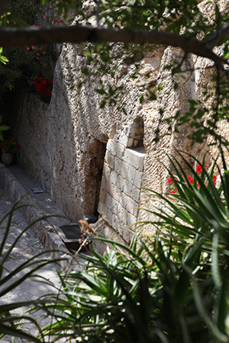
“In the glorious dawn of Easter morning, when the thoughts of the Christian world are turned to the resurrection of Jesus for a few fleeting moments, let us express appreciation to our Heavenly Father for the great plan of salvation that has been provided for us.”

Slide 5
The Atonement was a supreme act of love by our Heavenly Father and His Beloved Son, Jesus Christ.
The Atonement of Jesus Christ was a foreordained assignment by our Heavenly Father to redeem his children after their fallen state. It was an act of love by our Heavenly Father to permit his Only Begotten to make an atoning sacrifice. And it was a supreme act of love by his beloved Son to carry out the Atonement.

Slide 7
The Savior took upon Himself all of our sins, infirmities, grief, and pain.
As they met to celebrate the Passover, Jesus and his Apostles partook of the sacramental emblems that he initiated in this last supper together, and then walked to the Mount of Olives.Always the teacher to the very end, he continued his discourse on the theme of the sacrificial lamb. He told them he would be smitten, and that they would be scattered as sheep without a shepherd (see Matthew 26:31). “But after I am risen again,” he said, “I will go before you into Galilee” (Matthew 26:32).

Slide 9
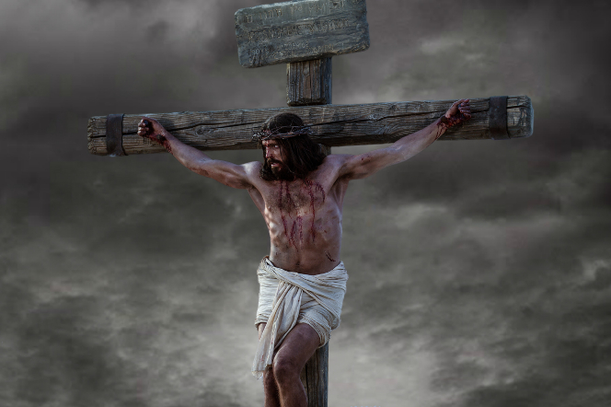
Jesus Christ arose from the grave and was the firstfruits of the Resurrection.
Go with me back in time to those final scenes in the Holy Land. The end of our Lord’s mortal life was near. He had healed the sick, raised the dead, and expounded the scriptures, including those prophecies of his own death and resurrection.

Slide 10
He said to his disciples:“Behold, we go up to Jerusalem; and the Son of man shall be betrayed unto the chief priests and unto the scribes, and they shall condemn him to death, “And shall deliver him to the Gentiles to mock, and to scourge, and to crucify him: and the third day he shall rise again” (Matthew 20:18–19).

Slide 11
As the dawn of that third day was beginning, Mary Magdalene and “the other Mary” had come to the sepulchre in which his lifeless body had been laid [Matthew 28:1; see also Mark 16:1; Luke 24:10]. Earlier, the chief priests and the Pharisees had gone to Pilate and persuaded him to place a guard at the door of the sepulchre, “lest his disciples come by night, and steal him away, and say unto the people, He is risen from the dead” (Matthew 27:64). But two mighty angels had rolled the stone from the door of the tomb, and the would-be guards had fled in terror at the sight.

Slide 13
Jesus appeared to many after His Resurrection.
In the days that followed his resurrection, the Lord appeared unto many. He displayed his five special wounds to them. He walked and talked and ate with them, as if to prove beyond a doubt that a resurrected body is indeed a physical body of tangible flesh and bones. Later he ministered to the Nephites, whom he commanded to “arise and come forth unto me, that ye may thrust your hands into my side, and also that ye may feel the prints of the nails in my hands and in my feet, that ye may know that I am the God of Israel, and the God of the whole earth, and have been slain for the sins of the world.

Slide 15
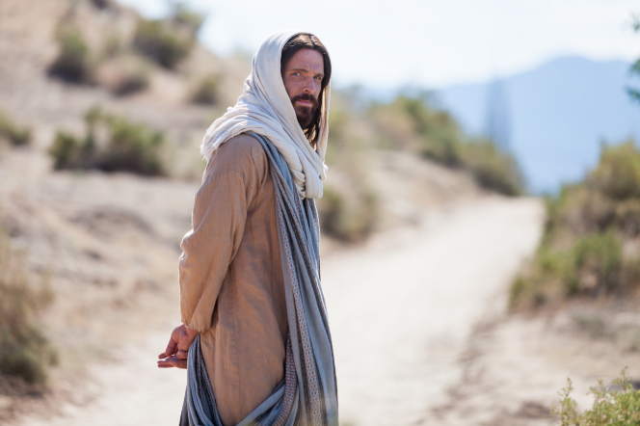
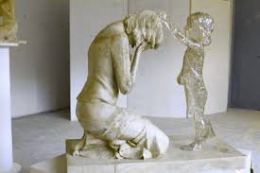
We shall rise from death and have life everlasting.
It was Job who posed what might be called the question of the ages: “If a man die, shall he live again?” (Job 14:14.) Christ’s answer rings down through time to this very hour: “Because I live, ye shall live also.” (John 14:19.)

