Slide 1
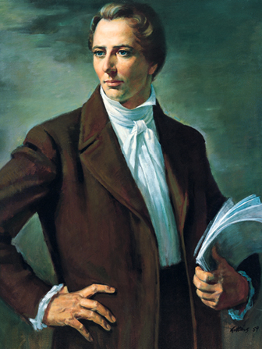
Chapter 5: Joseph Smith, Prophet of the Restoration
“I bear solemn testimony of the Prophet Joseph Smith as the Lord’s anointed servant in these the latter days.”

Slide 2
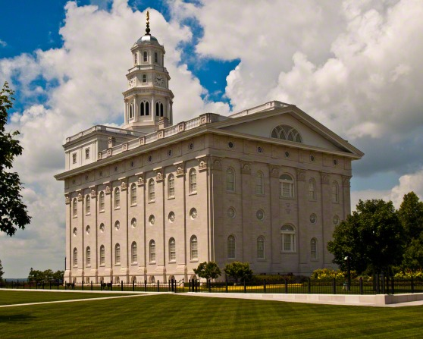
From the Life and Teachings of Howard W. Hunter
In a meeting held at the Nauvoo Temple site, President Hunter said:“The responsibility I feel for the work the Prophet Joseph inaugurated fills me with a determination to do all I can in the time and season allotted to me. Surely Joseph was faithful and true to his time and season! … I bear solemn testimony of the Prophet Joseph Smith as the Lord’s anointed servant in these the latter days. To his testimony of the divinity and reality of Jesus Christ I add my own.”

Slide 3
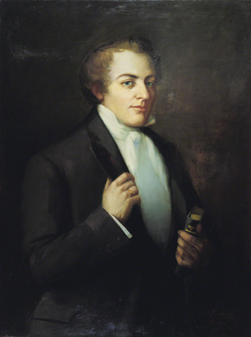
“Joseph Smith was not only a great man, but he was an inspired servant of the Lord, a prophet of God.”

Slide 4
God the Father and Jesus Christ appeared to Joseph Smith to initiate the Restoration.
Many times the gospel [has] been given to the world through the prophets, and each time [it has been] lost because of disobedience. In the year 1820 the silence was broken, and the Lord again appeared to a prophet. This prophet, Joseph Smith, could testify of his own positive knowledge that God lives, that Jesus is the Christ, the Son of God, a Resurrected Being, separate and distinct from the Father. He did not testify as to what he believed or what he or others thought or conjectured, but of what he knew. This knowledge came to him because God the Father and the Son appeared to him in person and spoke to him.

Slide 5
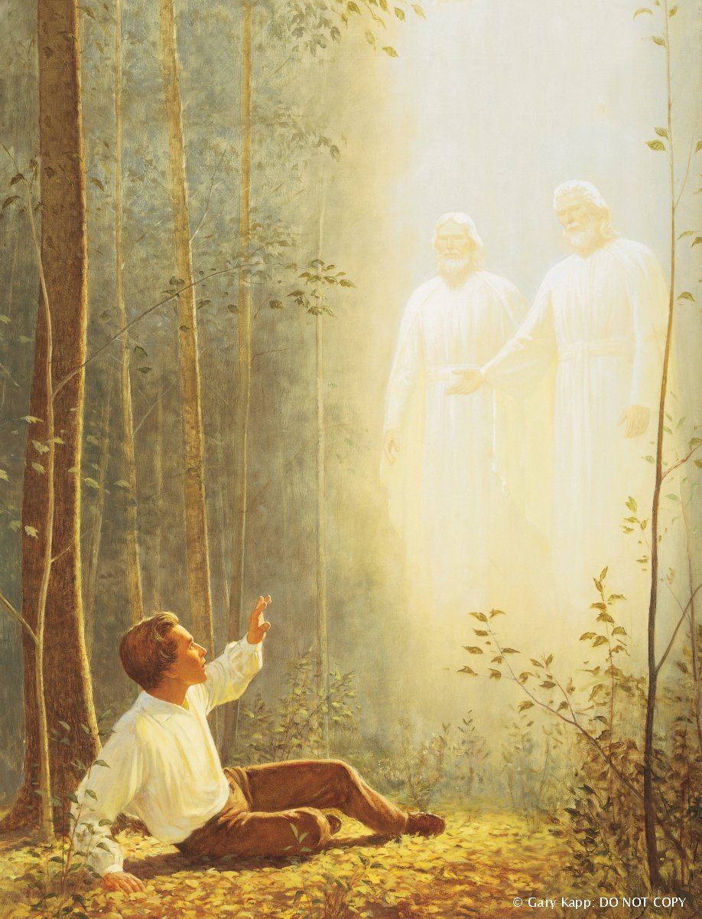

Slide 6
Jesus Christ reestablished His Church through the Prophet Joseph Smith.
On the sixth of April, 1830, … a group of men and women, acting in obedience to a commandment of God, assembled in the house of Mr. Peter Whitmer [Sr.] to organize The Church of Jesus Christ of Latter-day Saints. … None of them laid any claim to special learning or significant leadership. They were honorable people and respectable citizens, but were virtually unknown outside of their own immediate neighborhood. …

Slide 7
Through [Joseph Smith] and by subsequent events, the priesthood and the gospel in its fulness were once more restored to the earth, never again to be removed [see D&C 65:2]. The Church of Christ, the kingdom of God on earth, was reestablished and destined, according to scripture, to roll forth and fill the whole earth [see Daniel 2:35].

Slide 8
Joseph Smith was a prophet, seer, and revelator.
The terms “Prophet” and “Seer” and “Revelator” are often used interchangeably and are thought by many to be one and the same thing. They are not the same, however, and these three terms have separate and distinct meanings.

Slide 9
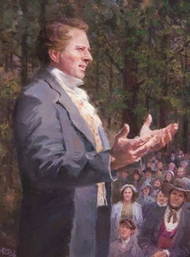
A seer is one who sees. This does not mean that he sees through his natural eyes but rather through spiritual eyes. The seeric gift is a supernatural endowment. Joseph was like unto Moses, the ancient seer, and Moses.
A revelation makes known something unknown or which has been previously known by man and taken from his memory. Always the revelation deals with truth, and always it comes with the divine stamp of approval. saw God face to face

Slide 10
Praise to the man who communed with Jehovah.
We praise Joseph for enduring bitter and repeated betrayals and disappointments. Thus, he went to Carthage “like a lamb to the slaughter,” “calm as a summer’s morning,” and “void of offense towards … all men” (D&C 135:4). He did not go to Carthage bitterly. He did not go to Carthage complainingly. What a marvelous capacity to endure well!Joseph knew which way he faced. It was toward the Savior Jesus Christ to whom he listened ever since our Heavenly Father first instructed young Joseph, saying, “This is My Beloved Son. Hear Him!” [Joseph Smith—History 1:17].13

Slide 12
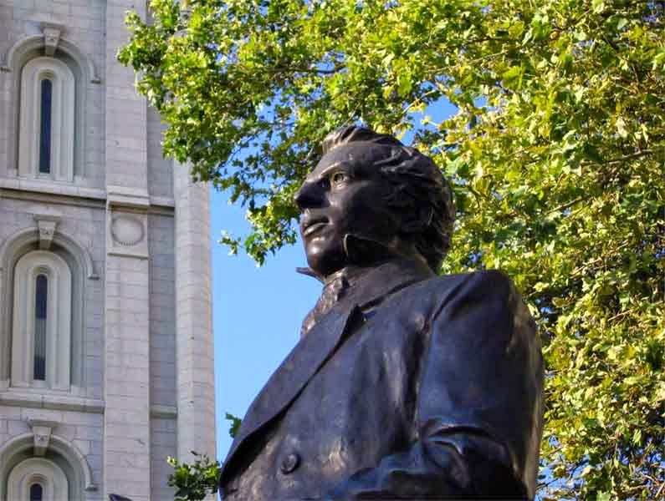
The life and mission of the Prophet Joseph Smith help us turn to the paths that lead to eternal life.
Now we look into his life and into his works. Many have pried into them to find the mystery of it all behind the written word, but there is no mystery. … There was a simple faith, the faith of a young boy who was to be trained in the things that pertained to God. And as time went by, this young man, without scholarly achievements and without education, was educated by the Lord for the things which should come.

