Slide 1
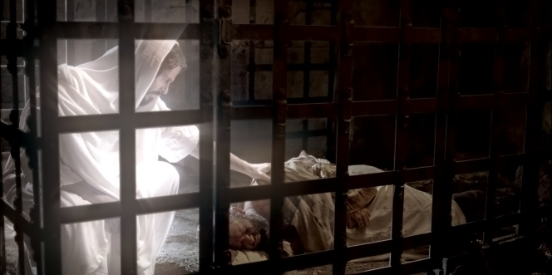
Chapter 4: Help from on High
“Perhaps no promise in life is more reassuring than that promise of divine assistance and spiritual guidance in times of need.”

Slide 2
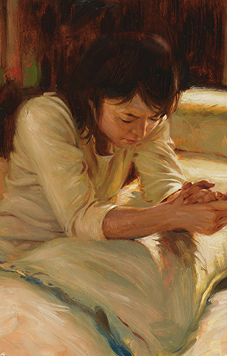
From the Life of Howard W. Hunter
Howard W. Hunter learned to pray when he was a young boy. “My mother had taught me to pray and to thank Heavenly Father for all the things that I enjoyed,” he said. “I often thanked Him for the beauty of the earth and for the wonderful times that I had at the ranch and by the river and with the Scouts. I also learned to ask Him for the things that I wanted or needed. … I knew that God loved me and listened to me.”
“The Lord promised that if we would be humble in … times of need and turn to him for aid, we would ‘be made strong, and [be] blessed from on high’” (D&C 1:28).

Slide 3
Our Heavenly Father promises to give us assistance and guidance in times of need.
We all have moments when we are overwhelmed by circumstances or confused by the counsel we get from others, and we feel a great need to receive spiritual guidance, a great need to find the right path and do the right thing. In the scriptural preface to this latter-day dispensation, the Lord promised that if we would be humble in such times of need and turn to him for aid, we would “be made strong, and [be] blessed from on high, and receive knowledge from time to time.” (D&C 1:28.)

Slide 4
That help is ours if we will but seek it, trust in it, and follow what King Benjamin, in the Book of Mormon, called “the enticings of the Holy Spirit.” (Mosiah 3:19.)

Slide 5
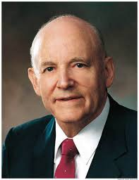
I testify of the divinity of Jesus Christ. God does live and imparts to us his Spirit. In facing life’s problems and meeting life’s tasks, may we all claim that gift from God, our Father, and find spiritual joy.

Slide 6
Like Joseph Smith, we can turn to the scriptures and prayer to be taught from on high.
The boy-prophet Joseph Smith … sought to know the mind and will of the Lord at a time of confusion and concern in his life. … The area near Palmyra, New York, had become a place of “unusual excitement on the subject of religion” during young Joseph’s boyhood years there. Indeed, the entire district appeared to him to be affected by it, with “great multitudes,” he wrote, uniting themselves to the different religious parties and causing no small “stir and division” among the people

Slide 7
“During this time of great excitement my mind was called up to serious reflection and great uneasiness; but though my feelings were deep and often poignant, still I kept myself aloof from all these [factions] … ; so great were the confusion and strife among the different denominations, that it was impossible for a person young as I was, and so unacquainted with men and things, to come to any certain conclusion who was right and who was wrong.
“My mind at times was greatly excited, the cry and tumult were so great and incessant. …

Slide 8
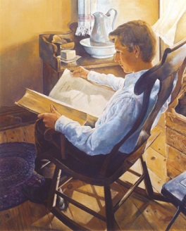
“While I was laboring under the extreme difficulties caused by the contests of these parties of religionists, I was one day reading the Epistle of James, first chapter and fifth verse, which reads: If any of you lack wisdom, let him ask of God, that giveth to all men liberally, and upbraideth not; and it shall be given him.
“Never did any passage of scripture come with more power to the heart of man than this did at this time to mine. It seemed to enter with great force into every feeling of my heart. I reflected on it again and again, knowing that if any person needed wisdom from God, I did; for how to act I did not know, and unless I could get more wisdom than I then had, I would never know”

Slide 9
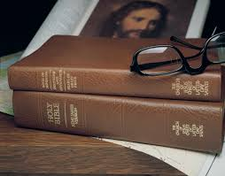
How remarkable … that this lad would turn profoundly to the scriptures and then to private prayer, perhaps the two greatest sources of spiritual insight and spiritual impression that are available universally to mankind. Certainly he was torn by differing opinions, but he was determined to do the right thing and determined to find the right way. He believed, as you and I must believe, that he could be taught and blessed from on high, as he was.

Slide 10
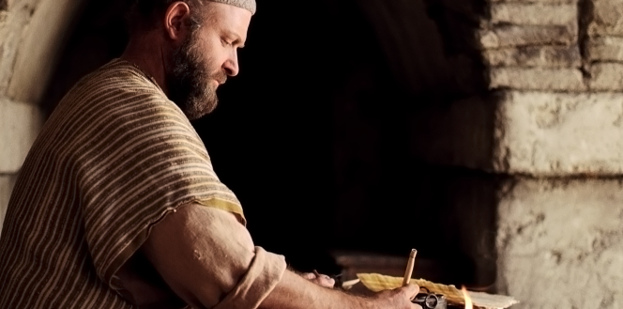
Prayer is one way to receive spiritual knowledge and guidance.
The learning and wisdom of the earth and all that is temporal comes to us through our physical senses in earthly, temporal ways. We touch, we see, we hear and taste and smell and learn. However, spiritual knowledge, as Paul has said, comes to us in a spiritual way from its spiritual source. Paul continues:
“But the natural man receiveth not the things of the Spirit of God: for they are foolishness unto him: neither can he know them, because they are spiritually discerned.”

Slide 11
We can pray always, not just in desperate times.
If prayer is only a spasmodic cry at the time of crisis, then it is utterly selfish, and we come to think of God as a repairman or a service agency to help us only in our emergencies. We should remember the Most High day and night—always—not only at times when all other assistance has failed and we desperately need help. If there is any element in human life on which we have a record of miraculous success and inestimable worth to the human soul, it is prayerful, reverential, devout communication with our Heavenly Father.

Slide 12
“Give ear to my words, O Lord, consider my meditation,” the Psalmist sang.
“Hearken unto the voice of my cry, my King, and my God: for unto thee will I pray.
“My voice shalt thou hear in the morning, O Lord; in the morning will I direct my prayer unto thee, and will look up.” (Ps. 5:1–3.)

Slide 13
We develop our ability to receive spiritual knowledge as we take time to meditate, ponder, and pray.
Developing spirituality and attuning ourselves to the highest influences of godliness is not an easy matter. It takes time and frequently involves a struggle. It will not happen by chance, but is accomplished only through deliberate effort and by calling upon God and keeping his commandments. …

Slide 15
God will help us progress spiritually one step at a time.
None of us has attained perfection or the zenith of spiritual growth that is possible in mortality. Every person can and must make spiritual progress. The gospel of Jesus Christ is the divine plan for that spiritual growth eternally. It is more than a code of ethics. It is more than an ideal social order. It is more than positive thinking about self-improvement and determination. The gospel is the saving power of the Lord Jesus Christ with his priesthood and sustenance and with the Holy Spirit. With faith in the Lord Jesus Christ and obedience to his gospel, a step at a time improving as we go, pleading for strength, improving our attitudes and our ambitions, we will find ourselves successfully in the fold of the Good Shepherd. That will require discipline and training and exertion and strength. But as the Apostle Paul said, “I can do all things through Christ which strengtheneth me.” (Philip. 4:13.)

