Slide 1
Chapter 3: Adversity—Part of God’s Plan for Our Eternal Progress
“When [the difficulties of mortality] humble us and refine us and teach us and bless us, they can be powerful instruments in the hands of God to make us better people.”

Slide 2
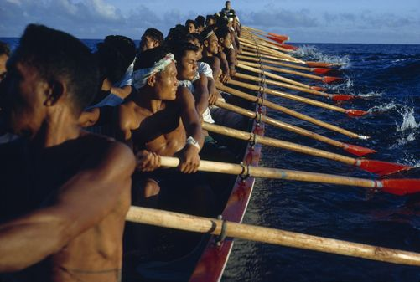
From the Life of Howard W. Hunter
Elder Hunter used the boat race in Samoa to introduce a talk about the purposes of adversity. During his ministry as an Apostle, he spoke about adversity many times, offering counsel, hope, and encouragement. He spoke from personal experience, having endured life-threatening illnesses and other trials. He testified with firm conviction that in times of trouble, “Jesus Christ possesses the power to ease our burdens and lighten our loads.”

Slide 3
In our trials, the Savior extends to each of us the invitation He extended to the man at the pool of Bethesda: “Wilt thou be made whole?”
John 5:6

Slide 4
Adversity is part of God’s plan for our eternal progress.
“Being human, we would expel from our lives physical pain and mental anguish and assure ourselves of continual ease and comfort, but if we were to close the doors upon sorrow and distress, we might be excluding our greatest friends and benefactors. Suffering can make saints of people as they learn patience, long-suffering, and self-mastery” [Faith Precedes the Miracle (1972), 98].

Slide 5
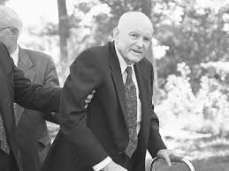
We came to mortal life to encounter resistance. It was part of the plan for our eternal progress. Without temptation, sickness, pain, and sorrow, there could be no goodness, virtue, appreciation for well-being, or joy. … We must remember that the same forces of resistance which prevent our progress afford us also opportunities to overcome.

Slide 6
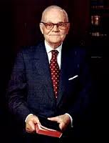
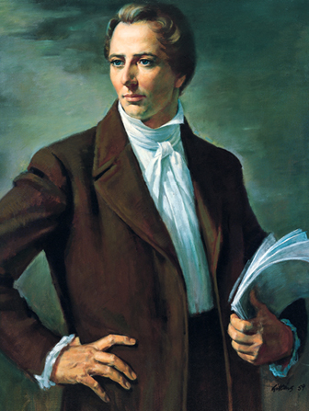
[President Marion G. Romney] said that all men and women, including the most faithful and loyal, would find adversity and affliction in their lives because, in the words of Joseph Smith, “Men have to suffer that they may come upon Mount Zion and be exalted above the heavens” [Teachings of Presidents of the Church: Joseph Smith (2007), 230; see Conference Report, Oct. 1969, 57].

Slide 7
Our mortal tribulations are for our growth and experience.
When [the difficulties of mortality] humble us and refine us and teach us and bless us, they can be powerful instruments in the hands of God to make us better people, to make us more grateful, more loving, and more considerate of other people in their own times of difficulty.

Slide 8
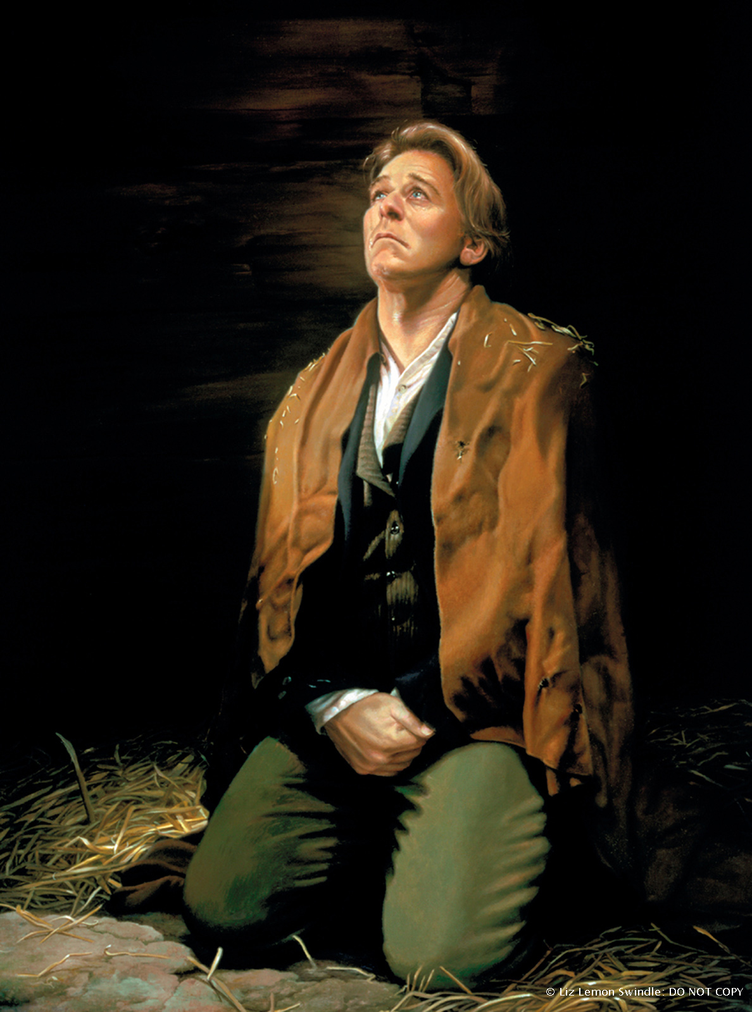
From out of the dark, damp confinement of Liberty Jail, the Prophet Joseph Smith learned that if we are called to pass through tribulation, it is for our growth and experience and will ultimately be counted for our good (see D&C 122:5–8).

Slide 9
We have every reason to be optimistic and confident even in times of difficulty.
There have always been some difficulties in mortal life, and there always will be. But knowing what we know, and living as we are supposed to live, there really is no place, no excuse, for pessimism and despair.

Slide 11
Every generation since time began has had some things to overcome and some problems to work out.
I hope you won’t believe all the world’s difficulties have been wedged into your decade, or that things have never been worse than they are for you personally, or that they will never get better. I reassure you that things have been worse and they will always get better. They always do—especially when we live and love the gospel of Jesus Christ and give it a chance to flourish in our lives. …

Slide 12
When we come to the Savior, He will ease our burdens and lighten our loads.
… This marvelous offer of assistance extended by the Son of God himself was not restricted to the Galileans of his day. This call to shoulder his easy yoke and accept his light burden is not limited to bygone generations. It was and is a universal appeal to all people, to all cities and nations, to every man, woman, and child everywhere.

Slide 13
“Disciples of Christ in every generation are invited, indeed commanded, to be filled with a perfect brightness of hope.”

Slide 14
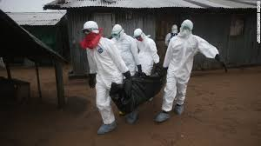
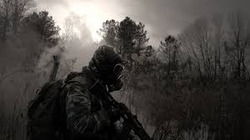
Latter-day Saints need not fear the tribulations of the last days.
The scriptures … indicate that there will be seasons of time when the whole world will have some difficulty. We know that in our dispensation unrighteousness will, unfortunately, be quite evident, and it will bring its inevitable difficulties and pain and punishment.

Slide 15
A time of great hope and excitement
For Latter-day Saints this is a time of great hope and excitement—one of the greatest eras in the Restoration and therefore one of the greatest eras in any dispensation, inasmuch as ours is the greatest of all dispensations. We need to have faith and hope, two of the great fundamental virtues of any discipleship of Christ. We must continue to exercise confidence in God, inasmuch as that is the first principle in our code of belief.

Slide 16
Seeking to dispel fear
… If our faith and hope are anchored in Christ, in his teachings, commandments, and promises, then we are able to count on something truly remarkable, genuinely miraculous, which can part the Red Sea and lead modern Israel to a place “where none shall come to hurt or make afraid.”

