Slide 1
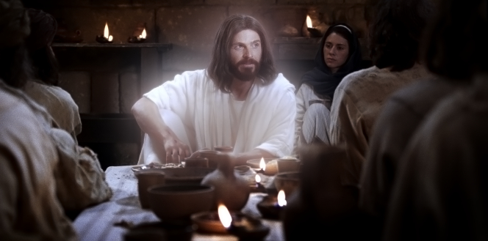
Chapter 24: Following the Example of Jesus Christ
“We should at every opportunity ask ourselves, ‘What would Jesus do?’ and then be more courageous to act upon the answer.”

Slide 2
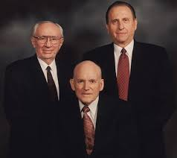
From the Life of Howard W. Hunter
President Thomas S. Monson, who served as second counselor to President Hunter, said that he “lived as he taught, after the pattern of the Savior whom he served.”

Slide 3
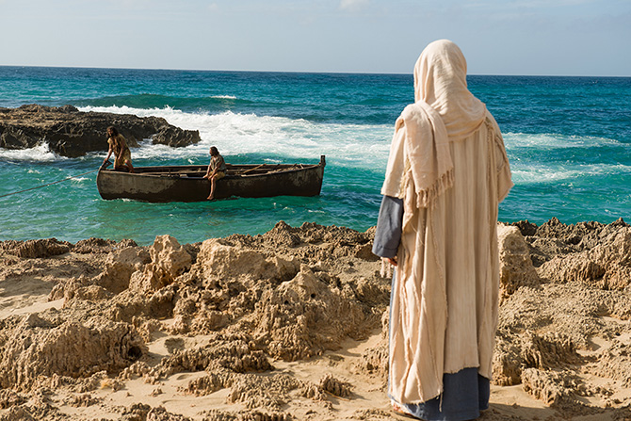
Another associate who worked closely with President Hunter for more than three decades said, “[He] knew instinctively the course he would follow. That course would be to emulate the character of his Savior Jesus Christ.”“If we are to follow the example of Christ and walk in his footsteps, we must seek to do the same things after the pattern he set.”

Slide 4
Jesus Christ set the perfect example for us.
To be a light is to be an exemplar—one who sets an example and is a model for others to follow. … [We have covenanted] to follow Christ, the great exemplar. We have the responsibility to learn of him, the things he taught and the things he did during his earthly ministry. Having learned these lessons, we are under commandment to follow his example, and these are some of the examples he set for us:

Slide 5
To be a light is to be an exemplar—one who sets an example and is a model for others to follow. … [We have covenanted] to follow Christ, the great exemplar. We have the responsibility to learn of him, the things he taught and the things he did during his earthly ministry. Having learned these lessons, we are under commandment to follow his example, and these are some of the examples he set for us:

Slide 6
Christ was obedient and valiant in the premortal life

Slide 7
He was baptized in order that the door to the celestial kingdom would be opened.

Slide 8
He held the priesthood and received all the saving and exalting ordinances of the gospel.

Slide 9
Jesus served for about three years in a ministry of teaching the gospel

Slide 10
He performed ordinances including the blessing of children, baptisms, administering to the sick, and ordinations to the priesthood.

Slide 11
In conformity with the mind and will of the Father, Jesus lived a perfect life without sin and acquired all of the attributes of Godliness.

Slide 12
He overcame the world

Slide 13
He brought to pass the Atonement, thereby ransoming men from the [spiritual and physical] death caused by the fall of Adam.

Slide 14
Now, resurrected and glorified, he has gained all power in heaven and in earth, has received the fullness of and is one with the Father.

Slide 15
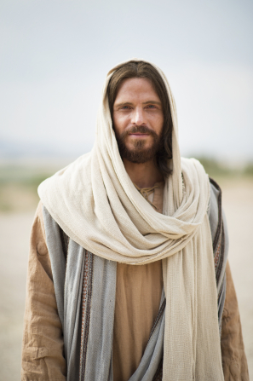
What a marvelous example for us to follow! Even in the midst of great personal sorrow and pain, our Exemplar reached out to bless others. … His was not a life focused on the things he did not have. It was a life of reaching out in service to others.

Slide 16
Let us follow the Son of God in all ways and walks of life.

Slide 17
“What manner of men ought ye to be?” Then in the same breath he gave this answer: “Even as I am” (3 Ne. 27:27).Only Christ can be our ideal, our “bright and morning star” (Rev. 22:16). Only he can say without any reservation, “Follow me, learn of me, [and] do the things you have seen me do. Drink of my water and eat of my bread. I am the way, the truth, and the life. I am the law and the light. Look unto me and ye shall live. Love one another as I have loved you” (see Matt. 11:29; 16:24; John 4:13–14; 6:35, 51; 7:37; 13:34; 14:6; 3 Ne. 15:9; 27:21).

Slide 18
Our salvation depends on our commitment to following the Savior.
Christ’s supreme sacrifice can find full fruition in our lives only as we accept the invitation to follow him [see D&C 100:2]. This call is not irrelevant, unrealistic, or impossible. To follow an individual means to watch him or listen to him closely; to accept his authority, to take him as a leader, and to obey him; to support and advocate his ideas; and to take him as a model. Each of us can accept this challenge. Peter said, “Christ also suffered for us, leaving us an example, that ye should follow his steps” (1 Pet. 2:21).

Slide 19
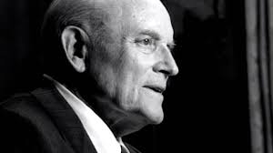
We should make room for Christ.
What is our responsibility today as members of The Church of Jesus Christ of Latter-day Saints? It is to see that our individual lives reflect in word and deed the gospel as taught by our Lord and Savior, Jesus Christ. All that we do and say should be patterned after the example of the one sinless person to walk the earth, even the Lord Jesus Christ.

