Slide 1
Chapter 23: “No Less Serviceable”
“Most of us will be quiet, relatively unknown folks who … do our work without fanfare. To those of you who may find that … unspectacular, I say, you are ‘no less serviceable’ than the most spectacular of your associates.”

Slide 2
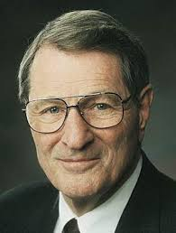
From the Life of Howard W. Hunter
He knew that the service itself was important, not whether he received any recognition. Elder Neal A. Maxwell of the Quorum of the Twelve once said of him, “President Howard W. Hunter is a meek man. … This is the same lowly man, when I awakened after a weary and dusty day together with him on assignment in Egypt, who was quietly shining my shoes, a task he had hoped to complete unseen.

Slide 3
President Thomas S. Monson first noticed President Hunter’s humble way of serving when the Los Angeles California Temple was dedicated in 1956, several years before either of them was called as an Apostle. He recalled:“My … introduction to President Hunter was when he served as president of the Pasadena California Stake and had responsibility to coordinate local arrangements for the dedication of the Los Angeles (California) Temple. It was my privilege to print the tickets. His assignment was mammoth. I saw only that portion which pertained to the tickets, which were color coded, intricately labeled, and numbered in the most orderly fashion I had ever seen. He generously gave credit to others and insured that his name was not excessively featured, even though he had been a driving force behind these monumental undertakings.”

Slide 5
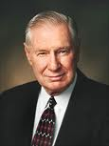
Elder James E. Faust of the Quorum of the Twelve further observed: “He had no ego needs. With all his wisdom, he could sit among his brethren and say very little. He was at complete peace with himself.”

Slide 6
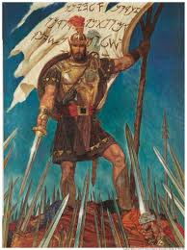
Those who serve quietly and inconspicuously are “no less serviceable” than those who receive the world’s acclaim.
“If all men had been, and were, and ever would be, like unto Moroni, behold, the very powers of hell would have been shaken forever; yea, the devil would never have power over the hearts of the children of men.”

Slide 7
What a compliment to a famous and powerful man! I can’t imagine a finer tribute from one man to another. Two verses later is a statement about Helaman and his brethren, who played a less conspicuous role than Moroni: “Now behold, Helaman and his brethren were no less serviceable unto the people than was Moroni.” (Alma 48:19.)

Slide 9
Not all of us are going to be like Moroni, catching the acclaim of our colleagues all day every day. Most of us will be quiet, relatively unknown folks who come and go and do our work without fanfare. To those of you who may find that [thought] lonely or frightening or just unspectacular, I say, you are “no less serviceable” than the most spectacular of your associates. You, too, are part of God’s army.

Slide 10
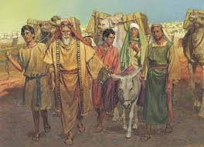
In the scriptures, many people who served in the shadow of others made important contributions.
Nephi is one of the most famous figures in the entire Book of Mormon. But Sam? Sam’s name is mentioned there only ten times.

Slide 11
He was an almost unknown person in life, but he is obviously a triumphant leader and victor in the annals of eternity.Ishmael traveled with the family of Nephi at great personal sacrifice, suffering “much affliction, hunger, thirst, and fatigue.”

Slide 12
The names and memories of such men and women who were “no less serviceable” are legion in the Book of Mormon. Whether it be Mother Sariah or the maid Abish, servant to the Lamanite queen, each made contributions that were unacknowledged by the eyes of men but not unseen by the eyes of God. Mosiah, king over the land of Zarahemla and father of the famous King Benjamin, Limhi, Amulek, Pahoran, The soldier Teancum, who sacrificed his own life, or Lachonius and Shiblon

Slide 14
Even though we may not be well known, we can render great service in the kingdom.
Oliver Granger is the kind of quiet, supportive individual in the latter days that the Lord remembered in section 117 of the Doctrine and Covenants. During Oliver’s time in Kirtland, some people, including disaffected members of the Church, were endeavoring to discredit the First Presidency and bring their integrity into question by spreading false accusations. Oliver Granger, in very deed, “redeemed the First Presidency” through his faithful service. … The Lord said of Oliver Granger: “His name shall be had in sacred remembrance from generation to generation, forever and ever.” (D&C 117:12.) “I will lift up my servant Oliver, and beget for him a great name on the earth, and among my people, because of the integrity of his soul.” (History of the Church, 3:350.)

Slide 15
Nephi is an example of remembering God as the source of his strength and blessings.
I think we should be aware that there can be a spiritual danger to those who misunderstand the singularity of always being in the spotlight. They may come to covet the notoriety and thus forget the significance of the service being rendered.

Slide 17
We must not allow ourselves to focus on the fleeting light of popularity or substitute that attractive glow for the substance of true but often anonymous labor that brings the attention of God, even if it does not get coverage on the six o’clock news. In fact, applause and attention can become the spiritual Achilles’ heels of even the most gifted among us.

Slide 18
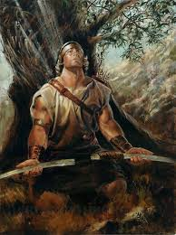
Nephi is one of the great examples.
“...My God hath been my support; he hath led me through mine afflictions in the wilderness; and he hath preserved me upon the waters of the great deep... " (2 Ne. 4:19–22.)

Slide 19
When we understand why we serve, we won’t be concerned about where we serve
President J. Reuben Clark, Jr., taught this vital principle in his own life. At general conference in April 1951, President David O. McKay was sustained as President of the Church after the passing of President George Albert Smith. Up to that time, President Clark had served as the First Counselor to President Heber J. Grant and then to President George Albert Smith. President McKay had been the Second Counselor to both men.

Slide 21
His remarks on this occasion were brief but teach a powerful lesson: “In the service of the Lord, it is not where you serve but how. In The Church of Jesus Christ of Latter-day Saints, one takes the place to which one is duly called, which place one neither seeks nor declines. I pledge to President McKay and to President Richards the full loyal devoted service to the tasks that may come to me to the full measure of my strength and my abilities, and so far as they will enable me to perform them, however inadequate I may be.”

Slide 22
We should serve faithfully and quietly, being on guard regarding the praise of others.
The sign at the railroad crossing that warns us to stop, look, and listen could be a guide for us. Stop as we rush through life. Look for all the friendly, thoughtful, courteous things we can do, and all the little human needs we can fill. Listen to others and learn of their hopes and problems so that we will be able to contribute in little ways to their success and happiness.

