Slide 1
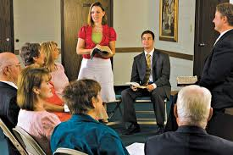
Chapter 22: Teaching the Gospel
“The purpose of teaching … [is] that we might be an instrument in the hands of the Lord in changing the heart of an individual.”

Slide 2
From the Life of Howard W. Hunter
In the April 1972 general conference, Elder Howard W. Hunter, then a member of the Quorum of the Twelve Apostles, was one of the last speakers in one of the sessions. He had prepared a talk, but there was not enough time left in the session for him to give it. “Observing the clock,” Elder Hunter said, “I fold the notes that I have prepared and place them in my inside pocket. But let me take just a moment to mention a little incident that made an impression upon me when I was a boy. This came to my mind when it was mentioned that there are with us this afternoon a large group of dedicated people who teach our youth.

Slide 3
“Before me now I see some of the choice spirits of the earth. … I try to visualize each [of you teachers] at work in your own specific assignment. I wonder what kind of fruit your labor will bring forth. Will some of that fruit be blighted because you have failed to till or cultivate the soil entrusted to your care; or will all the soil be cultivated so it will yield a maximum of good fruit?

Slide 4
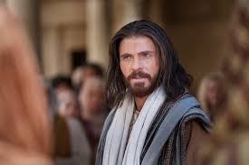
“What a challenge, what a joyous task, what a sacred responsibility is yours now! … How thoughtful, how considerate, how kind, how tender, how pure in heart, how possessed of that unselfish love as our Lord possessed, how humble, how prayerful you must be as you assume anew your work to feed the lambs as the Lord is telling you to do!”

Slide 5
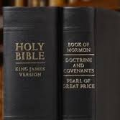
Help others develop confidence in the scriptures.
I strongly encourage you to use the scriptures in your teaching and to do all within your power to help the students use them and become comfortable with them. I would like our young people to have confidence in the scriptures, and I would like you to interpret that phrase two ways.

Slide 6
“For there are many yet on the earth among all sects, parties, and denominations, who are blinded by the subtle craftiness of men, whereby they lie in wait to deceive, and who are only kept from the truth because they know not where to find it” (D&C 123:12; emphasis added).

Slide 7
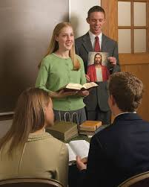
First, we want the students to have confidence in the strength and truths of the scriptures, confidence that their Heavenly Father is really speaking to them through the scriptures, and confidence that they can turn to the scriptures and find answers to their problems and their prayers.

Slide 8
[A second] meaning implied in the phrase “confidence in the scriptures” is to teach students the standard works so thoroughly that they can move through them with confidence, learning the essential scriptures and sermons and texts contained in them.

Slide 9
Teach with the Spirit.
“And the Spirit shall be given unto you by the prayer of faith; and if ye receive not the Spirit ye shall not teach” (D&C 42:14).
… I get concerned when it appears that strong emotion or free-flowing tears are equated with the presence of the Spirit. Certainly the Spirit of the Lord can bring strong emotional feelings, including tears, but that outward manifestation ought not to be confused with the presence of the Spirit itself.

Slide 10
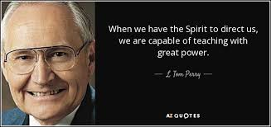

Slide 11
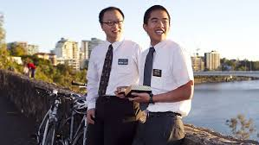
Listen for the truth, hearken to the doctrine, and let the manifestation of the Spirit come as it may in all of its many and varied forms. Stay with solid principles; teach from a pure heart. Then the Spirit will penetrate your mind and heart and every mind and heart of your students.

Slide 12
Invite students to seek God the Father and Jesus Christ directly.
I am sure you recognize the potential danger of … your students build[ing] an allegiance to you rather than to the gospel. … That is why you have to invite your students into the scriptures themselves, not just give them your interpretation and presentation of them. That is why you must invite your students to feel the Spirit of the Lord, not just give them your personal reflection of that. That is why, ultimately, you must invite your students directly to Christ, not just to one who teaches his doctrines, however ably. You will not always be available to these students. …

Slide 13
Strive to reach the individual.
When Christ appeared to the Nephites, he said:“Arise and come forth unto me, that ye may thrust your hands into my side, and also that ye may feel the prints of the nails in my hands and in my feet. …“And it came to pass that the multitude went forth, and thrust their hands into his side, and did feel the prints of the nails in his hands and in his feet; and this they did do, going forth one by one until they had all gone forth, and did see with their eyes and did feel with their hands, and did know of a surety and did bear record” (3 Nephi 11:14–15; emphasis added).

Slide 14
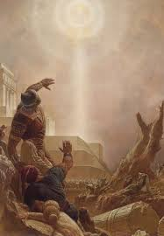
It will be hard for you to give all of the personal attention some of your students both want and need, but try the best you can to think of them individually, to let them feel something personal and special in the concern of you, their teacher.

Slide 15
Teach by example.
Example carries with it an influence much more forceful than precept. He who would persuade others to do right should do right himself. It is true that he who practices good precepts because they are good and does not suffer himself to be influenced by the unrighteous conduct of others will be more abundantly rewarded than one who says and does not. … Children are prone to imitate those in whom they place confidence. The greater their confidence, the more readily they are influenced for good or for evil. Every good Saint respects genuine goodness wherever it is seen and will try to imitate all good examples.

Slide 16
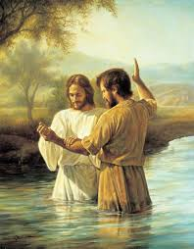
Be an instrument in the Lord’s hands in helping students experience a miraculous change of heart.

