Slide 1
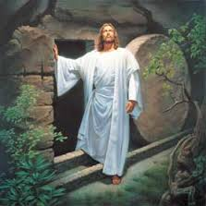
Chapter 21: Faith and Testimony
“The supreme achievement of life is to find God and to know that He lives.”

Slide 2
From the Life of Howard W. Hunter
Howard W. Hunter began to develop his testimony during his early childhood in Boise, Idaho. Although his father was not then a member of the Church, his mother raised him in the gospel. “It was at her knee that we learned to pray,” he recalled. “I received a testimony as a boy at my mother’s knee.”

Slide 3
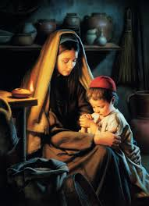
Howard’s testimony grew over the years. When he was in his 20s and living in Los Angeles, California, he began to recognize the importance of serious gospel study. … I think of this period of my life as the time the truths of the gospel commenced to unfold. I always had a testimony of the gospel, but suddenly I commenced to understand.

Slide 4
Many years later, President Hunter explained: “There comes a time when we understand the principles of our creation and who we are. Suddenly these things are illuminated to us and the cords of our hearts do vibrate. This is the time when testimony enters into our very souls and we know beyond a question of a doubt that God is our father—that he lives, that he is a reality, that we are literally his children.”

Slide 5
Through faith, we can find God and know that He lives.
The supreme achievement of life is to find God and to know that He lives. Like any other worthy accomplishment, this can only be obtained by those who will believe and have faith in that which at first may not be apparent.

Slide 6
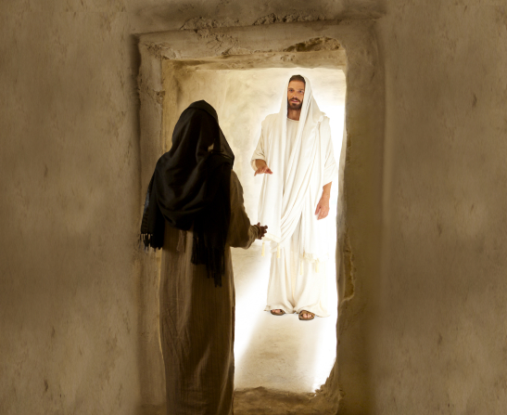

Slide 7
The most powerful force in human nature is the spiritual power of faith.
The greatest quest is a search for God—to determine his reality, his personal attributes, and to secure a knowledge of the gospel of his Son Jesus Christ. It is not easy to find a perfect understanding of God. The search requires persistent effort, and there are some who never move themselves to pursue this knowledge. …

Slide 8
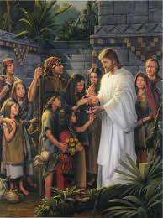
“Now faith is the substance of things hoped for, the evidence of things not seen.” (Heb. 11:1.)
I have a positive conviction that God is a reality—that he lives. He is our Heavenly Father, and we are his spiritual children. He created the heaven and the earth and all things upon the earth and is the author of the eternal laws by which the universe is governed

Slide 9
To obtain knowledge of the reality of God, we must make a faithful effort, do His will, and pray for understanding.
… Sometimes faith means believing a thing to be true where the evidence is not sufficient to establish knowledge
“Ask, and it shall be given you; seek, and ye shall find; knock, and it shall be opened unto you: For every one that asketh receiveth; and he that seeketh findeth; and to him that knocketh it shall be opened.” (Matt. 7:7–8.) …

Slide 10
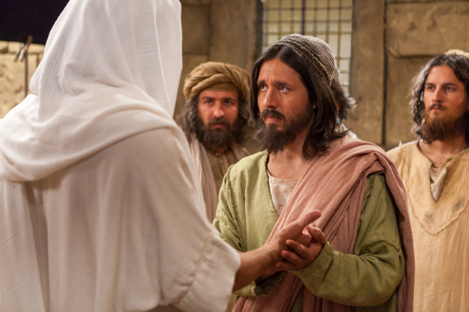
We must believe in order to see.
Thomas wanted to see before he would believe.

Slide 11
Faith gives us confidence in things that are not visible.
It would appear that Thomas had lost his confidence in the future. He looked to the past. He wanted proof of that which was not then visible. Those who lose or lack faith, live in the past—there is loss of hope for the future. What a great change comes into the life of one who finds an abiding faith to give assurance and confidence.

Slide 12
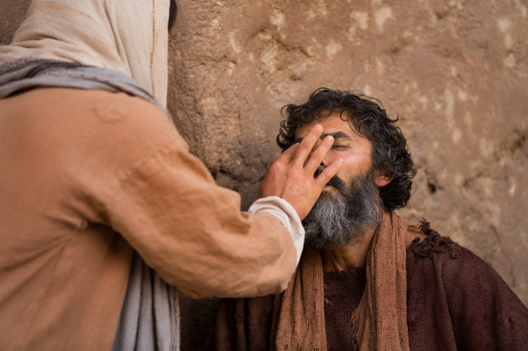
The man born blind did not doubt; he believed in the Savior.

Slide 13
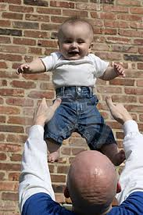
Acting on our faith leads to personal testimony.
As children we accepted as fact the things which were told to us by our parents or our teachers because of the confidence that we had in them

Slide 14
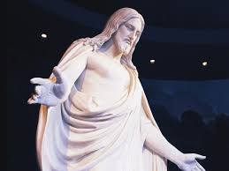
… In order for an individual to obtain unwavering knowledge of the reality of God, he must live the commandments and the doctrines announced by the Savior during his personal ministry.

Slide 15
When a man has found God and understands his ways, he learns that nothing in the universe came by chance, but all things resulted from a divinely prearranged plan. What a rich meaning comes into his life!

Slide 16
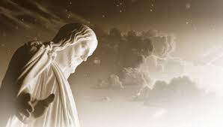
He lives

Slide 17
As children grow older, they commence to think for themselves, to question and have doubts about those things which are not subject to tangible proof.
Students spend hours in scientific laboratories experimenting to find the truth. If they will do the same thing with faith, prayer, forgiveness, humility and love, they will find a testimony of Jesus Christ, the giver of these principles.

Slide 18
The gospel of Jesus Christ is not just a gospel of belief; it is a plan of action. … He did not say “observe” my gospel; he said “live” it! He did not say, “Note its beautiful structure and imagery”; he said, “Go, do, see, feel, give, believe!”

Slide 19
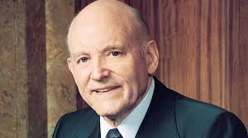
My testimony
As an ordained Apostle and special witness of Christ, I give to you my solemn witness that Jesus Christ is in fact the Son of God. … It is by the power of the Holy Ghost that I bear my witness. I know of Christ’s reality as if I had seen with my eyes and heard with my ears. I know also that the Holy Spirit will confirm the truthfulness of my witness in the hearts of all those who listen with an ear of faith.

