Slide 1
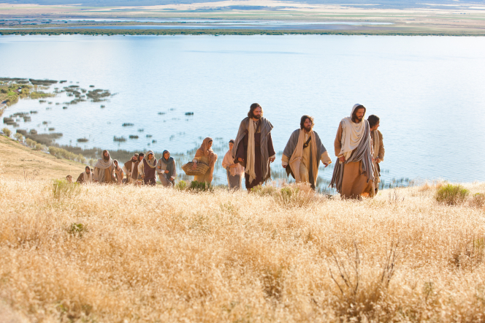
Chapter 20: Walking the Savior’s Path of Charity
“The touchstone of compassion is a measure of our discipleship; it is a measure of our love for God and for one another.”

Slide 2
From the Life of Howard W. Hunter
President Howard W. Hunter taught that the Savior “gave us His love, His service, and His life. … We should strive to give as He gave.”1 Most particularly, President Hunter encouraged Church members to follow the Savior’s example of charity in their everyday lives.

Slide 3
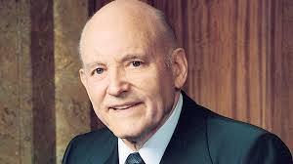
Acts of charity were a defining aspect of Howard W. Hunter’s career in the legal profession
“He spent a lot of his time giving [free] legal service … because he just did not have the heart to send a bill. … He was perceived as a friend, guide, counselor, and a professional who was much more concerned about seeing that people got the help they needed than that he got compensated for it.

Slide 4
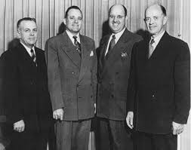
A woman from President Hunter’s stake in California paid this tribute:
“President Howard W. Hunter was our stake president years ago when our family lived in the Pasadena Stake. My father had died, leaving my mother to rear my older sister and me. Although we were not a prominent family in the stake, which covered a huge geographical area, President Hunter still knew us personally.

Slide 5
“My most significant memory of him is one that contributed to my sense of self-worth. After each stake conference, we would wait in line to shake hands with him. He always took my mother’s hand and said, ‘How are you, Sister Sessions, and how are Betty and Carolyn?’ It gave me a thrill to hear him call us by name. I knew he knew us and cared about our well-being. The memory still warms my heart.

Slide 7
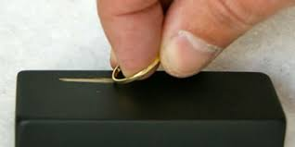
The two great commandments are the Lord’s touchstone for our discipleship.
I suggest to you that the Lord has prepared a touchstone for you and me, an outward measurement of inward discipleship that marks our faithfulness and will survive the fires yet to come.

Slide 8
“Inasmuch as ye have done it unto one of the least of these my brethren, ye have done it unto me” (Matthew 25:40)

Slide 9
The Savior taught us to love everyone, including those who may be difficult to love
“And who is my neighbour?” (Luke 10:29).
The Samaritan gave us an example of pure Christian love. He had compassion; he went to the man who had been injured by the thieves and bound up his wounds. He took him to an inn, cared for him, paid his expenses, and offered more if needed for his care. This is a story of the love of a neighbor for his neighbor.

Slide 10
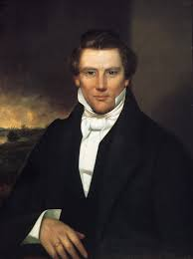
We should love and serve others in their affliction.
Joseph Smith wrote a letter to the Saints.“Dear Brethren:—It is a duty which every Saint ought to render to his brethren freely—to always love them, and ever succor them."

Slide 11
The touchstone of compassion is a measure of our discipleship; it is a measure of our love for God and for one another. Will we leave a mark of pure gold or, like the priest and the Levite, pass by on the other side?

Slide 13
We need to walk more resolutely the path of charity that Jesus has shown.
The Prophet Joseph Smith said:“If we would secure and cultivate the love of others, we must love others, even our enemies as well as friends. … Christians should cease wrangling and contending with each other, and cultivate the principles of union and friendship in their midst.”

Slide 14
Charity is the pure love of Christ and will not fail.
“A new commandment I give unto you,” [Jesus] said, “That ye love one another; … By this shall all men know that ye are my disciples, if ye have love one to another.” (John 13:34–35.)… Charity encompasses all other godly virtues. It distinguishes both the beginning and the end of the plan of salvation. When all else fails, charity—Christ’s love—will not fail. It is the greatest of all divine attributes.

Slide 15
Out of the abundance of his heart, Jesus spoke to the poor, the downtrodden, the widows, the little children; to farmers and fishermen, and those who tended goats and sheep; to strangers and foreigners, the rich, the politically powerful, as well as the unfriendly Pharisees and scribes. He ministered to the poor, the hungry, the deprived, the sick. He blessed the lame, the blind, the deaf, and other people with physical disabilities. He drove out the demons and evil spirits that had caused mental or emotional illness. He purified those who were burdened with sin. He taught lessons of love and repeatedly demonstrated unselfish service to others. All were recipients of his love

Slide 17
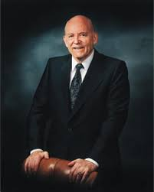
Loving others is “a more excellent way.”
A different way? A better way? A higher way? A more excellent way? Oh, how the world could benefit from such a magnificent lesson. As Moroni declares:“Wherefore, whoso believeth in God might with surety hope for a better world. …“In the gift of his Son hath God prepared a more excellent way.” (Ether 12:4, 11.)

