Slide 1
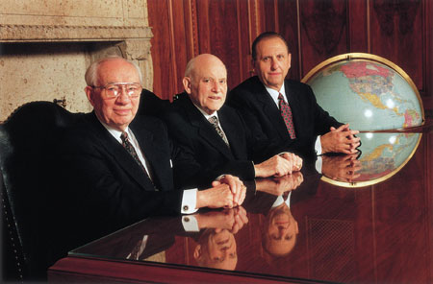
Chapter 19: Our Commitment to God
“A successful life … requires commitment—whole-souled, deeply held, eternally cherished commitment to the principles we know to be true in the commandments God has given.”

Slide 2
From the Life of Howard W. Hunte
When Howard W. Hunter was called to be a member of the Quorum of the Twelve, he declared, “I accept, without reservation, the call … made of me, and I am willing to devote my life and all that I have to this service.”
Elder Hunter lived true to his commitment. After he was ordained an Apostle, he returned to California to complete Church and business obligations and to begin preparing to relocate to Salt Lake City.

Slide 3
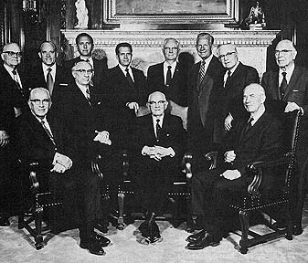
“Today I finished most of my work at the office. Nearly all of the pending matters are completed. I was alone in the office today with the realization that my practice of law was now at an end.
I made notes on a number of files and left them on the desk. … I had a sick feeling as I left the office. I have enjoyed the practice of law and it has been my life for the last number of years, but in spite of this I am pleased and happy to respond to the great call which has come to me in the Church.”

Slide 4
Our Father in Heaven requires our total commitment, not just a contribution.
Please understand that I do not speak only of a commitment to the Church and its activities, although that always needs to be strengthened. No, I speak more specifically of a commitment that is shown in our individual behavior, in our personal integrity, in our loyalty to home and family and community, as well as to the Church.

Slide 5
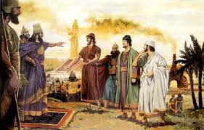
Shadrach, Meshach, and Abed-nego
Shadrach, Meshach, and Abed-nego—quietly refused. The king was full of “rage and fury” and demanded that they be brought before him.

Slide 6
“ye shall be cast the same hour into the midst of a burning fiery furnace.” Then with some self-satisfaction he asked, “And who is that God that shall deliver you out of my hands?”“If it be so,” they said, “[that you threaten us with death,] our God whom we serve is able to deliver us from the burning fiery furnace, and he will deliver us out of thine hand, O king.“But if not [if for whatever reason he chooses not to save us from the fire], be it known unto thee, O king, that we will not serve thy gods, nor worship the golden image which thou hast set up.”

Slide 7
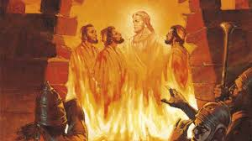

Slide 8
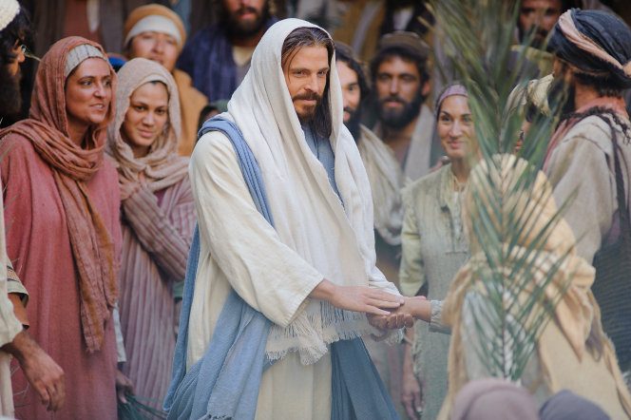
A successful life, the good life, the righteous Christian life requires something more than a contribution, though every contribution is valuable. Ultimately it requires commitment—whole-souled, deeply held, eternally cherished commitment to the principles we know to be true in the commandments God has given. …

Slide 9
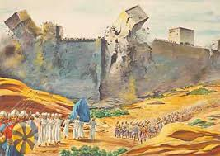
Be committed to obeying the Lord regardless of what others decide to do.
When Joshua was directed to destroy the city of Jericho that lay before [the tribes of Israel], the great walls of the city stood as an imposing and physically impossible barrier to Israel’s success—or at least so it seemed.

Slide 10
Joshua Fit the battle of Jericho
Not knowing the means, but assured as to the end, Joshua carried out the instructions he had been given by a messenger of the Lord.
“the wall fell down flat, so that the people went up into the city, every man straight before him, and they took the city.” (Josh. 6:20.)
This great military and spiritual leader then urged a commitment, and made one himself and for his family: “Choose you this day whom ye will serve; … but as for me and my house, we will serve the Lord.” (Josh. 24:15.)

Slide 11
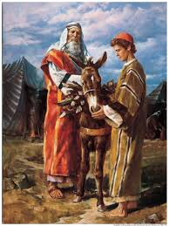
Decide now to choose the path of strict obedience.
Are we willing to become totally obedient to God’s law? There comes a time in our lives when a definite decision must be made.

Slide 12
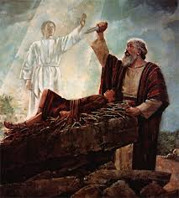
“How pleased the Lord must have been when Abraham … did as he was instructed, without question and without wavering.”I pray that we will have the strength to decide now to do what we ought to do. I pray that we will decide now to serve the Lord.

Slide 13
Belief alone is not sufficient; we also need to do Heavenly Father’s will.
When speaking to the multitudes, the Master said: “Not every one that saith unto me, Lord, Lord, shall enter into the kingdom of heaven; but he that doeth the will of my Father which is in heaven.”

Slide 14
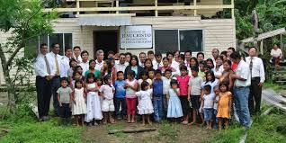
“Living members” strive to have a total commitment.

