Slide 1
Chapter 18: We Believe in Being Honest
“If we would have the companionship of the Master and the Spirit of the Holy Ghost, we must be honest with ourselves, honest with God, and with our fellowmen.”

Slide 2
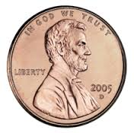
From the Life of Howard W. Hunter
While waiting to take a tour of Hearst Castle in California, President and Sister Hunter and another couple drove to a small store. As they were looking around the store, “Elder Hunter went to the counter, counted out some licorice, [and] paid the clerk 10 pennies.” The two couples then returned to the car and began driving back to the castle for the tour. On the way, “Elder Hunter passed the licorice around once, and then again, and then suddenly it was apparent to him that he must have miscounted, for we ended up with 11 pieces instead of the 10 he had paid for.

Slide 3
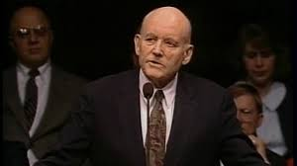
“He could have easily overlooked the error. After all, it was just a penny, and we were in a bit of a hurry now to make the tour. Who would know the difference or care? But he didn’t even think twice about it. He wheeled the car around and headed back up the road to the store. … He explained the problem to a different attendant, apologized for the error, and paid the extra penny to the surprised clerk.”

Slide 4
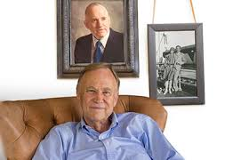
For Howard W. Hunter, it was important to be honest in small matters as well as large ones.
He taught his sons about integrity by his example. “What I know about honesty and integrity has come in large measure by what people have told me about my father,” Richard Hunter said.

Slide 5
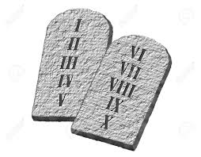
A happy life will come to each of us if we will but be honest
Honest with our fathers and mothers, whether it pertains to our dating, our school work, the kids we run with, or attendance at church; honest with our bishopsNever cheating in any part of our activities, whether in class or on the campus; honest in paying our way, whether into games or movies, or in carrying our part of the responsibilities at a party; honest with our boyfriends and girlfriends

Slide 6
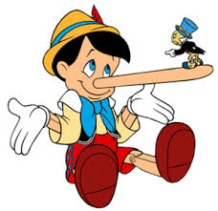
The Lord admonishes us to be honest.
THOU SHALT NOT—thou shalt not steal; thou shalt not bear false witness; thou shalt not covet

Slide 7
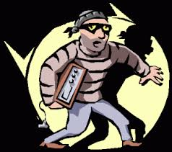
Stealing
Even in our chapels there are reports of petty theft.

Slide 8
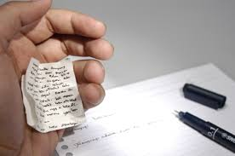
Cheating
There are some who would cheat their way through school and some who would cheat in examinations.

Slide 9
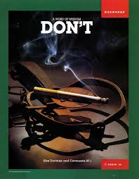
Violations of Word of Wisdom standards
These are Church standards. They are not violations of the standards of the world. But you have been given the word of the Lord on this subject.

Slide 10
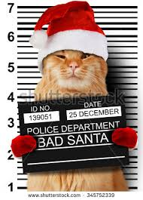
Violation of traffic ordinances
One cannot be basically honest and violate laws formulated by society and government for the welfare of other persons.

Slide 11
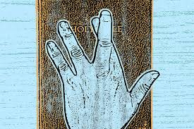
Thou shalt not bear false witness against thy neighbour
Suppression of the truth which results in the same injury is also a violation of this commandment.

Slide 12
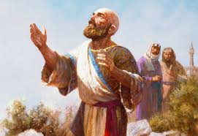
We can serve God by being honest and fair in our personal and business dealings.
May I suggest a definition of “honorable employment.” Honorable employment is honest employment. Fair value is given and there is no defrauding, cheating, or deceit. Its product or service is of high quality, and the employer, customer, client, or patient receives more than he or she expected. Honorable employment is moral. It involves nothing that would undermine public good or morality. For example, it does not involve traffic in liquor, illicit narcotics, or gambling. Honorable employment is useful. It provides goods or services which make the world a better place in which to live

Slide 13
True joy Results from being honest with ourselves, with others, and with God
“Men are, that they might have joy” Will we be proud of it? We will if we have done our best—if we have been honest with ourselves, with our loved ones, with our friends, with all mankind. …Blessed are they who are honest. …Blessed are they who are obedient to the Lord.

Slide 14
Integrity protects us from evil, helps us be successful, and will save our souls.
One of the greatest accomplishments of our lives is to promote an honest, earnest integrity within ourselves. This means that we become spiritually sound, intellectually sincere, morally honest, and always personally responsible to God. Integrity is that golden key which will unlock the door to almost any success

