Slide 1
Chapter 17: Preserve and Protect the Family
“Home may seem commonplace at times with its routine duties, yet its success should be the greatest of all our pursuits.”

Slide 2
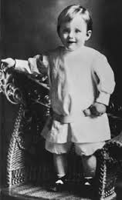
From the Life of Howard W. Hunter
Howard W. Hunter grew up in a loving, hard-working family, where he learned from his parents that building a happy home often required sacrifice. Shortly before he was married, he made a sacrifice that he felt was necessary for the well-being of his future family.

Slide 3
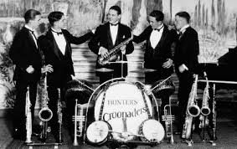
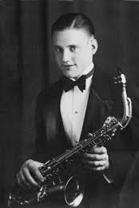
Four days before they were married, Howard performed with his band and then packed up his instruments and never played again professionally. Providing music for dances and parties “was glamorous in some respects,” he said, “and I made good money,” but he felt that parts of the lifestyle were incompatible with the kind of life he envisioned for his family.

Slide 4
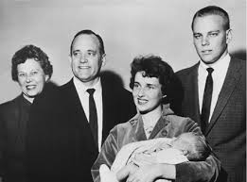
He said, “and I made good money,” but he felt that parts of the lifestyle were incompatible with the kind of life he envisioned for his family. “This left a void of something I had enjoyed, [but] the decision has never been regretted,” he said years later.Also, Howard had a full schedule with his law practice and Church callings, but he and Claire made their family a priority. Long before the Church designated Monday night for family home evening, the Hunters set aside that night as a time for teaching the gospel, telling stories, playing games, and going places together.

Slide 5
The family is the most important unit in society, in the Church, and in eternity.
What Family Means?
The Church has the responsibility—and the authority—to preserve and protect the family as the foundation of society. The pattern for family life, instituted from before the foundation of the world, provides for children to be born to and nurtured by a father and mother who are husband and wife, lawfully married.
Transcends every other interest in life

Slide 6
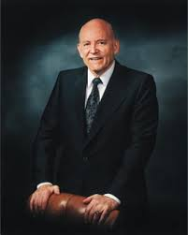
In seeking after the welfare of individuals and families, it is important to remember that the basic unit of the Church is the family. However, in focusing on the family, we should remember that in the world in which we live families are not restricted to the traditional grouping of father, mother, and children.

Slide 7
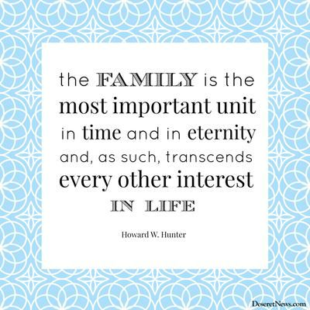

Slide 8
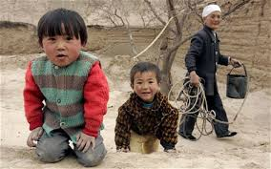
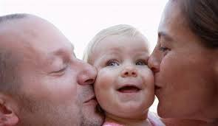
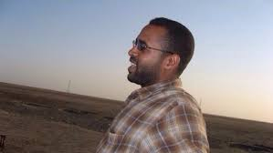
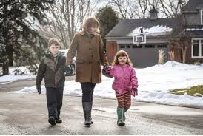
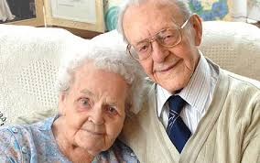
Families in the Church today also consist of

Slide 9
Parents are partners in the leadership of the home and are under strict obligation to protect and love their children.
The responsibilities of parenthood are of the greatest importance.

Slide 10
“Train up a child in the way he should go: and when he is old, he will not depart from it.” (Proverbs 22:6.)

Slide 11
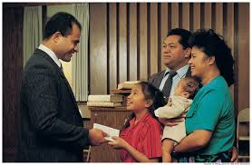
A man who holds the priesthood leads his family in Church participation so they will know the gospel and be under the protection of the covenants and ordinances .A man who holds the priesthood has reverence for motherhood.

Slide 12
You share, as a loving partner, the care of the children
Help her to manage and keep up your home. Help teach, train, and discipline your children.
You should express regularly to your wife and children your reverence and respect for her.
A man who holds the priesthood accepts his wife as a partner in the leadership of the home and family

Slide 13
Our homes should be places of love, prayer, and gospel teaching.
We need to try harder to live the gospel in our family circles. Our homes deserve our most faithful commitments.

Slide 14
A successful parent is one who has loved, sacrificed, cared for, taught, and ministered to the needs of a child.
Don’t give up hope for a boy or a girl who has strayed. Many who have appeared to be completely lost have returned.

Slide 15
Mosiah 27:14
14 And again, the angel said: Behold, the Lord hath heard the prayers of his people, and also the prayers of his servant, Alma, who is thy father; for he has prayed with much faith concerning thee that thou mightest be brought to the knowledge of the truth; therefore, for this purpose have I come to convince thee of the power and authority of God, that the prayers of his servants might be answered according to their faith.

Slide 16
Our homes should be holy places where the principles of the gospel can be lived and where the Spirit of the Lord can dwell.
“But my disciples shall stand in holy places, and shall not be moved” (D&C 45:32).

