Slide 1
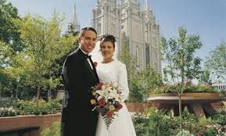
Chapter 16: MarriageAn Eternal Partnership
“Life’s greatest partnership is in marriage—that relationship which has lasting and eternal significance.”

Slide 2
From the life of Howard W. Hunter
When Howard W. Hunter was 20 years old, he met Claire Jeffs at a Church dance in Los Angeles, California, while she was on a date with one of his friends. After the dance, a few of the young adults went wading in the ocean surf. Howard lost his tie, and Claire volunteered to walk along the beach with him to help find it. Howard later said, “The next time we went out, I took Claire, and [my friend] went with someone else.”

Slide 3
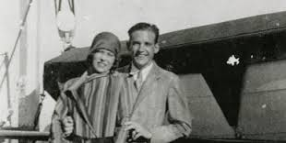
The following year they began dating seriously, and on a spring evening nearly three years after they met, Howard took Claire to a beautiful overlook above the ocean. “We [watched] the waves roll in from the Pacific and break over the rocks in the light of a full moon,” he wrote. That night Howard proposed marriage, and Claire accepted. “We talked about our plans,” he said, “[and] made many decisions that night and some strong resolutions regarding our lives.”

Slide 4
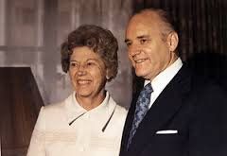
Howard and Claire were married in the Salt Lake Temple on June 10, 1931. During the next 52 years, their love deepened as they raised their sons, served in the Church, and faced their challenges with faith.

Slide 5
Marriage between a man and a woman is ordained of God and is intended to be eternal.
Life’s greatest partnership is in marriage—that relationship which has lasting and eternal significance.
Marriage is often referred to as a partnership with God.
This is not just a figure of speech. If this partnership remains strong and active, the man and woman will love each other as they love God, and there will come into their home a sweetness and affection that will bring eternal success.

Slide 6
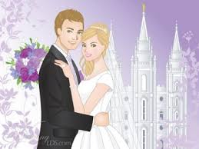

Slide 7
In the temple we receive the highest ordinance available to men and women, the sealing of husbands and wives together for eternity

Slide 8
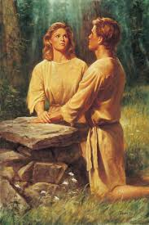
Adam & Eve
The first marriage was performed by the Lord. It was an eternal marriage because there was no such thing as time when that ceremony took place. The ceremony was performed for a couple not then subject to death; thus, under the circumstances the relationship would never be terminated.

Slide 9
When deciding whom to marry, be patient, have faith, and stay worthy of receiving divine assistance.
I think the greatest decision you must make … is the decision that’s going to shape your life for eternity, and that is your marriage. I’m sure that you would agree with me that this is going to be far more important than anything else you do in life, because your work and your profession or whatever you’re going to do is not nearly as important as eternal values. …

Slide 10
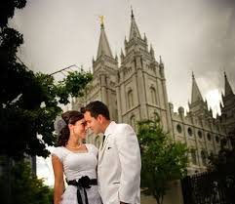

Slide 11
Do not … rush into a relationship without proper forethought and inspiration. Prayerfully seek the Lord’s guidance on this matter. Stay worthy of receiving that divine assistance.
Many of you … worry about courtship, marriage, and starting a family. You probably will not find the name of your future spouse in Nephi’s vision or the book of Revelation; you probably will not be told it by an angel or even by your bishop. Some things you must work out for yourself. Have faith and be obedient, and blessings will come.
“While waiting for promised blessings, … be anxiously engaged in good causes, including your own development.”

Slide 12
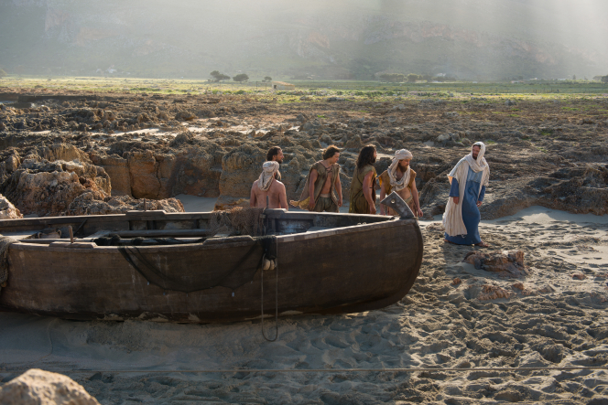
No blessing will be denied to worthy individuals who are not married.
This is the church of Jesus Christ, not the church of marrieds or singles or any other group or individual. The gospel we preach is the gospel of Jesus Christ, which encompasses all the saving ordinances and covenants necessary to save and exalt every individual who is willing to accept Christ and keep the commandments that he and our Father in Heaven have given.

Slide 13
To you who are unmarried men, women and divorces:
Men: Don’t put off marriage because you are not in a perfect career and financial position. … Remember that as a priesthood bearer you have the obligation to take the lead in seeking eternal companionship.
Women: To you unmarried women: The promises of the prophets of God have always been that the Lord is mindful of you; if you are faithful, all blessings will be yours.
To you who have experienced divorce: Don’t let disappointment or a sense of failure color your perception of marriage or of life. Do not lose faith in marriage or allow bitterness to canker your soul and destroy you or those you love or have loved.

Slide 14
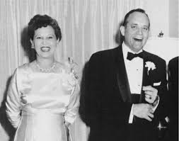
Successful marriage requires our best efforts to live the principles of the gospel.
Prior to marriage we looked at life from our own point of view, but after stepping over that threshold, we began to consider it from another’s viewpoint also. There is a necessity to make sacrifices and adjustments as manifestations of reassurance and love.

Slide 15
Husbands and wives should work together to strengthen the bonds of marriage.
Charity … The Bible tells us: “Charity suffereth long, and is kind” (see 1 Corinthians 13:4). That kind of love, the kind that is not taken lightly, not terminated at pleasure and thrown away like disposable plastic, but which faces all of life’s little difficulties hand in hand entwining the souls, is the ultimate expression of human happiness.

Slide 16
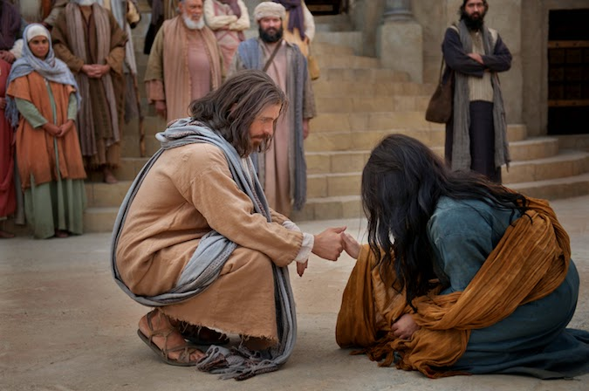

Slide 17
Oneness of heart
Surely the happiest marriages are those where your hurt is my hurt, my pain is your pain, my victory, your victory, my concerns, your concerns. The oneness of heart, of soul, of flesh seems to be more of a challenge than ever before in the world in which the question seems to be: “What is there in this for me?”

Slide 18
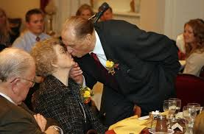
Fidelity in thought, word, and deed
“The words none else eliminate everyone and everything. The spouse then becomes pre-eminent in the life of the husband or wife and neither social life nor occupational life nor political life nor any other interest nor person nor thing shall ever take precedence over the companion spouse”

Slide 19
